Slide 1

CHAPTER FOUR
PART I

Slide 2
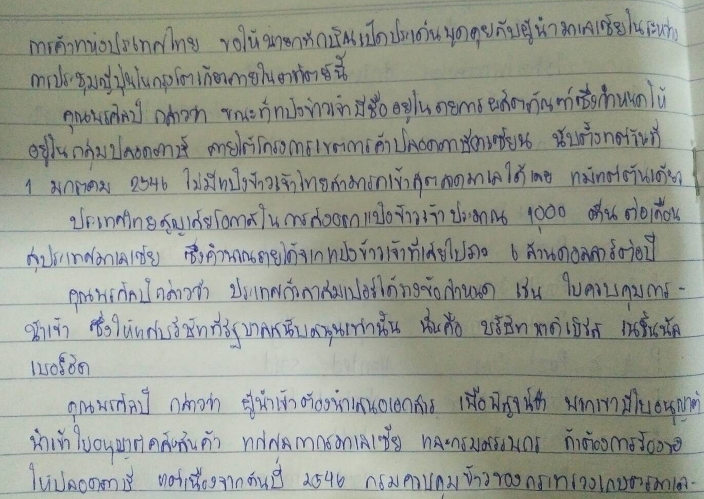

Slide 3
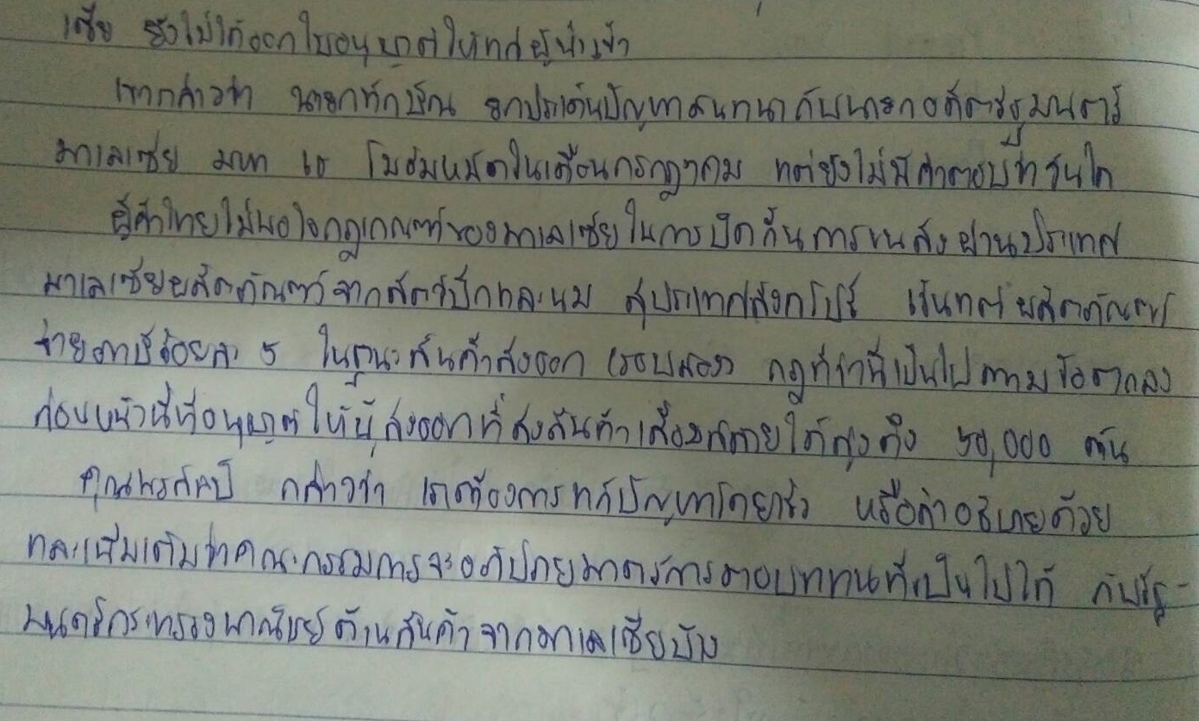

Slide 4
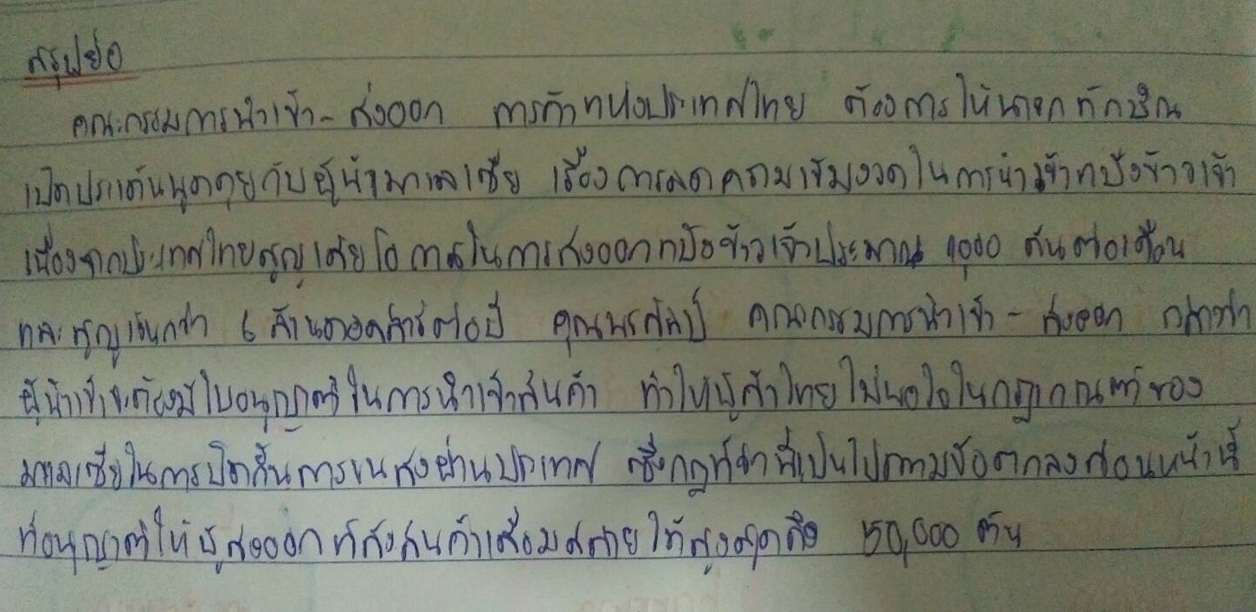
Summary

Slide 5
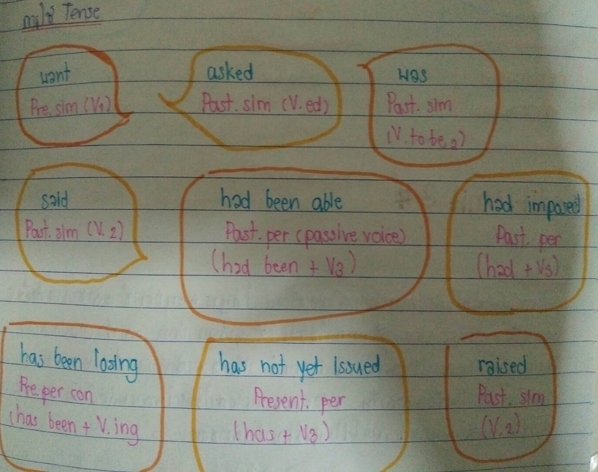
Tenses

Slide 6
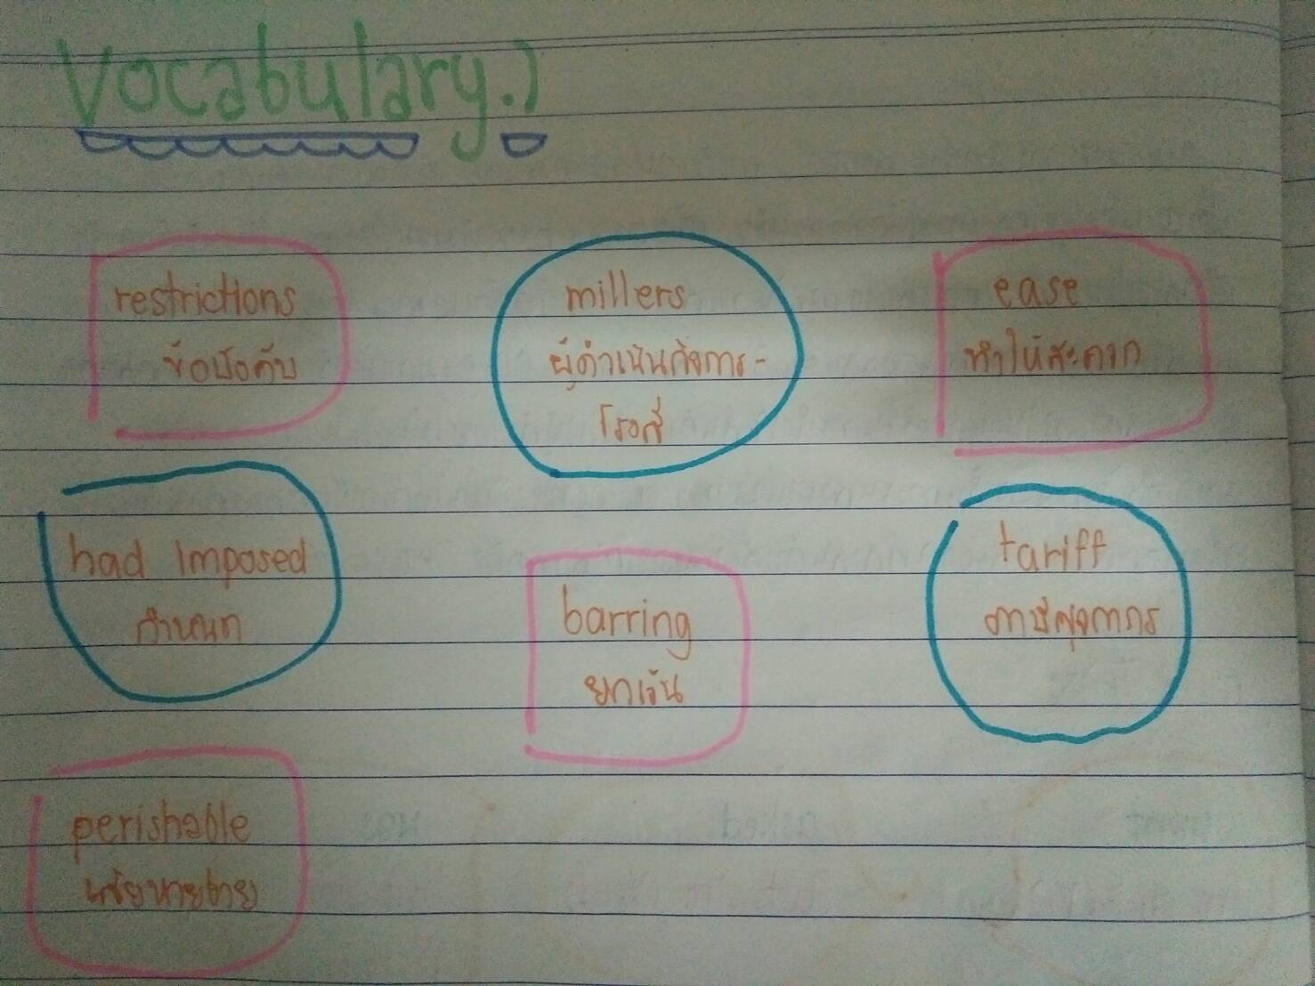
Vocabulary

Slide 7

Thank you
for
watching

