Slide 1
Chapter 3 “Petroleum” EGAT says PTT supply monopoly should end lower costs would help competitiveness

Slide 2
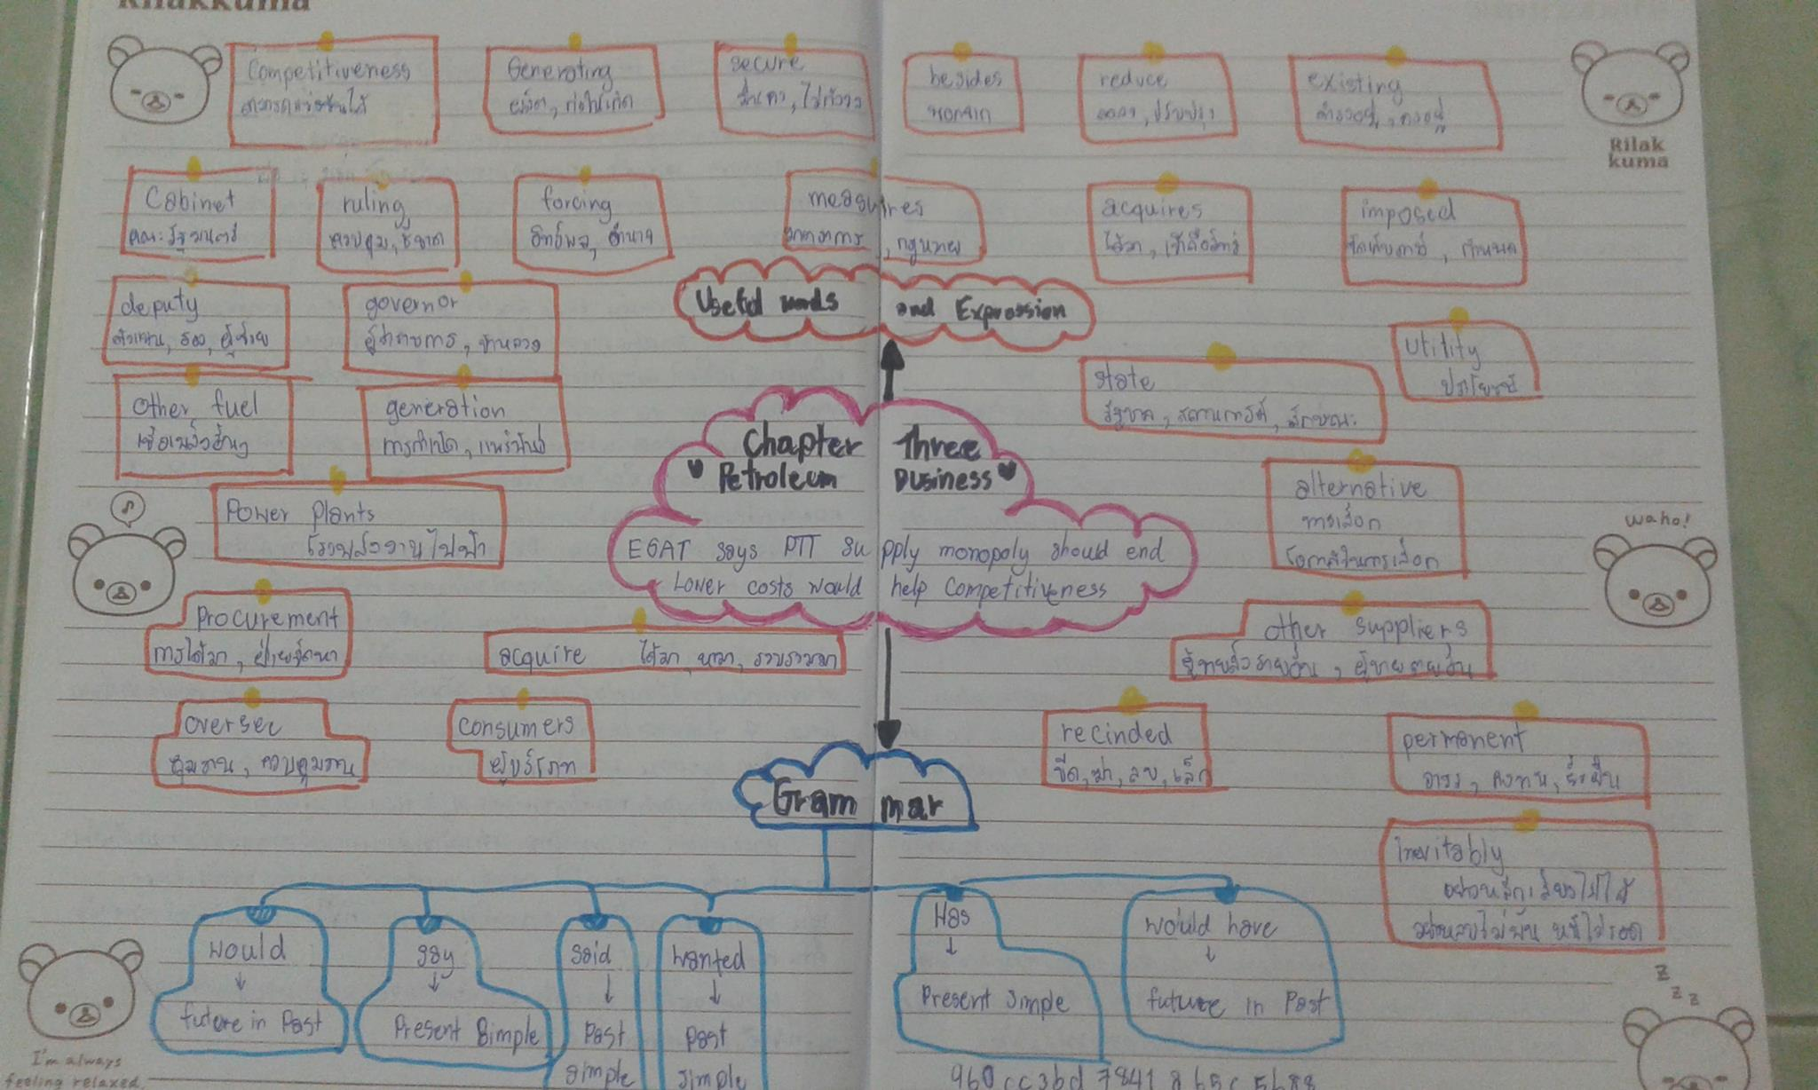

Slide 3
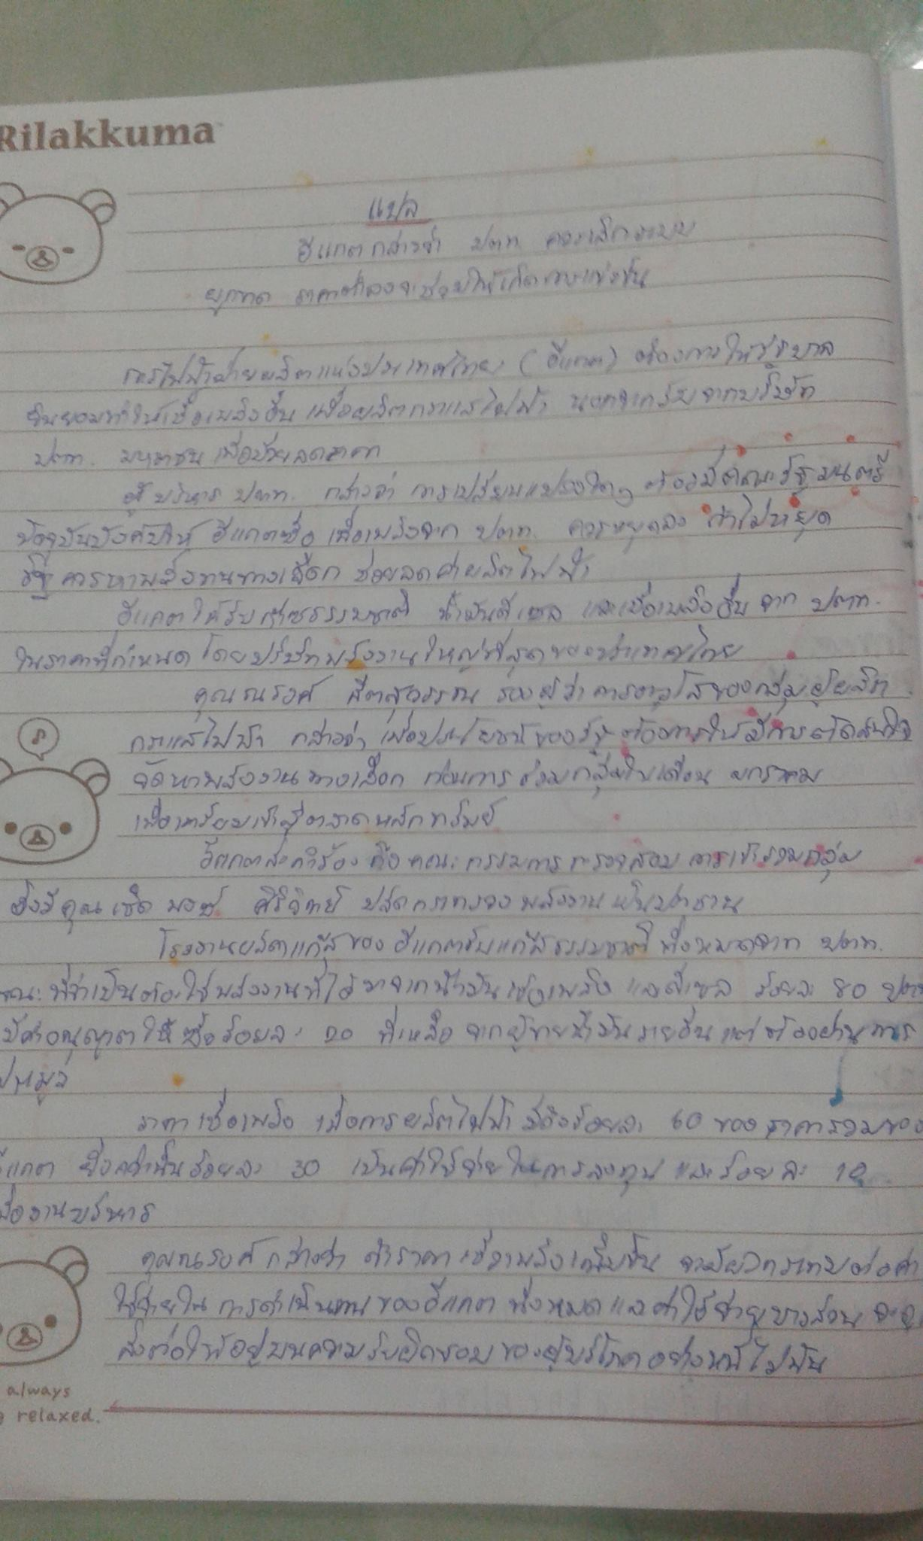

Slide 4
Chapter 4 “Export-import” Millers cry foul over restrictions PM urged to hold talks with Malaysia

Slide 5
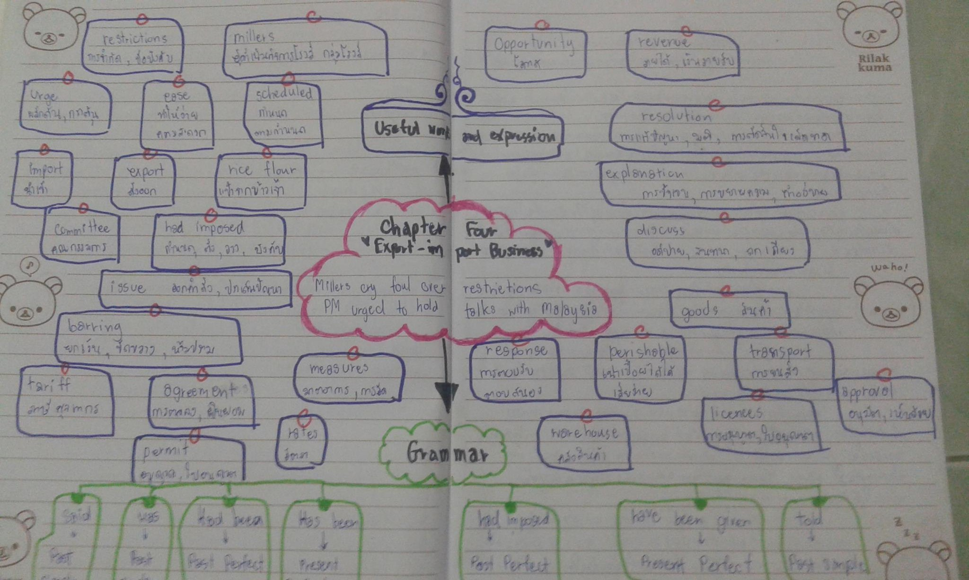

Slide 6
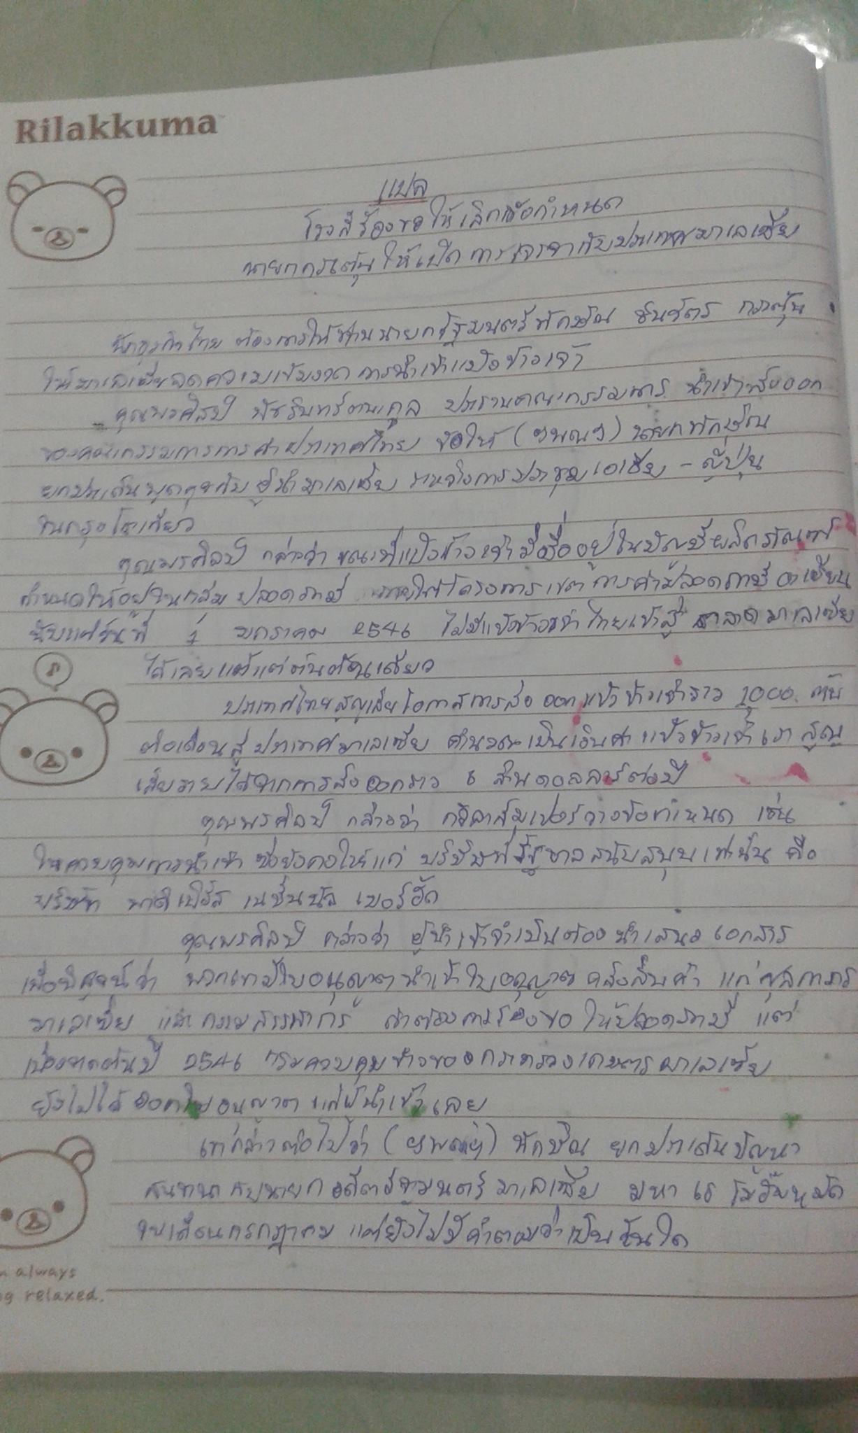

Slide 7
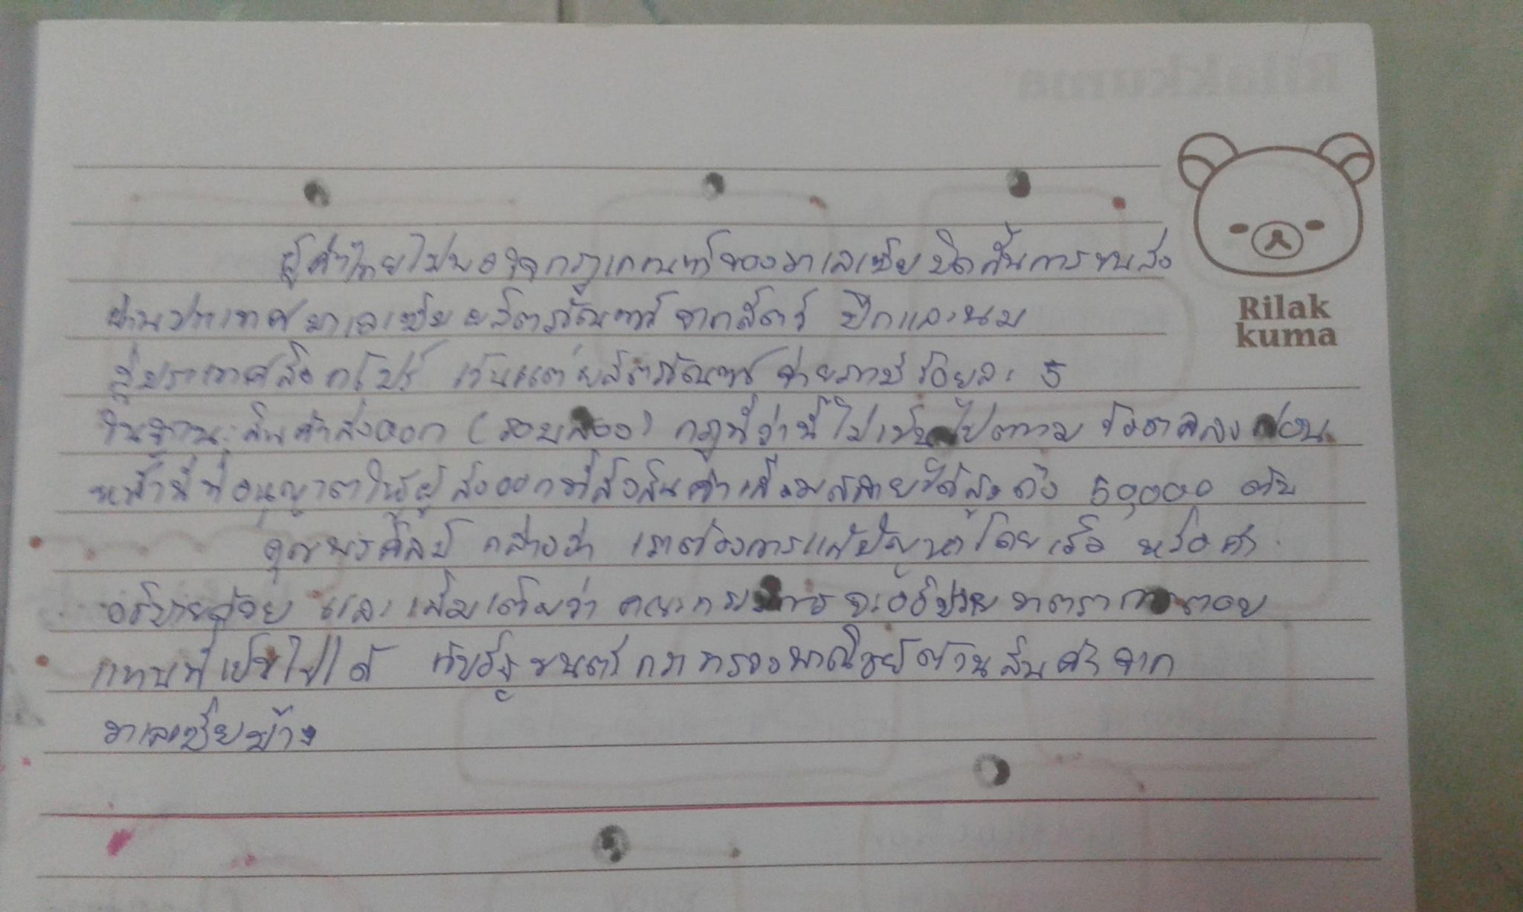

Slide 8
Chapter 4 “Export-import” Shortage of cranes threatens projects

Slide 9
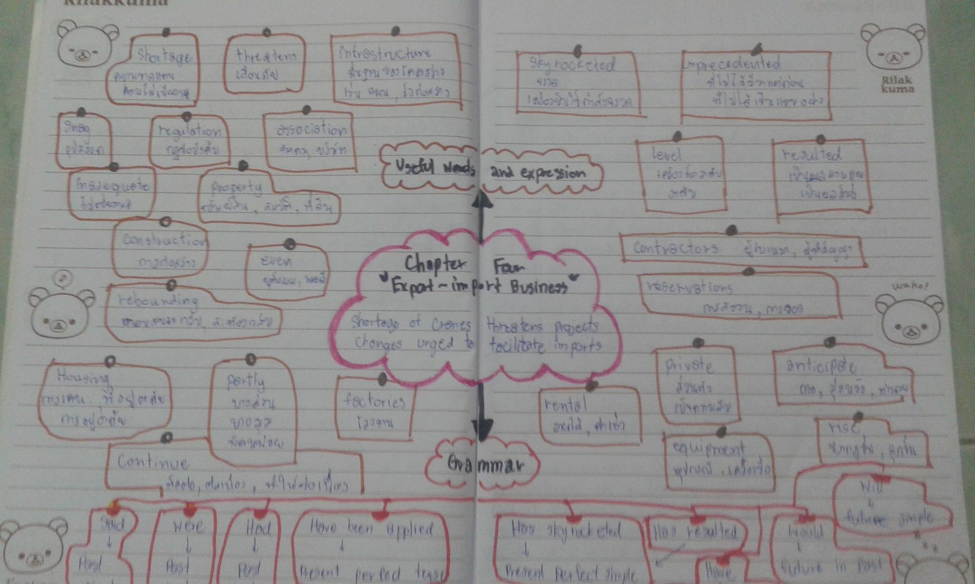

Slide 10
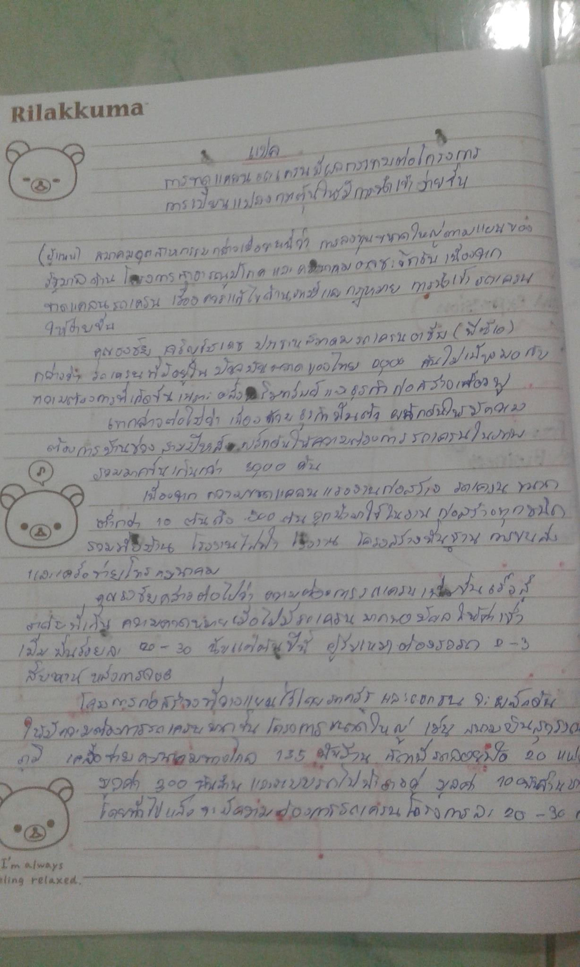

Slide 11
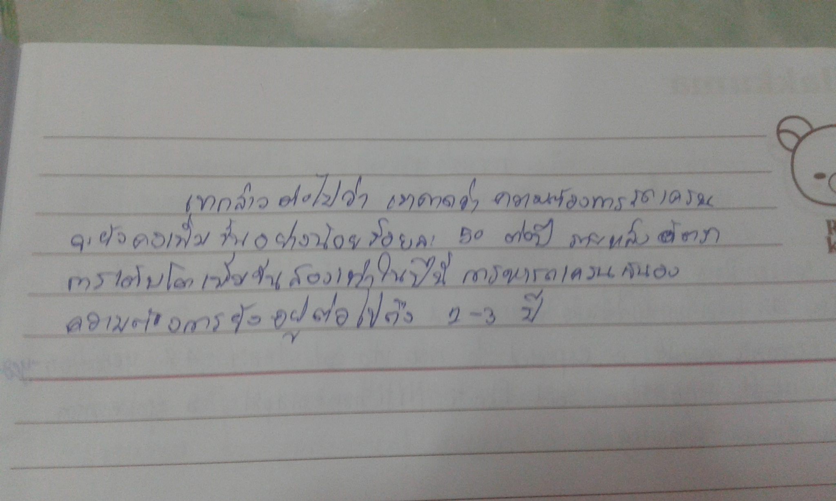

Slide 12
Chapter 5 “ Investment” Automobiles:Toyota and Thai Rung discuss link

Slide 13
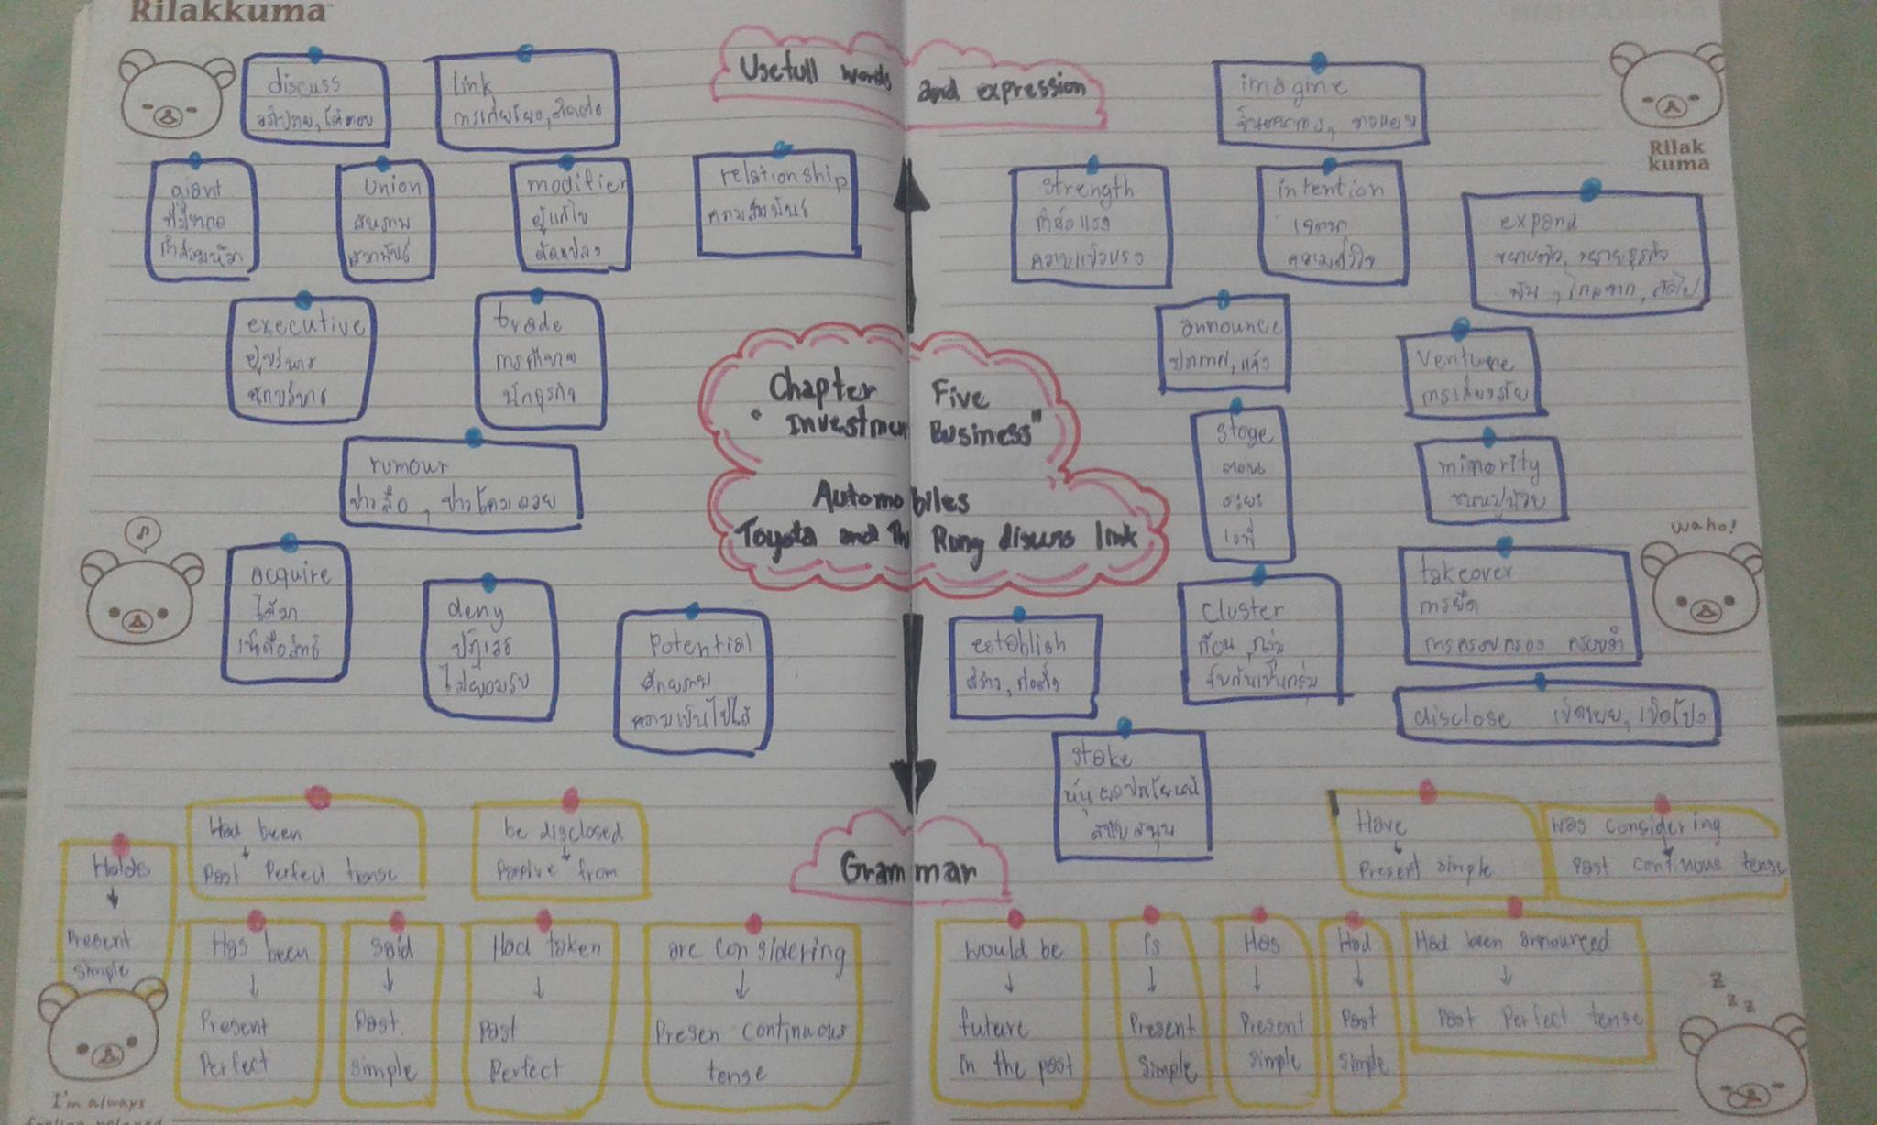

Slide 14
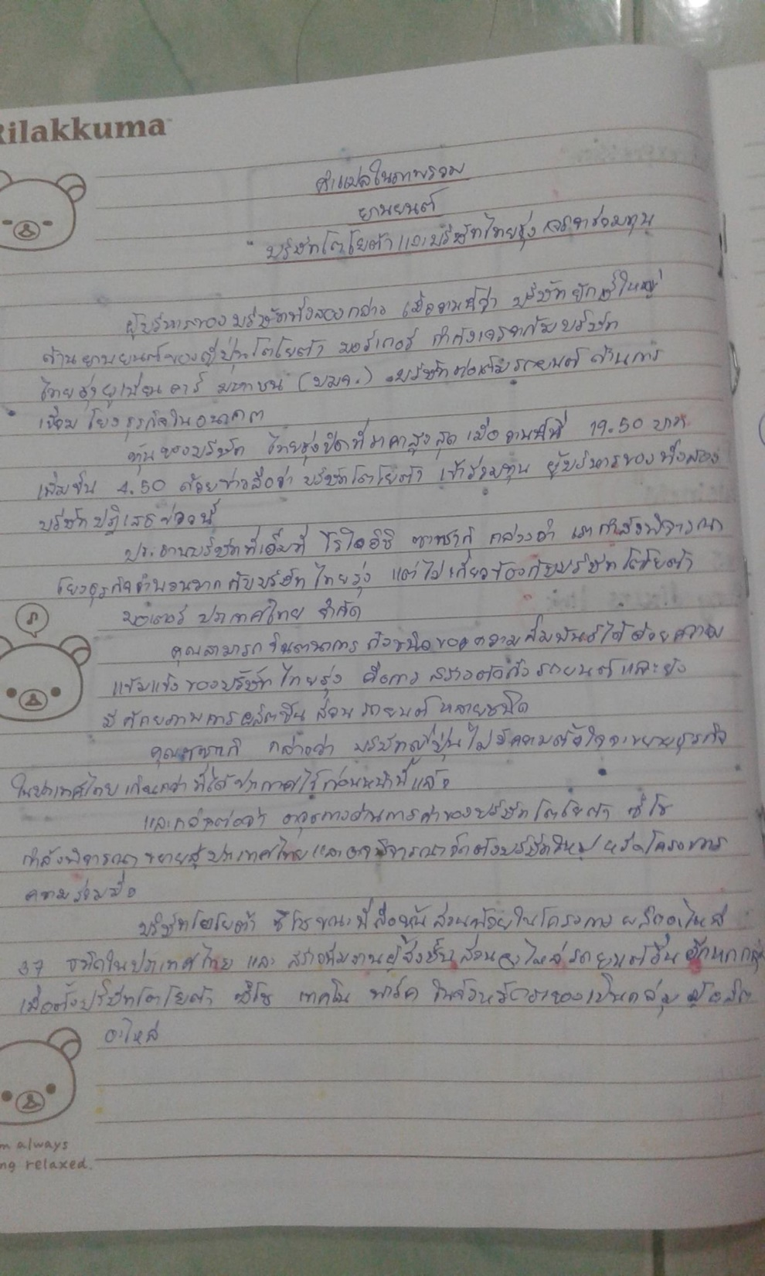

Slide 15
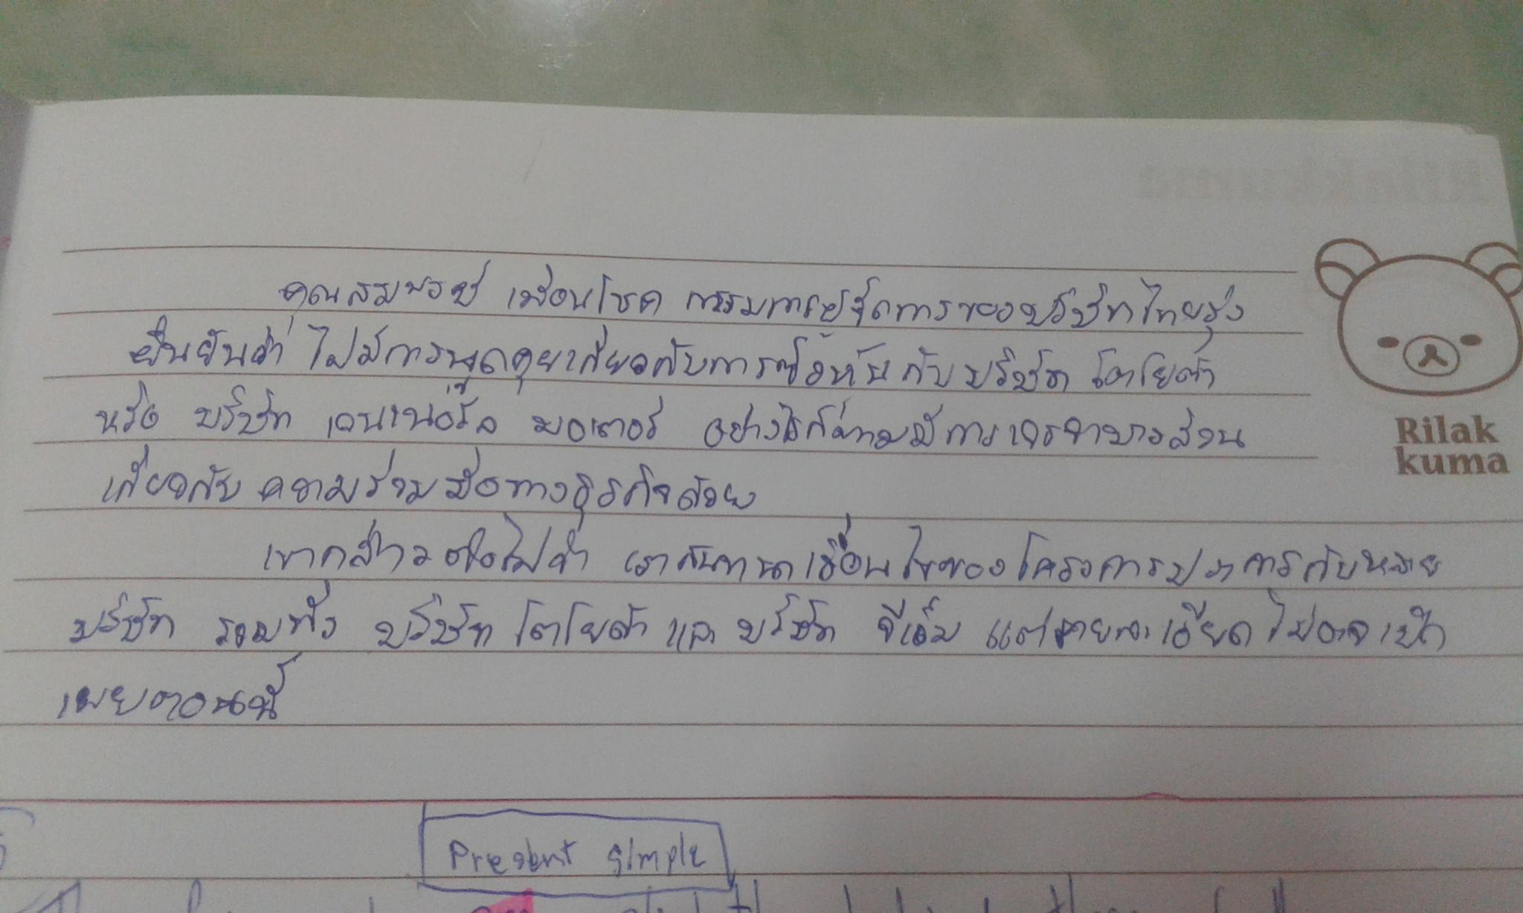

Slide 16
Chapter 7 “Trading” Diamond Plaza Hotel

Slide 17
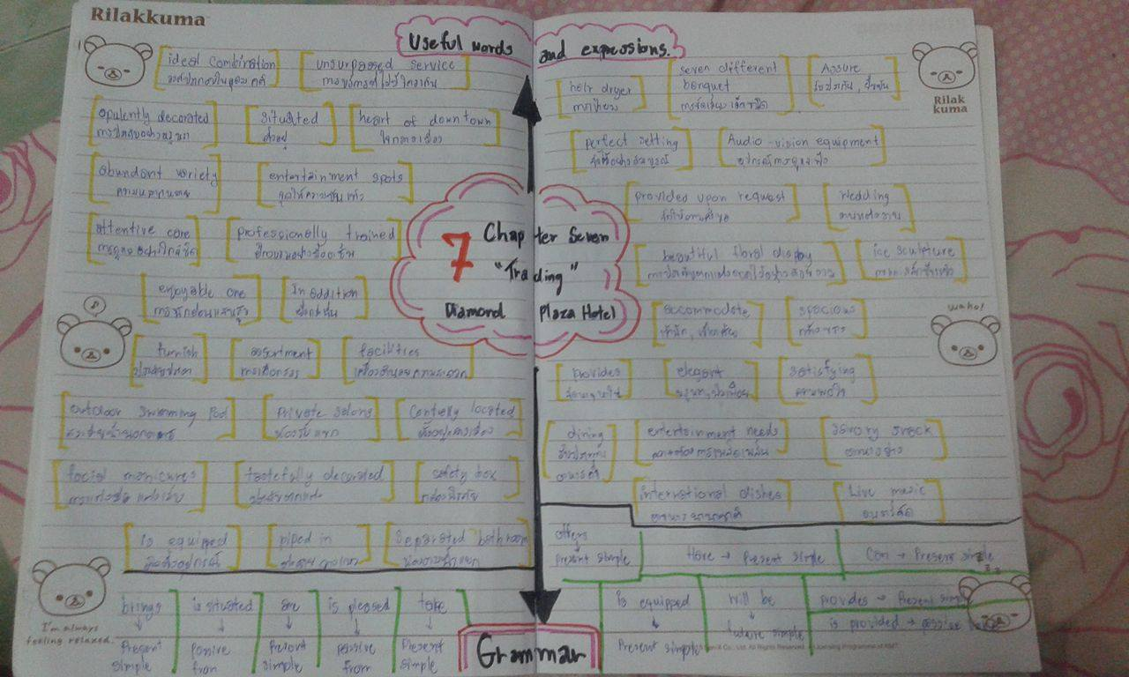

Slide 18
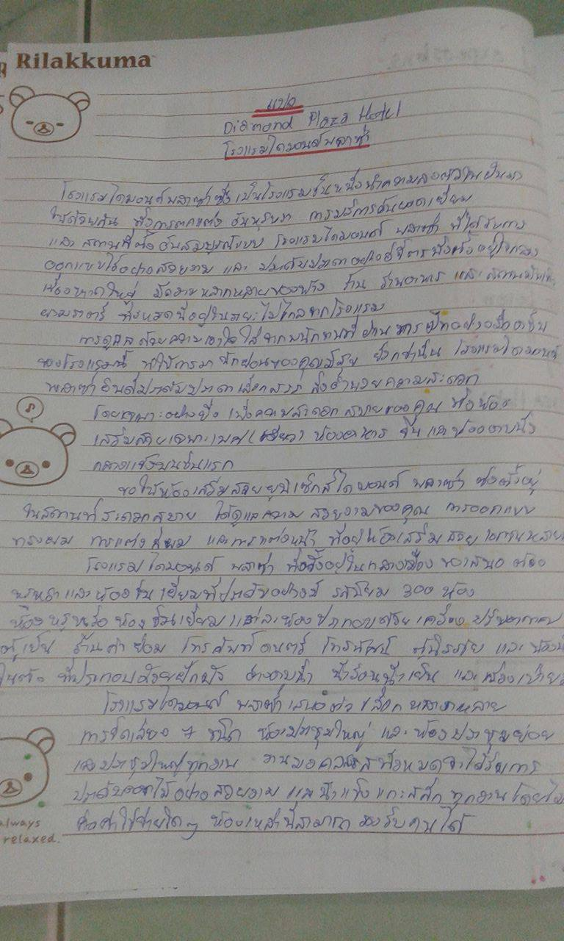

Slide 19
