Slide 1


Mrs. Piyanart Singchoo
Personal business.
Surat Thani, Thailand.
The Strategies Development for Enhancing the Corporate Social Responsibility in Motorcycle Business
Ph.D. : Innovation Management for Development

Slide 2


(Business cannot succeed in a society that fails)
Bjorn Stigson
(WBCSD)

Slide 3

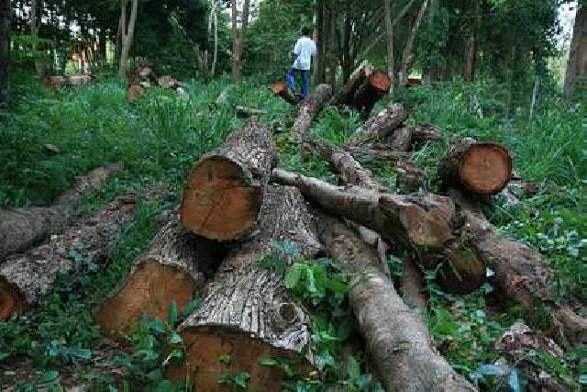



The Importance and Background of the Problems
Ph.D. : Innovation Management for Development

Slide 4
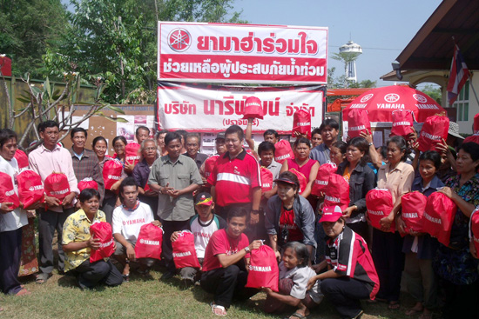
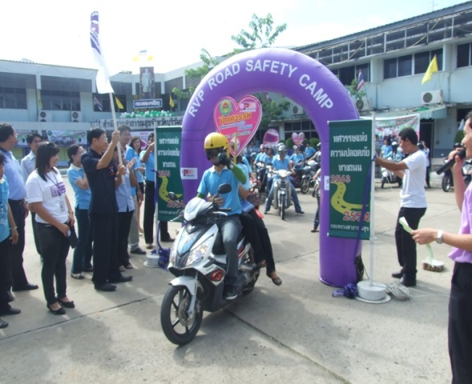

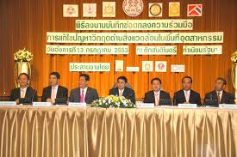
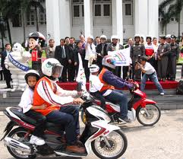
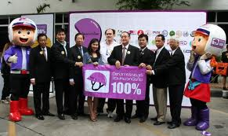
The Importance and Background of the Problems

Slide 5

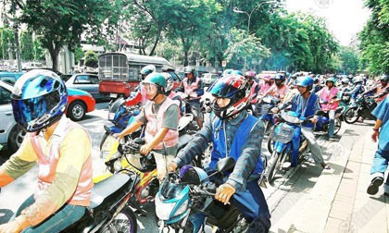
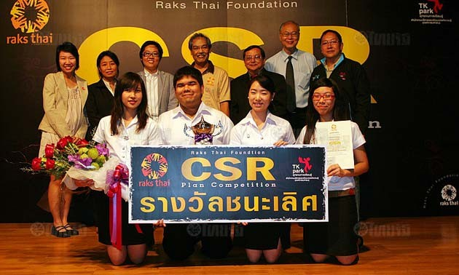

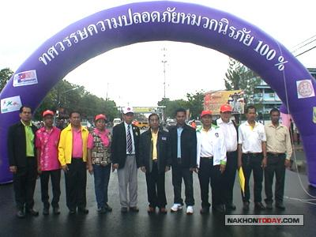
The Importance and Background of the Problems

Slide 6
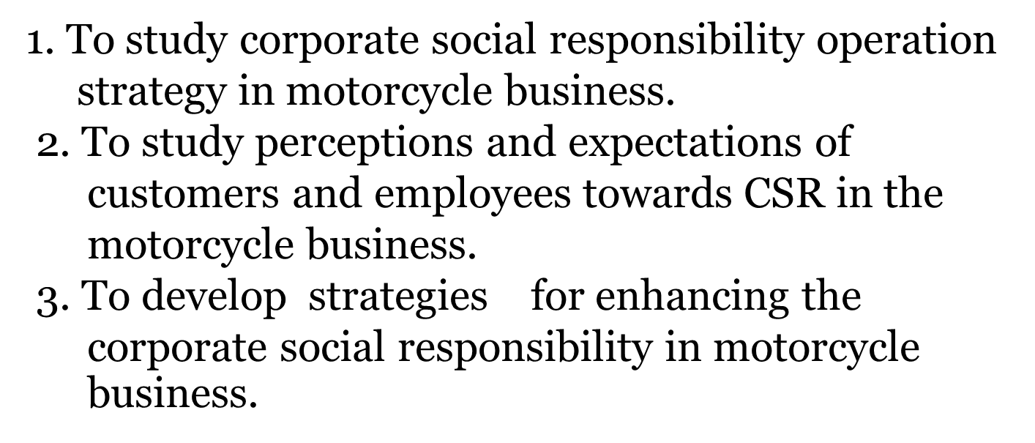
The objective of the research
Ph.D. : Innovation Management for Development

Slide 7
The benefits of the research
1.Findings of this research can be used for planning marketing strategies and for the study of consumer behaviors.
2.Could be a prototype implementation of social responsibility that other businesses can adapt to suit the society and the development of businesses organizations.
Ph.D. : Innovation Management for Development

Slide 8
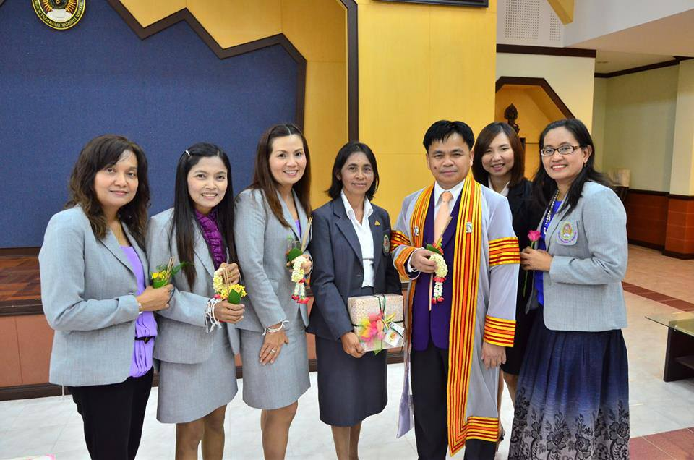

Research Methodology
Instruments used in the research.
* Interview
* Questionnaires.
* Assessment.
*Research & Development
*Mixed Methodology
Ph.D. : Innovation Management for Development

Slide 9
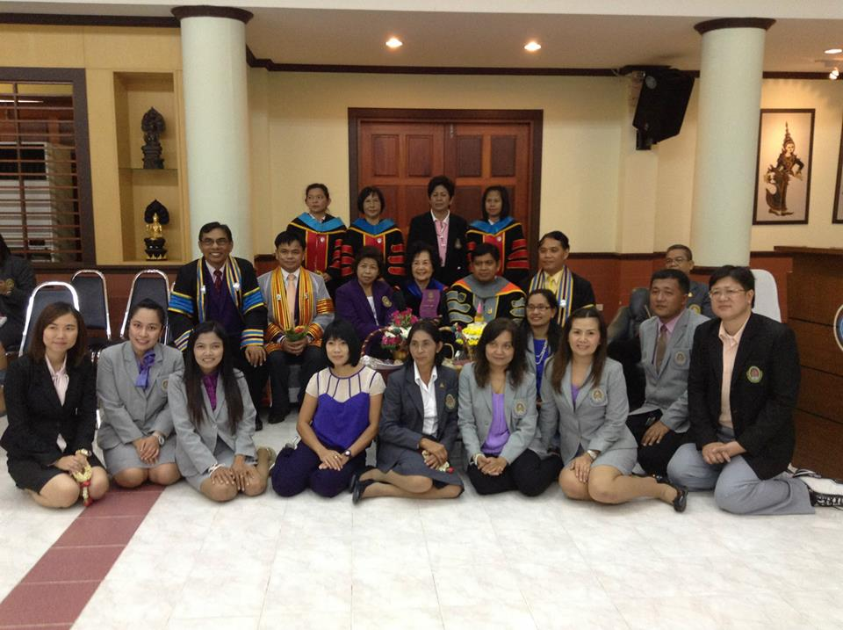

Thank you everybody.
Ph.D. : Innovation Management for Development

