Slide 1
Exponents.
Panatda noennil
Photakphittayakhom School

Slide 2
Topic
1. Exponents
2. Scientific Notation(If the original number is greater than 1)
3. Scientific Notation(If the original number is less than 1)
4. Exponent and Addition
5. Exponent and Subtraction
6. Exponent and Multipication
7. Exponent and Division
8. Zero and Negative Exponents.
9. Properties of exponents.
10. Order of Operations With Exponents.
11. Word Problem.

Slide 3
Learning Objective
1. Understand the terms, exponent, base and ordinary notation
2. Addition and subtraction using exponent.
3. Multiplication and division using exponents.
4. Simplifying expression in scientific notation.
5. Solve word problems.

Slide 4
Key words
a. Addition การบวก
b. Subtraction การลบ
c. Convert ผกผัน
d. Sum ผลรวม
e. Division การหาร
f. Multiplication การคูณ
g. Difference ผลต่าง
h. Base ฐาน
i. Ordinary notation สัญกรณ์สามัญ
j. Standard form รูปแบบมาตรฐาน
k. Decimal ทศนิยม
l. Scientific notation สัญกรณ์วิทยาศาสตร์

Slide 5

Exponents
You can use exponents to show repeated multiplication.
exponent
base $2^{6}$ = 2 ⋅ 2 ⋅ 2 ⋅ 2 ⋅ 2 ⋅ 2 = 64 the value of
power The base 2 is used the expression
as a factor 6 times.
A power has two parts, a base and an exponent. The expression $2^{6}$ is read as “ two to the sixth power.” Depending on the situation, you may decide to communicate an idea using ether a power or the value of the power.

Slide 6
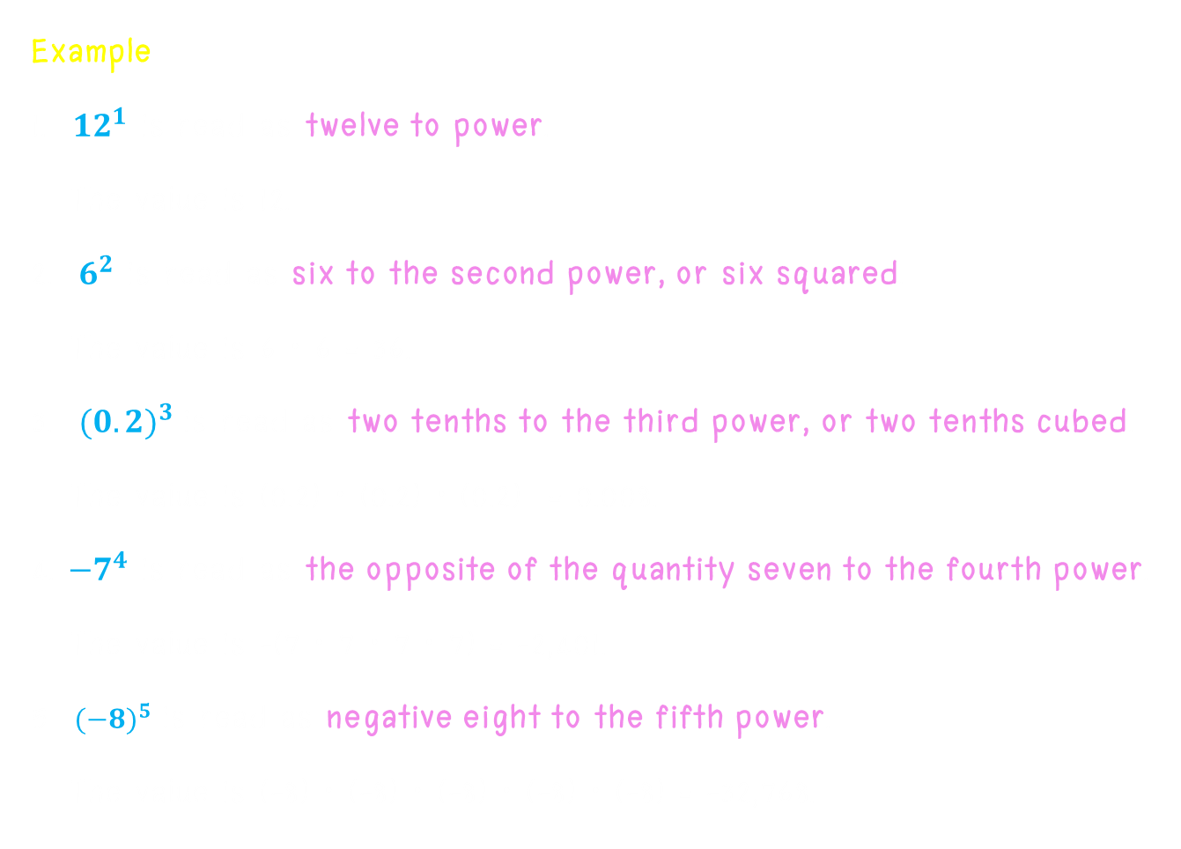
Exponents
Example
1. ${12}^{1}$ is read as twelve to power.
The value is 12.
2. $6^{2}$ is read as six to the second power, or six squared.
The value is 6 ⋅ 6 = 36.
3. ${(0.2)}^{3}$ is read as two tenths to the third power, or two tenths cubed.
The value is (0.2) ⋅ (0.2) ⋅ (0.2) = 0.008.
4. ${−7}^{4}$ is read as the opposite of the quantity seven to the fourth power.
The value is –(7 ⋅ 7 ⋅ 7 ⋅ 7) = -2,401.
5 ${(−8)}^{5}$ is read as negative eight to the fifth power.
The value is (-8) ⋅ (-8) ⋅ (-8) ⋅ (-8) ⋅ (-8) = -32,768.

Slide 7

Exponents
Example Using an Exponent
Write the expression using an exponent.
1. (-5)(-5)(-5)
= ${(−5)}^{3}$ Include the negative sign within parentheses.
2. -2 ⋅ a ⋅ b ⋅ a ⋅ a
= -2 ⋅ a ⋅ a ⋅ a ⋅ b commutative and associative properties
= -2$a^{3}$b Write a ⋅ a ⋅ a using exponents.

Slide 8

Exponents
Example Simplifying a Power
A microscope can magnify a specimen ${10}^{3}$ times. How many time is that?
${10}^{3}$ = 10 ⋅ 10 ⋅ 10 The exponent indicates that the base 10 is used
as a factor 3 times.
= 1,000 Multiply.
The microscope can magnify the specimen 1,000 times.
Example Simplify $7^{2}$
${ 7}^{2}$ = 7 ⋅ 7 The exponent indicates that the base 7 is used
as a factor 2 times.
= 49 Multiply.

Slide 9

Exponents
Example Simplifying a Power
a. ${−2}^{4}$ = -(2 ⋅ 2 ⋅ 2 ⋅ 2)
= -16
b. ${(−2)}^{4}$= (-2) ⋅ (-2) ⋅ (-2) ⋅ (-2)
= 16
The expressions ${−2}^{4}$ and ${(−2)}^{4}$ are not equivalent. The expression ${−2}^{4}$ means the opposite, or the negative, of $2^{4}$. The base of ${−2}^{4}$ is 2, not -2

Slide 10
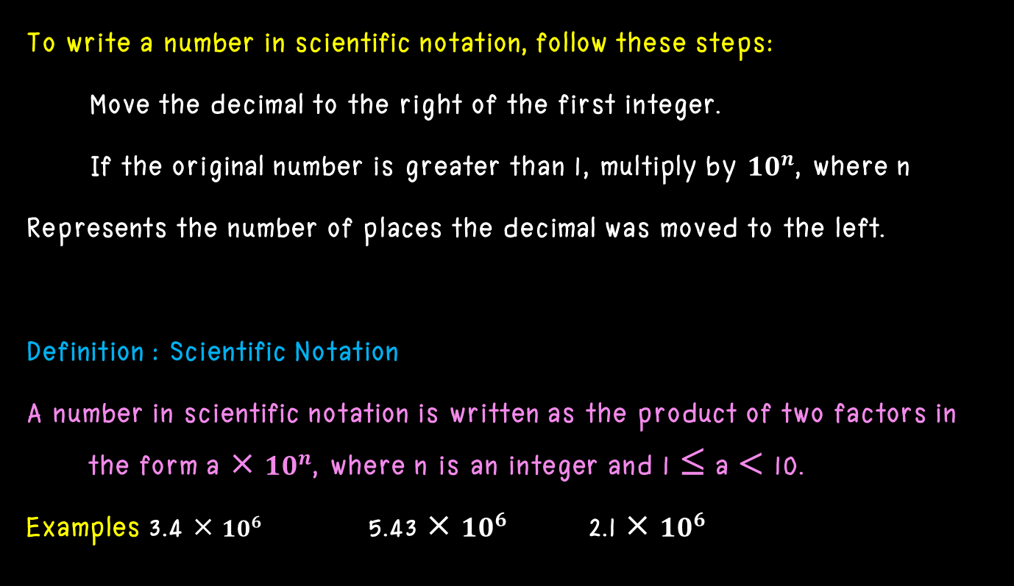
Scientific Notation If the original number is greater than 1
To write a number in scientific notation, follow these steps:
Move the decimal to the right of the first integer.
If the original number is greater than 1, multiply by ${10}^{n}$, where n
Represents the number of places the decimal was moved to the left.
Definition : Scientific Notation
A number in scientific notation is written as the product of two factors in the form a × ${10}^{n}$, where n is an integer and 1 ≤ a < 10.
Examples 3.4 × ${10}^{6}$ 5.43 × ${10}^{6}$ 2.1 × ${10}^{6}$

Slide 11
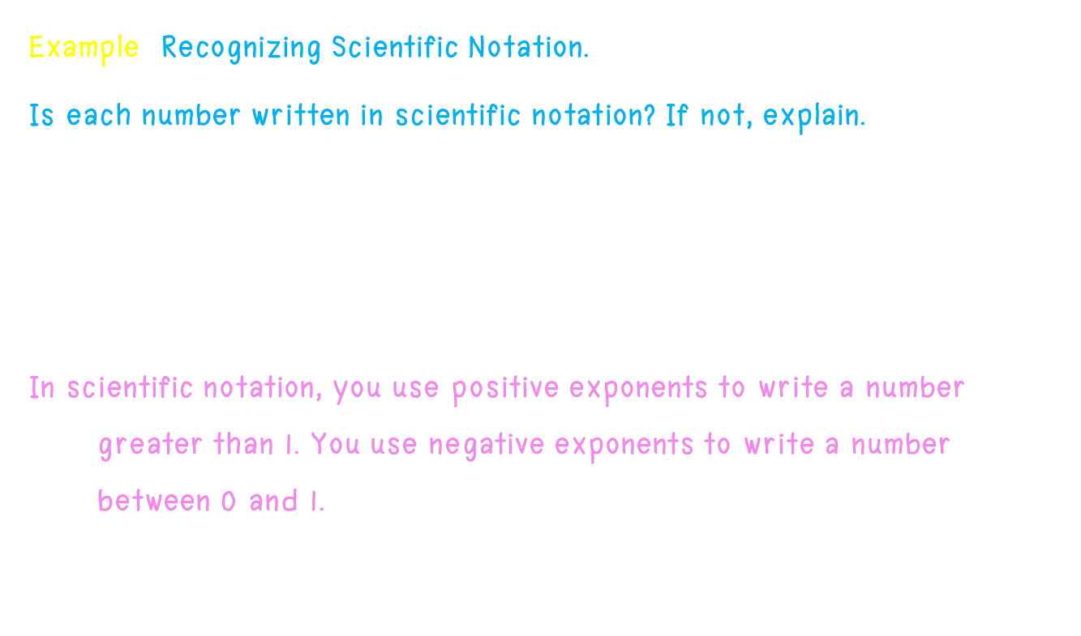
Scientific Notation If the original number is greater than 1
Example Recognizing Scientific Notation.
Is each number written in scientific notation? If not, explain.
a. 56.29 × ${10}^{12}$ No; 56.29 is greater than 10.
b. 0.84 × ${10}^{−3}$ No; 0.84 is less than 1.
c. 6.11 × ${10}^{5}$ yes
In scientific notation, you use positive exponents to write a number greater than 1. You use negative exponents to write a number between 0 and 1.

Slide 12
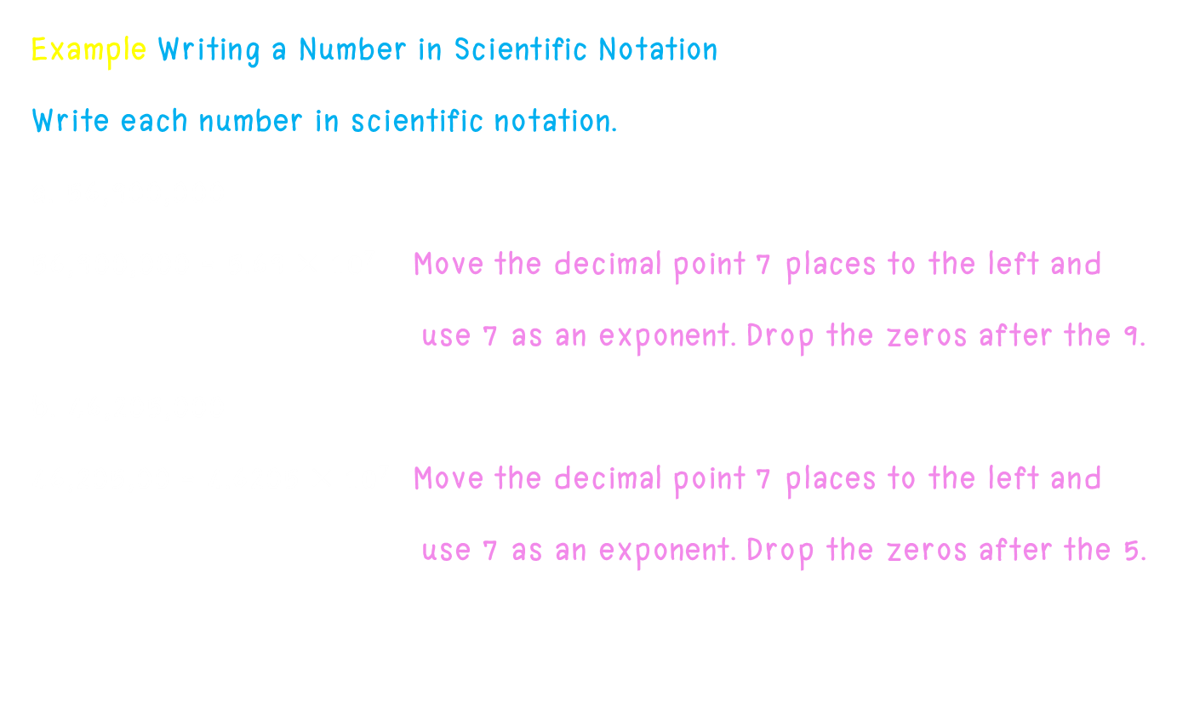
Scientific Notation If the original number is greater than 1
Example Writing a Number in Scientific Notation
Write each number in scientific notation.
a. 56,900,000
56,900,000 = 5.69 × ${10}^{7}$ Move the decimal point 7 places to the left and
use 7 as an exponent. Drop the zeros after the 9.
b. 46,205,000
46,205,00 = 4.6205 × ${10}^{7}$ Move the decimal point 7 places to the left and
use 7 as an exponent. Drop the zeros after the 5.

Slide 13
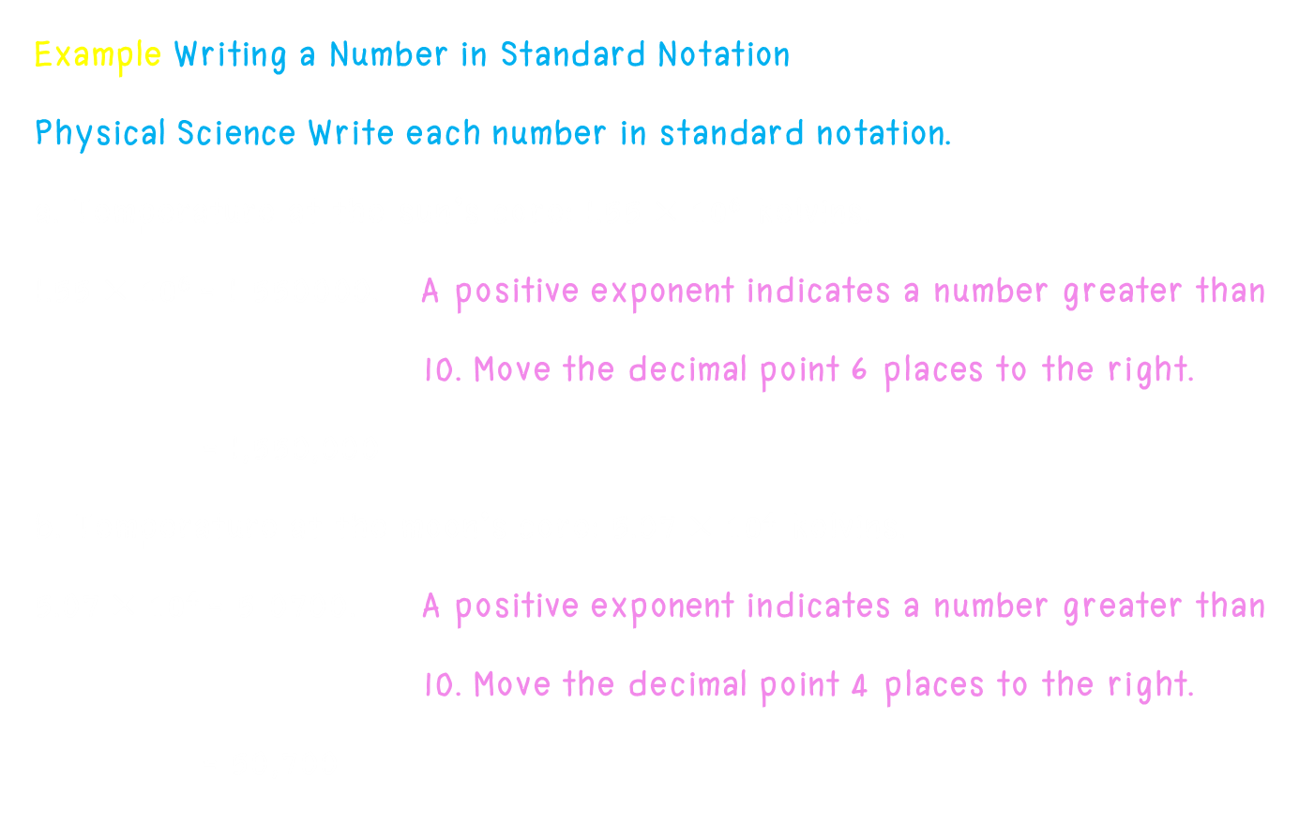
Scientific Notation If the original number is greater than 1
Example Writing a Number in Standard Notation
Physical Science Write each number in standard notation.
a. Temperature at the sun’s core: 1.55 × ${10}^{6}$ kelvins.
1.55 × ${10}^{6}$= 1 550000. A positive exponent indicates a number greater than
10. Move the decimal point 6 places to the right.
= 1,550,000
b. Temperature at the moon’s core: 5.07 × ${10}^{4}$ kelvins.
5.07 × ${10}^{4}$= 5 0700. A positive exponent indicates a number greater than
10. Move the decimal point 4 places to the right.
= 50,700

Slide 14
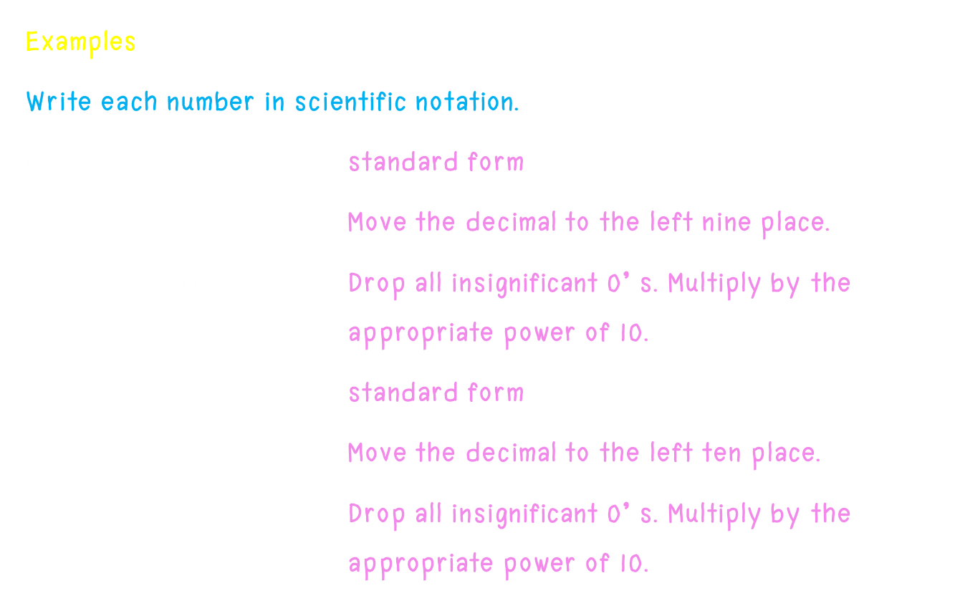
Scientific Notation If the original number is greater than 1
Examples
Write each number in scientific notation.
1. 9,040,000,000 standard form
9.040 000 000. Move the decimal to the left nine place.
9.04 × ${10}^{9}$ Drop all insignificant 0’ s. Multiply by the appropriate power of 10.
2. 14,070,000,000 standard form
1.4070 000 000. Move the decimal to the left ten place.
1.407 × ${10}^{10}$ Drop all insignificant 0’ s. Multiply by the appropriate power of 10.

Slide 15
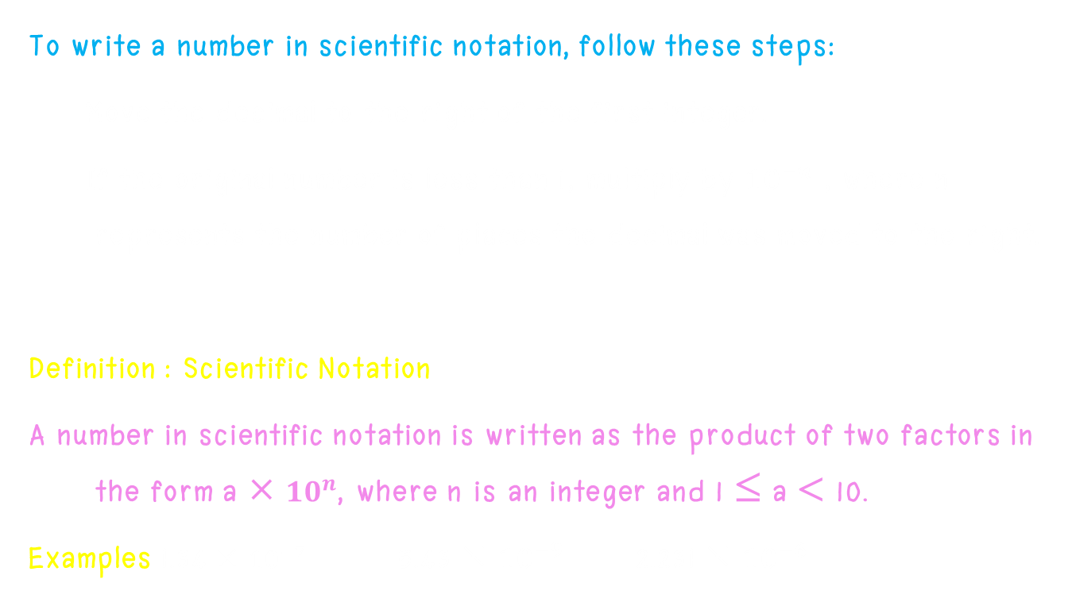
Scientific Notation If the original number is less than 1
To write a number in scientific notation, follow these steps:
Move the decimal to the right of the first integer.
If the original number is less than 1, multiply by ${10}^{−n}$ , where n represents the number of places the decimal was moved to the right.
Definition : Scientific Notation
A number in scientific notation is written as the product of two factors in the form a × ${10}^{n}$, where n is an integer and 1 ≤ a < 10.
Examples 1.34 × ${10}^{−7}$ 5.43 × ${10}^{−9}$ 2.231 × ${10}^{−6}$

Slide 16

Scientific Notation If the original number is less than 1
Example Recognizing Scientific Notation.
Is each number written in scientific notation? If not, explain.
a. 27.29 × ${10}^{−12}$ No;56.29 is greater than 10.
b. 0.842 × ${10}^{−3}$ No; 0.84 is less than 1.
c. 6.25 × ${10}^{−5}$ yes
In scientific notation, you use positive exponents to write a number greater than 1. You use negative exponents to write a number between 0 and 1.

Slide 17
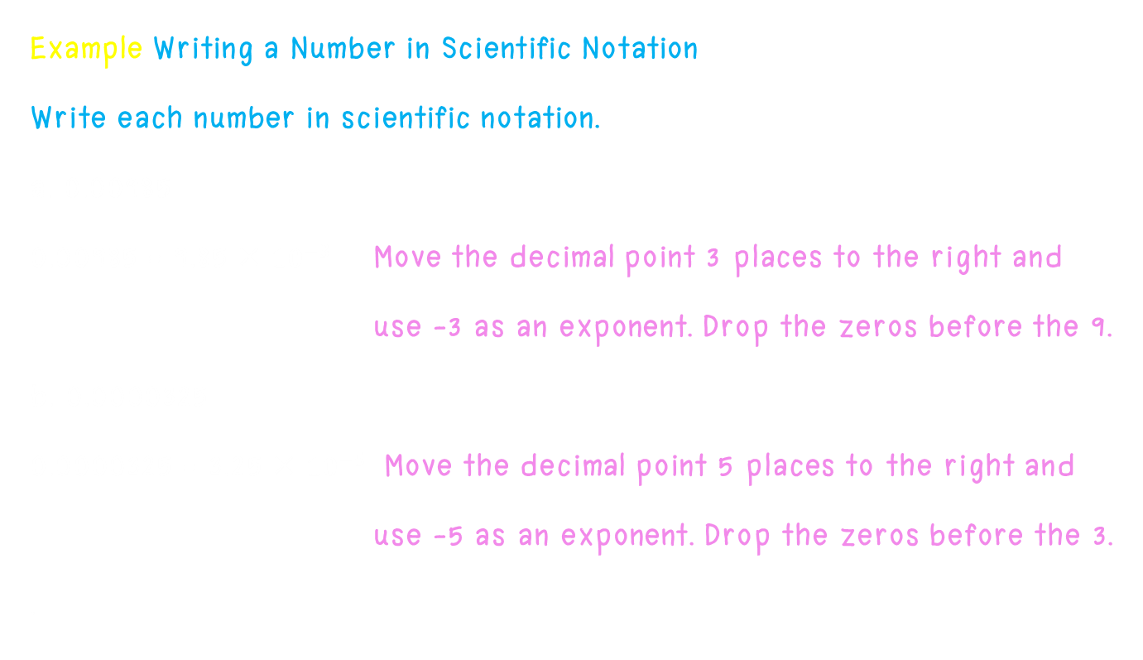
Scientific Notation If the original number is less than 1
Example Writing a Number in Scientific Notation
Write each number in scientific notation.
a. 0.00985
0.00985 = 9.85 × ${10}^{−3}$ Move the decimal point 3 places to the right and
use -3 as an exponent. Drop the zeros before the 9.
b. 0.0000325
0.0000325 = 3.25 × ${10}^{−5}$ Move the decimal point 5 places to the right and
use -5 as an exponent. Drop the zeros before the 3.
.

Slide 18
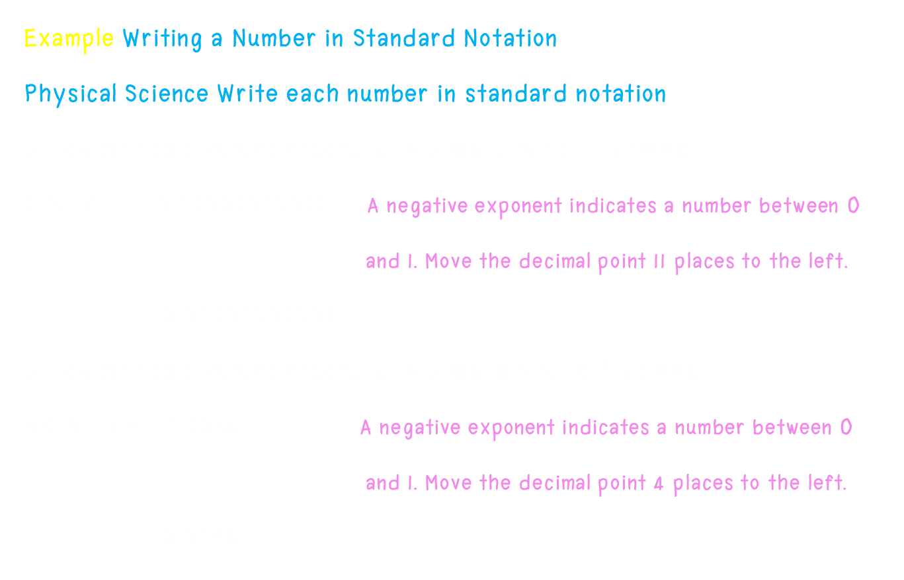
Scientific Notation If the original number is less than 1
Example Writing a Number in Standard Notation
Physical Science Write each number in standard notation.
a. Lowest temperature recorded in a lab: 2 × ${10}^{−11}$ kelvins.
2 × ${10}^{−11}$= 0.00000000002 A negative exponent indicates a number between 0
and 1. Move the decimal point 11 places to the left.
= 0.00000000002
a. Lowest temperature recorded in a lab: 5.6 × ${10}^{−4}$ kelvins.
5.6 × ${10}^{−4}$= 0.0056 A negative exponent indicates a number between 0
and 1. Move the decimal point 4 places to the left.
= 0.0056

Slide 19
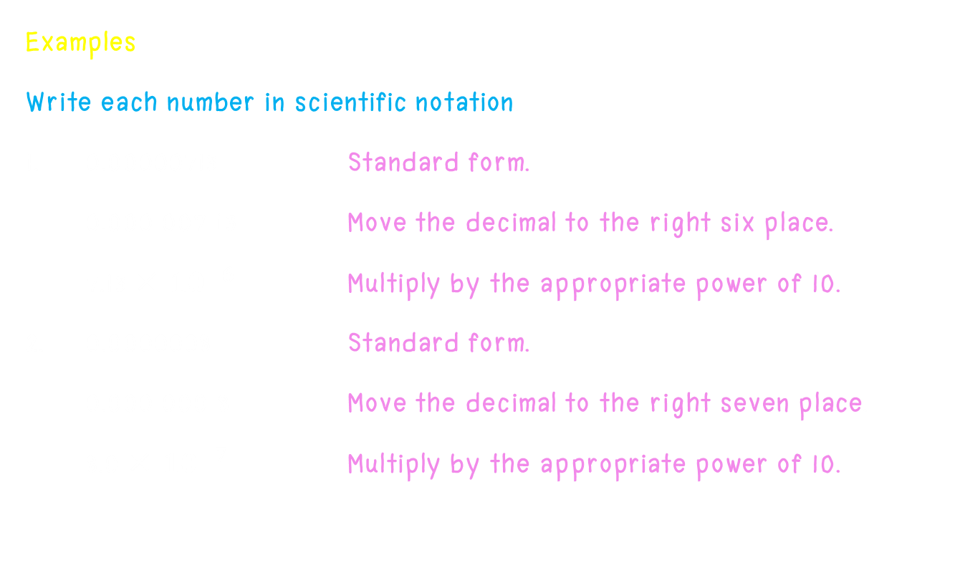
Scientific Notation (If the original number is less than 1)
Examples
Write each number in scientific notation.
1. 0.00000713 Standard form.
0.000 007 13 Move the decimal to the right six place.
7.13 × ${10}^{−6}$ Multiply by the appropriate power of 10.
2. 0.0000008 Standard form.
0.000 000 8 Move the decimal to the right seven place.
8.0 × ${10}^{−7}$ Multiply by the appropriate power of 10.

Slide 20
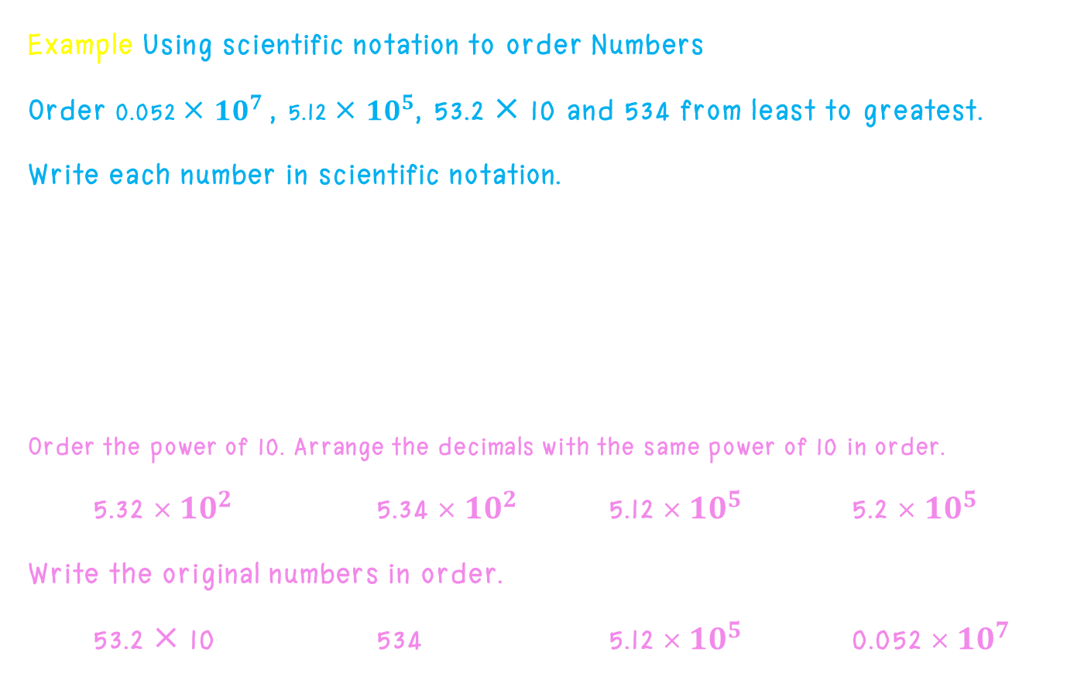
Scientific Notation
Example Using scientific notation to order Numbers
Order 0.052 × ${10}^{7}$, 5.12 × ${10}^{5}$, 53.2 × 10 and 534 from least to greatest.
Write each number in scientific notation.
0.052 × ${10}^{7}$ 5.12 × ${10}^{5}$ 53.2 × 10 534
5.2 × ${10}^{5}$ 5.12 × ${10}^{5}$ 5.32 × ${10}^{2}$ 5.34 × ${10}^{2}$
Order the power of 10. Arrange the decimals with the same power of 10 in order.
5.32 × ${10}^{2}$ 5.34 × ${10}^{2}$ 5.12 × ${10}^{5}$ 5.2 × ${10}^{5}$
Write the original numbers in order.
53.2 × 10 534 5.12 × ${10}^{5}$ 0.052 × ${10}^{7}$

Slide 21

Exponent and Addition
Example Add the following $2^{4}$+ $3^{2}$
a. $2^{4}$+ $3^{2}$= (2 ⋅ 2 ⋅ 2 ⋅ 2) + (3 ⋅ 3) Change the exponents to repeated
multiplication.
= 16 + 9 Add.
= 25 Simplify.
b. $1^{4}$+ $3^{3}$+ $2^{5}$
= (1 ⋅ 1 ⋅ 1 ⋅ 1) + (3 ⋅ 3 ⋅ 3) + (2 ⋅ 2 ⋅ 2 ⋅ 2 ⋅ 2) Change the exponents to
repeated multiplication.
= 1 + 27 + 32 Add.
= 60 Simplify.

Slide 22
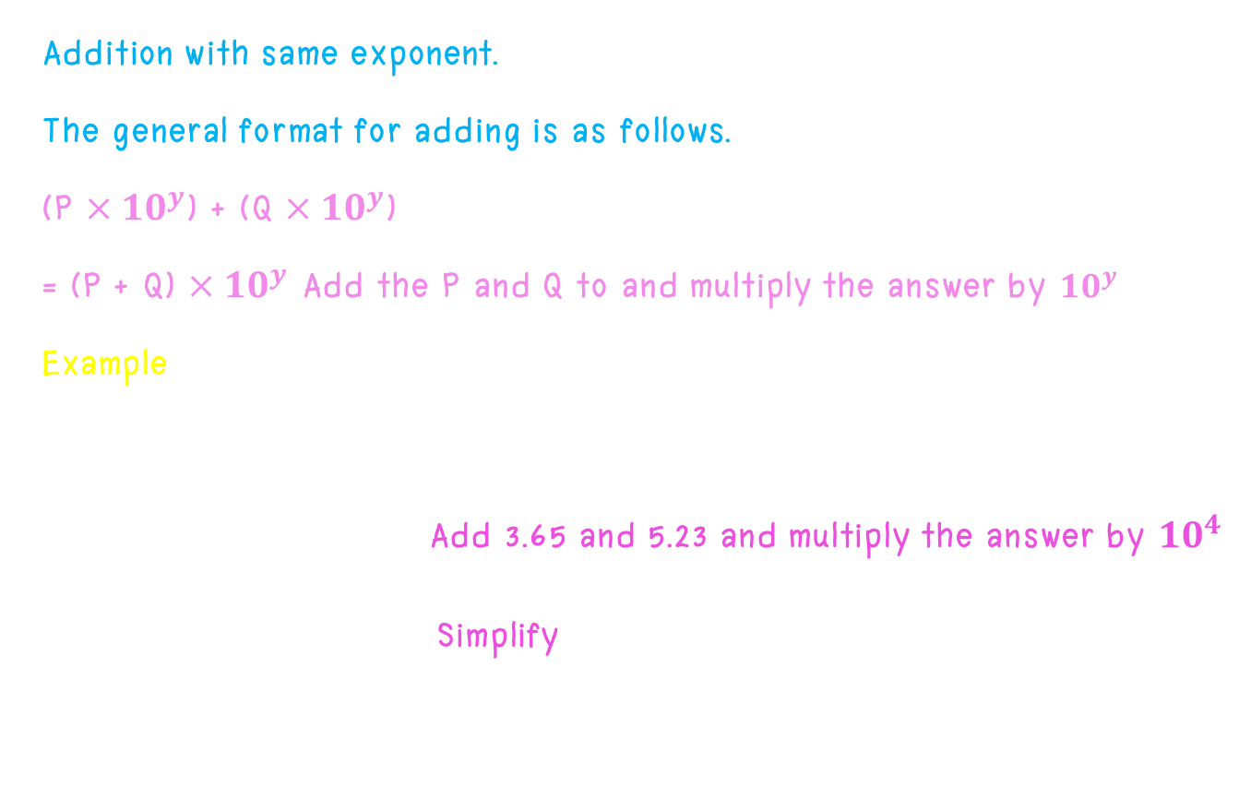
Exponent and Addition
Addition with same exponent.
The general format for adding is as follows.
(P $×{10}^{y}$) + (Q $×{10}^{y}$)
= (P + Q) $×{10}^{y}$ Add the P and Q to and multiply the answer by ${10}^{y}$
Example Add the following (3.65 $×{10}^{4}$) + (5.23 $×{10}^{4}$)
(3.65 $×{10}^{4}$) + (5.23 $×{10}^{4}$)
= (3.65 + 5.23) $×{10}^{4}$ Add 3.65 and 5.23 and multiply the answer by ${10}^{4}$
= 8.88 $×{10}^{4}$ Simplify

Slide 23

Exponent and Addition
Addition with different exponent.
Example Add the following (5.13 $×{10}^{6}$) + (2.52 $×{10}^{4}$)
(5.13 $×{10}^{6}$) + (2.52 $×{10}^{4}$)
= (513 $×{10}^{4}$) + (2.52 $×{10}^{4}$) Chang one of the number so that both
number have the same exponents value.
= (513 + 2.52) $×{10}^{4}$ Add 513 and 2.52 together.
= 515.52 $×{10}^{6}$ Multiply the answer with the ${10}^{4}$.
= 5.1552 $×{10}^{6}$ Change to scientific notation.

Slide 24

Exponent and Subtraction
Example Subtract the following $2^{5}$- $3^{3}$
a. $2^{4}$- $3^{2}$= (2 ⋅ 2 ⋅ 2 ⋅ 2 ⋅ 2) - (3 ⋅ 3 ⋅ 3) Change the exponents to repeated multiplication.
= 32 + 27 Subtract.
= 59 Simplify.
b. $5^{2}$- $3^{2}$- $2^{4}$
= (5 ⋅ 5 ) - (3 ⋅ 3) - (2 ⋅ 2 ⋅ 2 ⋅ 2) Change the exponents to
repeated multiplication.
= 25 - 9 - 16 Subtract
= 0 Simplify.

Slide 25

Exponent and Subtraction
Subtraction with same exponent.
Example Subtract the following (9.63 $×{10}^{6}$) - (1.09 $×{10}^{6}$)
(9.63 $×{10}^{6}$) - (1.09 $×{10}^{6}$)
= (9.63 – 1.09) $×{10}^{6}$ Subtract 9.63 and 1.09 together.
= 8.5$4×{10}^{6}$ multiply the answer by ${10}^{6}$

Slide 26

Exponent and Subtraction
Subtraction with different exponent.
Example Subtract the following (9.82 $×{10}^{−4}$) - (8.2 $×{10}^{−6}$)
(9.82 $×{10}^{−4}$) - (8.2 $×{10}^{−6}$)
= (9.82 $×{10}^{−4}$) - (0.082 $×{10}^{−4}$) Chang one of the number so that both
number have the same exponents value.
= (9.82 – 0.082) $×{10}^{−4}$ Subtract 9.82 and 0.082 together.
= 9.738 $×{10}^{−4}$ Multiply the answer with the ${10}^{4}$.

Slide 27
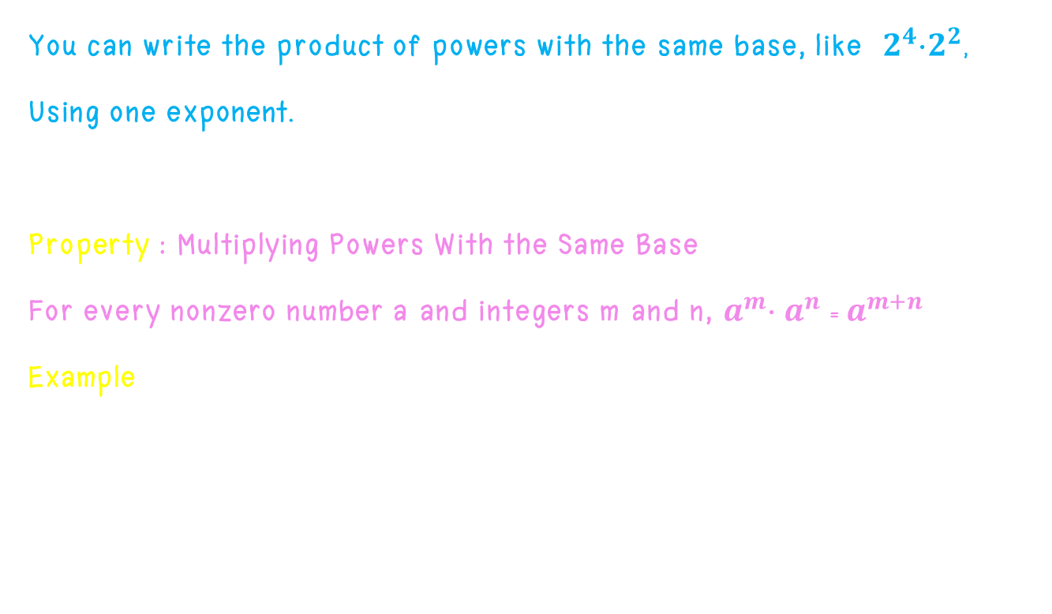
Exponent and Multiplication
You can write the product of powers with the same base, like $2^{4}$⋅$2^{2}$,
Using one exponent.
$2^{4}$⋅$2^{2}$ = (2 ⋅ 2 ⋅ 2 ⋅ 2) ⋅ (2 ⋅ 2) = $2^{6}$
Property : Multiplying Powers With the Same Base
For every nonzero number a and integers m and n, $a^{m}$⋅ $a^{n}$ = $a^{m+n}$
Example $4^{6}∙4^{3}$ = $4^{6+3}$=$4^{9}$ $h^{2}∙h^{9}$ = $h^{2+9}$=$h^{11}$

Slide 28
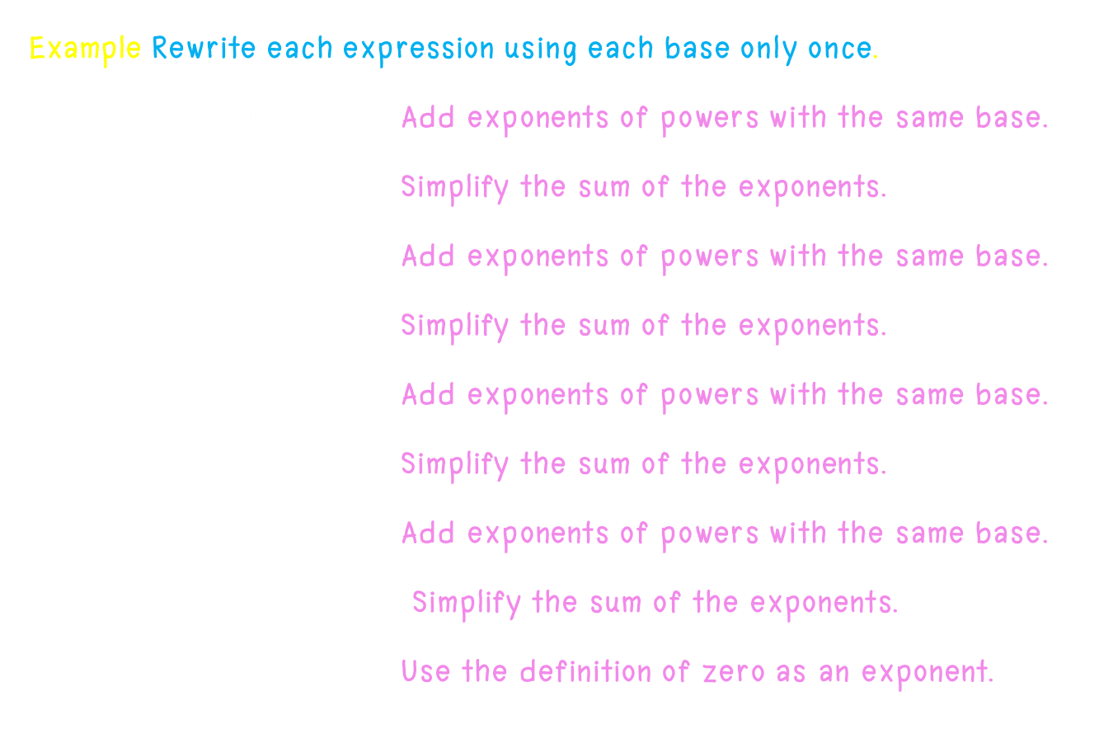
Exponent and Multiplication
Example Rewrite each expression using each base only once.
a. ${11}^{4}$⋅ ${11}^{3}$ = ${11}^{4+3}$ Add exponents of powers with the same base.
= ${11}^{7}$ Simplify the sum of the exponents.
b. $7^{−1}$⋅ $7^{−4}$ = $7^{−1+(−4)}$ Add exponents of powers with the same base.
= $7^{−5}$ Simplify the sum of the exponents.
c. $2^{3}$⋅ $2^{−4}$ = $2^{3+(−4)}$ Add exponents of powers with the same base.
= $2^{−1}$ Simplify the sum of the exponents.
d. $5^{−2}$⋅ $5^{2}$ = $5^{−2+2}$ Add exponents of powers with the same base.
= $5^{0}$ Simplify the sum of the exponents.
= 1 Use the definition of zero as an exponent.

Slide 29
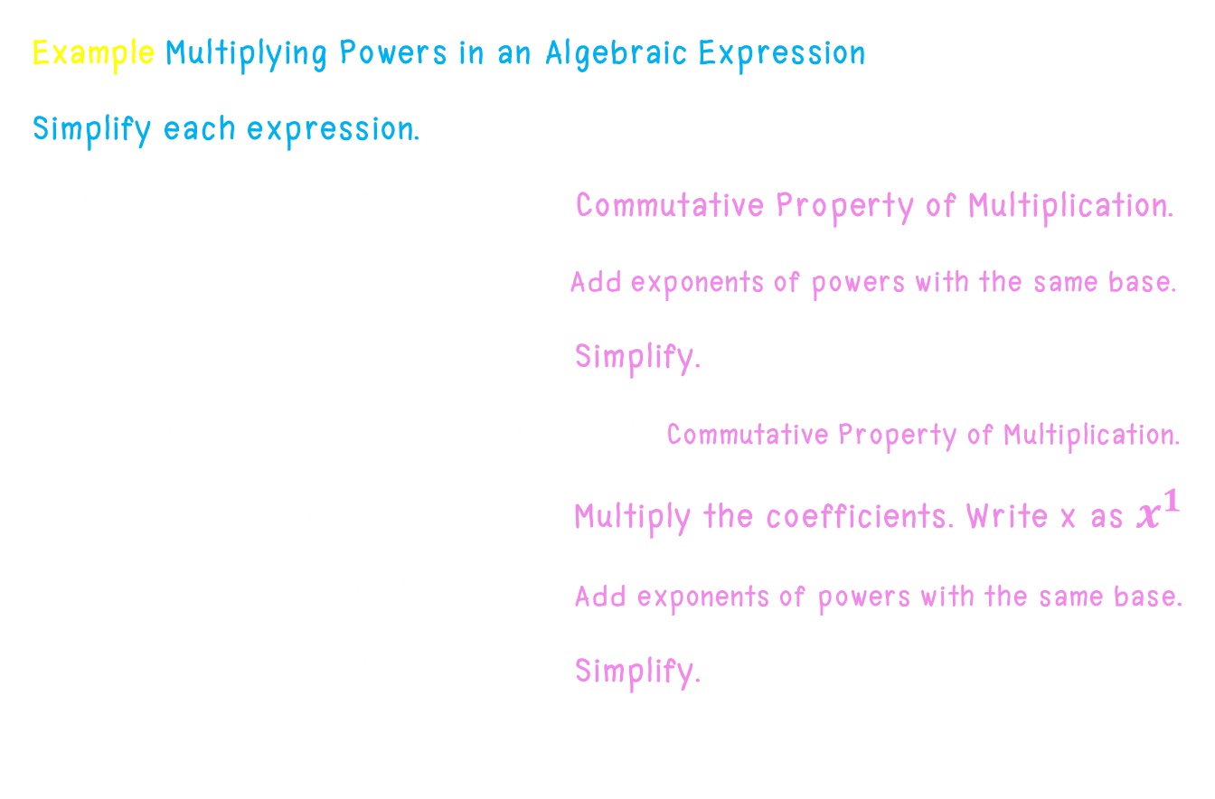
Exponent and Multiplication
Example Multiplying Powers in an Algebraic Expression
Simplify each expression.
a. ${2n}^{5}$⋅ ${3n}^{−2}$ = (2 ⋅ 3)($n^{5}$ ⋅$n^{−2}$) Commutative Property of Multiplication.
= 6($n^{5+(−2)}$) Add exponents of powers with the same base.
= ${6n}^{3}$ Simplify.
b. 5x ⋅ ${2y}^{4}$⋅ ${3x}^{8}$ = (5 ⋅ 2 ⋅ 3)(x × $x^{8}$⋅$y^{4}$) Commutative Property of Multiplication.
= 30 ($x^{1}{ x}^{8}$)($y^{4}$) Multiply the coefficients. Write x as $x^{1}$
= 30($x^{1+8}$)($y^{4}$) Add exponents of powers with the same base.
= ${30x}^{9}y^{4}$ Simplify.

Slide 30
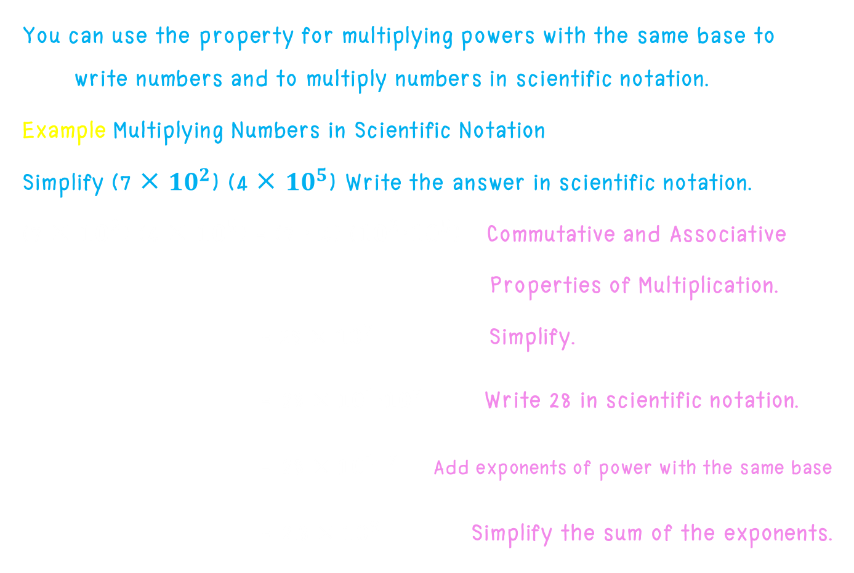
Exponent and Multiplication
You can use the property for multiplying powers with the same base to write numbers and to multiply numbers in scientific notation.
Example Multiplying Numbers in Scientific Notation
Simplify (7 × ${10}^{2}$) (4 × ${10}^{5}$) Write the answer in scientific notation.
(7 × ${10}^{2}$) (4 × ${10}^{5}$) = (7 ⋅ 4) (${10}^{2}$⋅${10}^{5}$) Commutative and Associative
Properties of Multiplication.
= 28 × ${10}^{7}$ Simplify.
= 28 × ${10}^{1}{10}^{7}$ Write 28 in scientific notation.
= 28 × ${10}^{1+7}$ Add exponents of power with the same base
= 2.8 × ${10}^{8}$ Simplify the sum of the exponents.

Slide 31
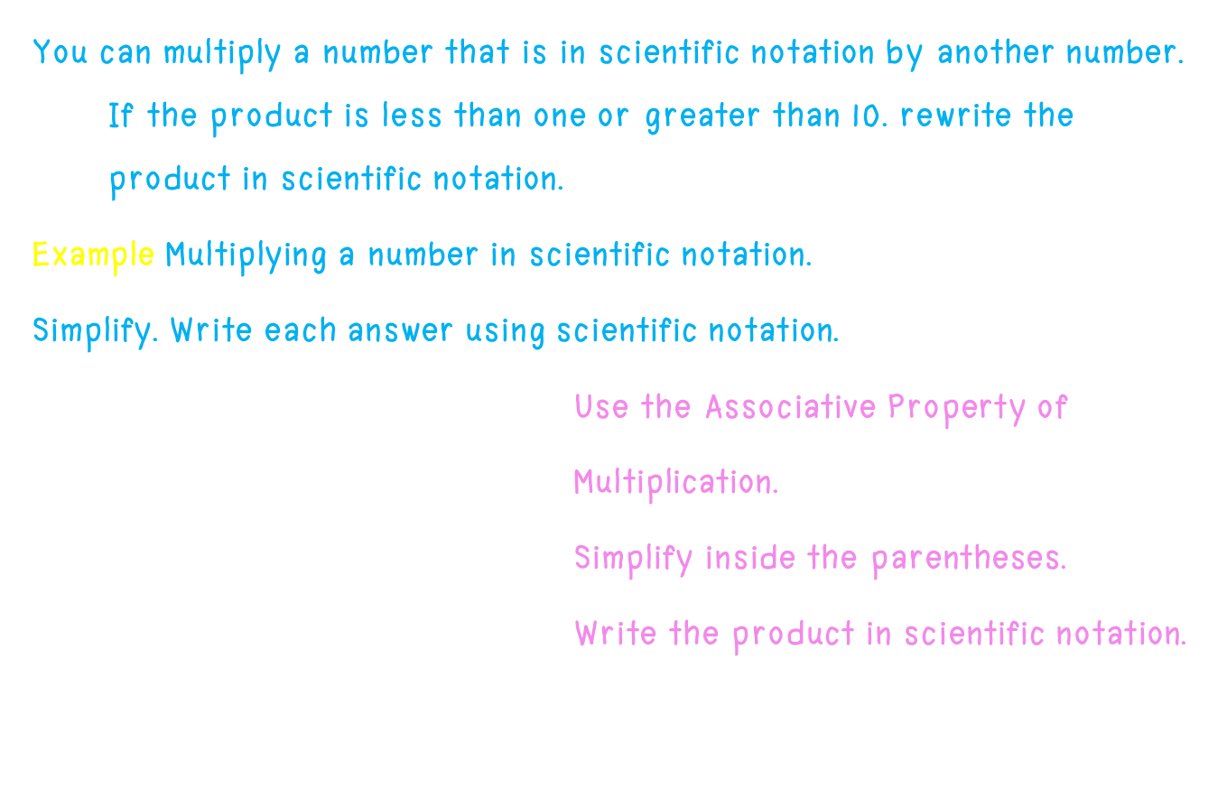
Exponent and Multiplication
You can multiply a number that is in scientific notation by another number. If the product is less than one or greater than 10. rewrite the product in scientific notation.
Example Multiplying a number in scientific notation.
Simplify. Write each answer using scientific notation.
a. 7(4 × ${10}^{5}$) = (7 ⋅ 4) × ${10}^{5}$ Use the Associative Property of
Multiplication.
= 28 × ${10}^{5}$ Simplify inside the parentheses.
= 28 × ${10}^{5}$ Write the product in scientific notation.

Slide 32
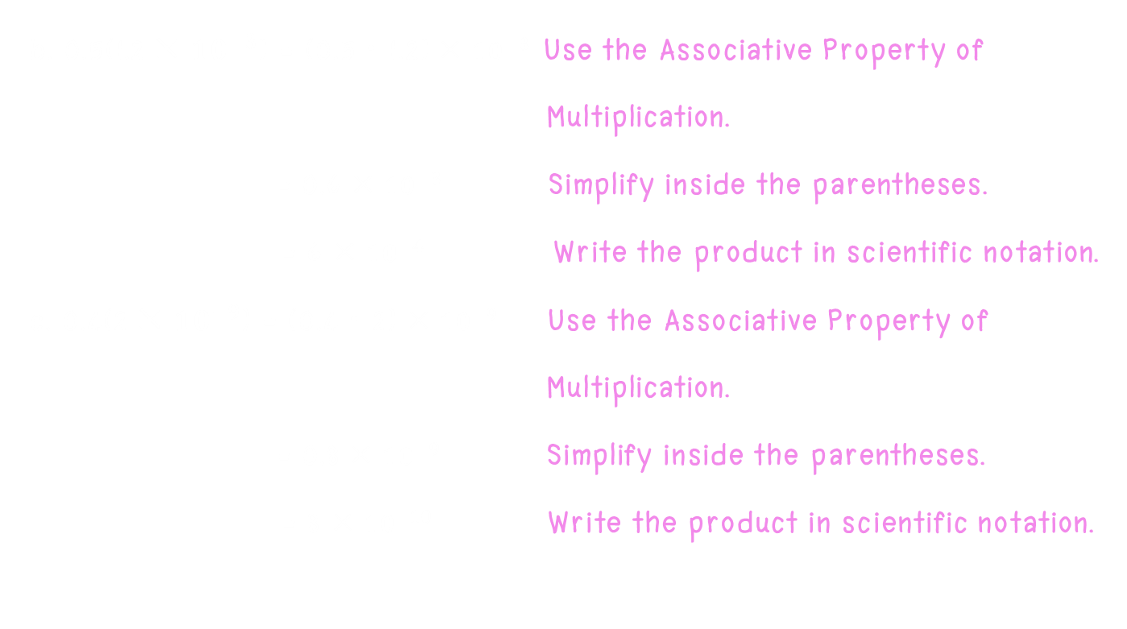
Exponent and Multiplication
b. 0.5(1.2 × ${10}^{−3}$) = (0.5 ⋅ 1.2) × ${10}^{−3}$ Use the Associative Property of
Multiplication.
= 0.6 × ${10}^{−3}$ Simplify inside the parentheses.
= 6 × ${10}^{−4}$ Write the product in scientific notation.
c. 0.4(2 × ${10}^{−9}$) = (0.4 ⋅ 2) × ${10}^{−9}$ Use the Associative Property of
Multiplication.
= 0.8 × ${10}^{−9}$ Simplify inside the parentheses.
= 8 × ${10}^{−10}$ Write the product in scientific notation.

Slide 33
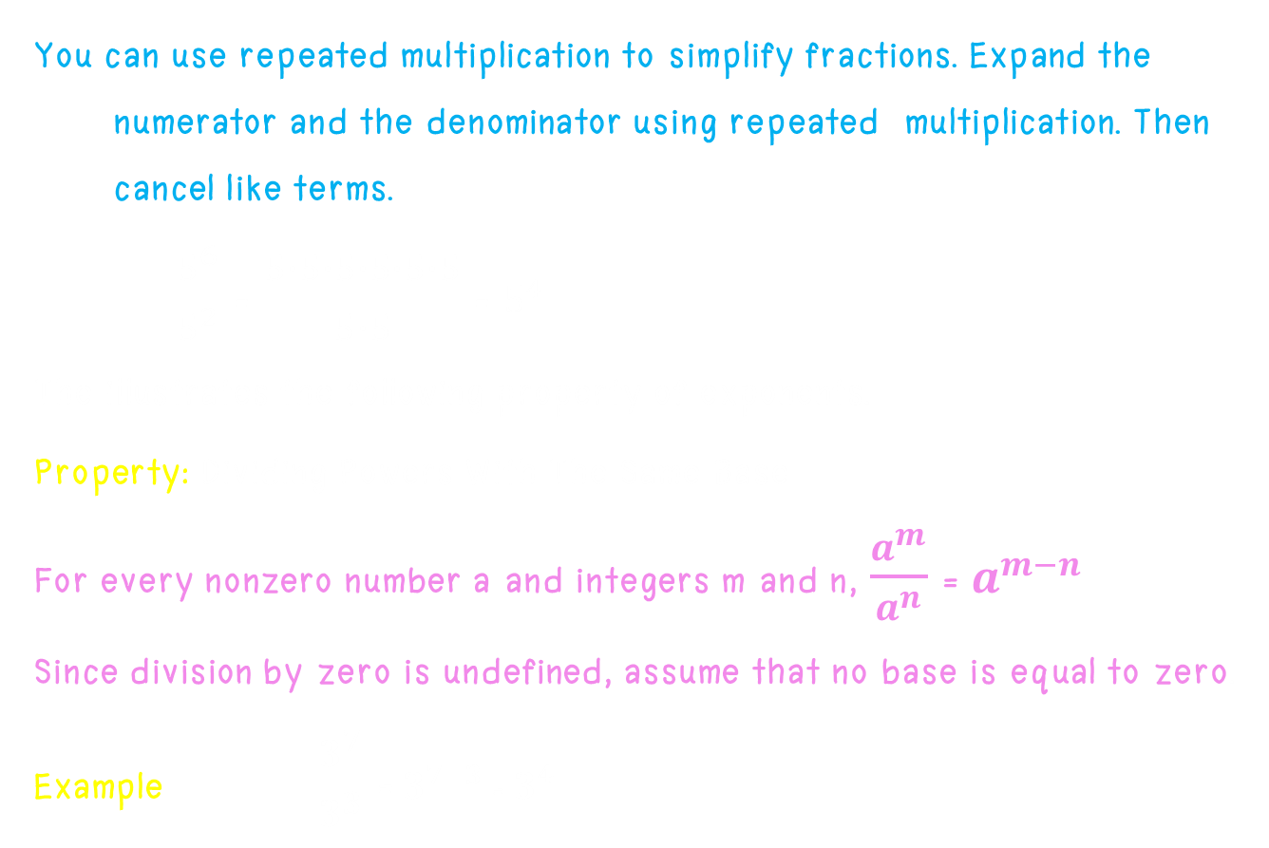
Exponent and Division
You can use repeated multiplication to simplify fractions. Expand the numerator and the denominator using repeated multiplication. Then cancel like terms.
$\frac{5^{6}}{5^{2}}$ = $\frac{5∙5∙5∙5∙5∙5}{5∙5}$ = $5^{4}$
The illustrates the following property of exponents.
Property: Dividing Powers With The Same Base
For every nonzero number a and integers m and n, $\frac{a^{m}}{a^{n}}$ = $a^{m−n}$
Since division by zero is undefined, assume that no base is equal to zero.
Example $\frac{3^{7}}{3^{3}}$ =${ 3}^{7−3}$ = $3^{4}$

Slide 34
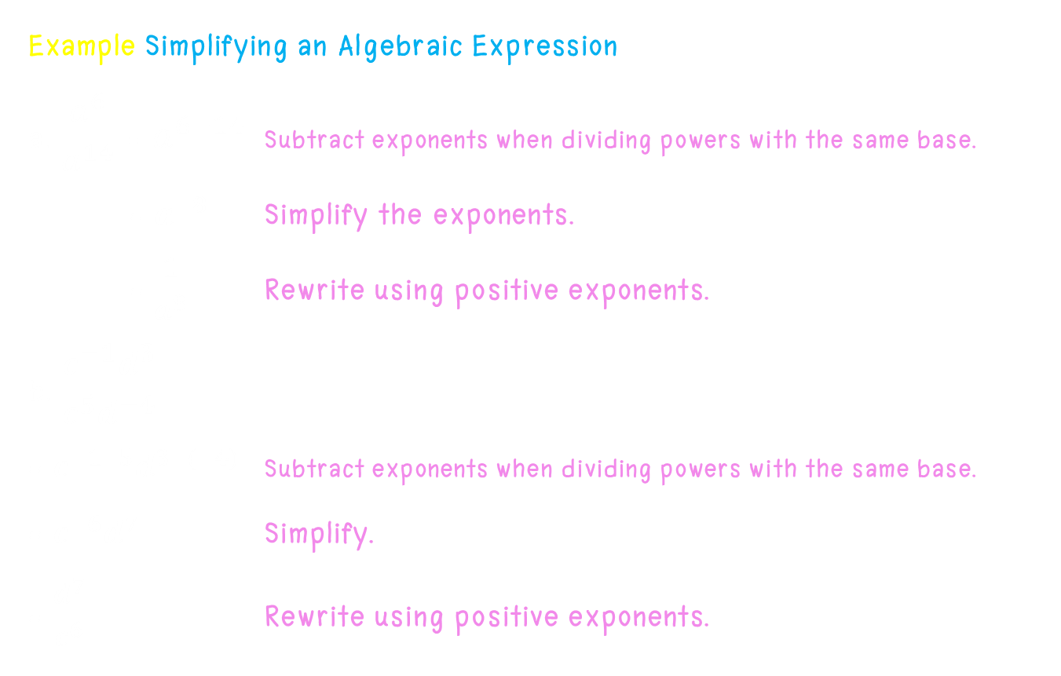
Exponent and Division
Example Simplifying an Algebraic Expression
a. $\frac{a^{6}}{a^{14}}$ = $a^{6−14}$ Subtract exponents when dividing powers with the same base.
= $a^{−8}$ Simplify the exponents.
= $\frac{1}{a^{8}}$ Rewrite using positive exponents.
b. $\frac{c^{−1}d^{3}}{c^{5}d^{−4}}$
= $c^{−1−5}d^{3−(−4)}$ Subtract exponents when dividing powers with the same base.
= $c^{−6}d^{7}$ Simplify.
= $\frac{d^{7}}{c^{6}}$ Rewrite using positive exponents.

Slide 35

Exponent and Division
Example Simplifying an Algebraic Expression
c. $\frac{2×{10}^{3}}{{8×10}^{8}}$
= $\frac{2}{8}×{10}^{3−8}$ Subtract exponents when dividing powers with the same base.
= $\frac{2}{8}×{10}^{−5}$ Simplify the exponents
=0.25 $×{10}^{−5}$ Divide.
= 2.5 $×{10}^{−6}$ Write in scientific notation.

Slide 36

Zero and Negative Exponents
Property : Zero as an exponent.
For every nonzero number a, $a^{0}$= 1
Examples $5^{0}$= 1 ${(−2)}^{0}$= 1 ${(1.02)}^{0}$= 1 ${(\frac{1}{3})}^{0}$ = 1
Property : Negative Exponent
For every nonzero number a and integer n, $a^{−n}$= $\frac{1}{a^{n}}$
Examples $a^{−4}$= $\frac{1}{a^{4}}$ ${(−8)}^{−1}$= $\frac{1}{{(−8)}^{1}}$

Slide 37
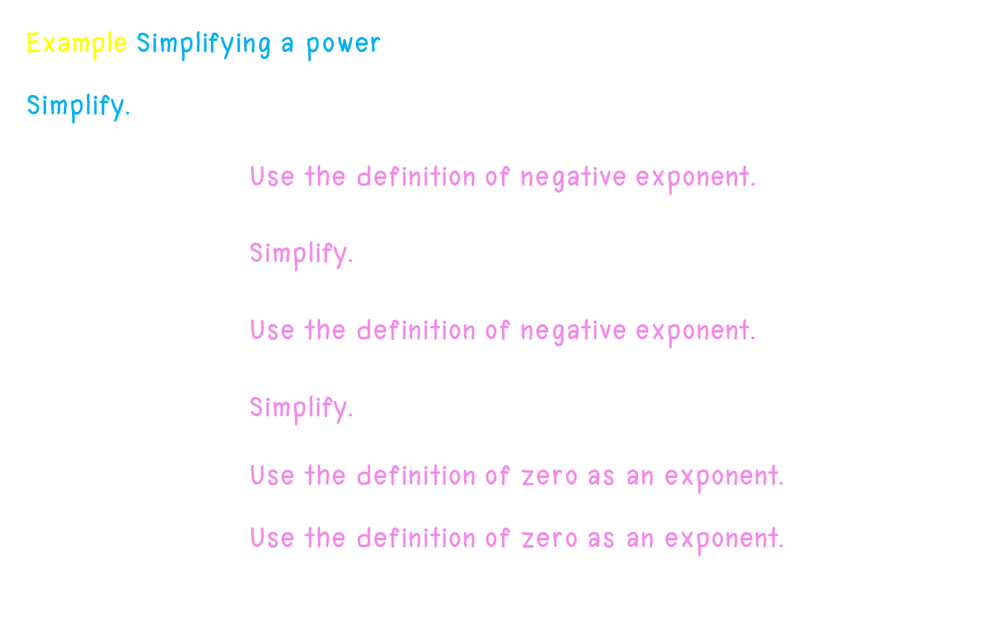
Zero and Negative Exponents
Example Simplifying a power
Simplify.
a. $4^{−3}$= $\frac{1}{4^{3}}$ Use the definition of negative exponent.
= $\frac{1}{64}$ Simplify.
b. $9^{−2}$= $\frac{1}{9^{2}}$ Use the definition of negative exponent.
= $\frac{1}{81}$ Simplify.
c. ${(−1.23)}^{0}$ = 1 Use the definition of zero as an exponent.
d. $g^{0}$ = 1 Use the definition of zero as an exponent.

Slide 38
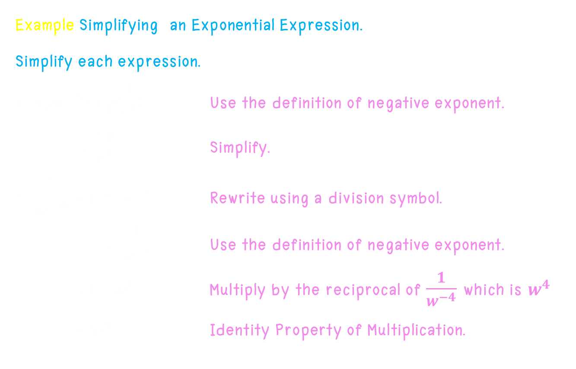
Zero and Negative Exponents
Example Simplifying an Exponential Expression.
Simplify each expression.
a. ${4yx}^{−3}$= 4y($\frac{1}{4^{3}}$) Use the definition of negative exponent.
= $\frac{4y}{x^{3}}$ Simplify.
b. $\frac{1}{w^{−4}}$ = 1 ÷ $w^{−4}$ Rewrite using a division symbol.
= 1 ÷ $\frac{1}{w^{−4}}$ Use the definition of negative exponent.
= 1 ⋅ $w^{4}$ Multiply by the reciprocal of $\frac{1}{w^{−4}}$ which is $w^{4}$.
= $w^{4}$ Identity Property of Multiplication.

Slide 39
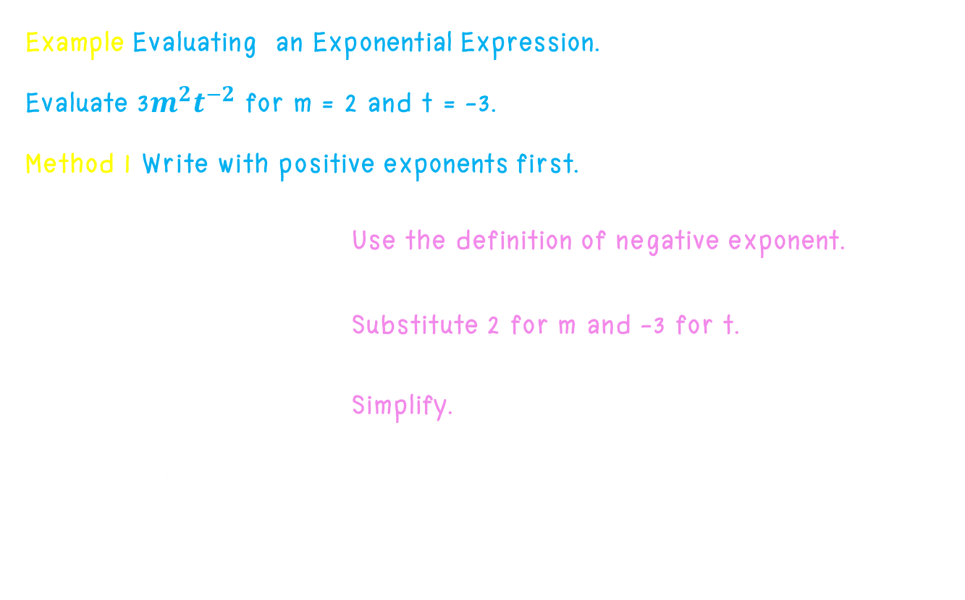
Zero and Negative Exponents
Example Evaluating an Exponential Expression.
Evaluate 3$m^{2}t^{−2}$ for m = 2 and t = -3.
Method 1 Write with positive exponents first.
$\text{3}m^{2}t^{−2}$= $\frac{{3m}^{2}}{t^{2}}$ Use the definition of negative exponent.
= $\frac{{3(2)}^{2}}{{(−3)}^{2}}$ Substitute 2 for m and -3 for t.
= $\frac{12}{9}$ Simplify.
= 1$\frac{1}{3}$

Slide 40

Zero and Negative Exponents
Example Evaluating an Exponential Expression.
Evaluate 3$m^{2}t^{−2}$ for m = 2 and t = -3.
Method 2 Substitute first.
$\text{3}m^{2}t^{−2}$= $\text{3}{(2)}^{2}{(−3)}^{−2}$ Substitute 2 for m and -3 for t.
= $\frac{{3(2)}^{2}}{{(−3)}^{2}}$ Use the definition of negative exponent
= $\frac{12}{9}$ Simplify.
= 1$\frac{1}{3}$

Slide 41

Properties of exponents.
You can use what you learned in the previous lesson to find an shortcut
for simplifying expressions with powers. Copy and complete each statement.
1. ${{(3}^{6})}^{2}$ = $3^{6}$⋅ $3^{6}$ = $3^{6+6}$ = $3^{6∙2}$ = $3^{12}$
2. ${{(5}^{4})}^{3}$ = $5^{4}$⋅ $5^{4}$⋅ $5^{4}$ = $5^{4+4+4}$ = $5^{4∙3}$= $5^{12}$
3. ${{(c}^{3})}^{4}$ = $c^{3}$⋅ $c^{3}$⋅ $c^{3}$ ⋅ $c^{3}$ = $c^{3+3+3+3}$ = $c^{3∙4}$ = $5^{12}$
Raising a power to a power is the same as raising the base to the product of the exponents.
Property : Raising a Power to a Power
For every nonzero number a and integers m and n, ${{(a}^{m})}^{n}$= $a^{mn}$
Example ${{(5}^{4})}^{2}$= $5^{4∙2}$= $5^{8}$ ${{(x}^{2})}^{5}$= $x^{2∙5}$= $5^{10}$

Slide 42
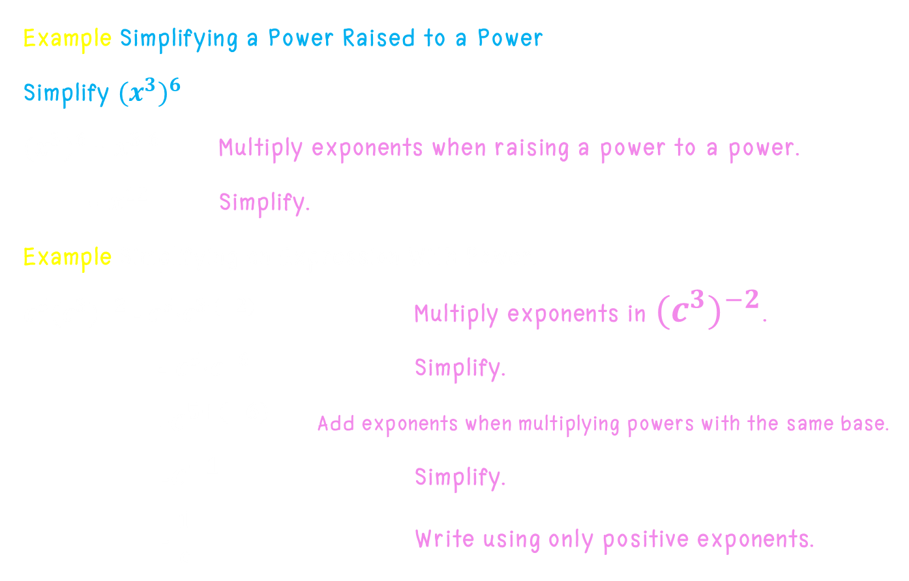
Properties of exponents.
Example Simplifying a Power Raised to a Power
Simplify ${{(x}^{3})}^{6}$
${{(x}^{3})}^{6}$ = $x^{3∙6}$ Multiply exponents when raising a power to a power.
= $x^{12}$ Simplify.
Example Simplifying an Expression With Power.
$c^{5}{{(c}^{3})}^{−2}$ = ${c^{5}c}^{3∙(−2)}$ Multiply exponents in ${{(c}^{3})}^{−2}$.
= ${c^{5}c}^{−6}$ Simplify.
=$c^{5+(−6)}$ Add exponents when multiplying powers with the same base.
=$c^{−1}$ Simplify.
= $\frac{1}{c}$ Write using only positive exponents.

Slide 43

Properties of exponents.
You can use repeated multiplication to simplify expressions like ${(5y)}^{3}$
Simplify ${(5y)}^{3}$ = 5y ⋅ 5y ⋅ 5y
= 5 ⋅ 5 ⋅ 5 ⋅ y ⋅ y ⋅ y
= $5^{3}$ $y^{3}$
= 125 $y^{3}$
Notice that ${(5y)}^{3}$ = $5^{3}$ $y^{3}$. This illustrates another property of exponents.
Property : Raising a Product to a Power
For every nonzero number a and b and integer n, ${(ab)}^{n}$ = $a^{n}$ $b^{n}$.
Example ${(3x)}^{4}$ = $3^{4}$ $x^{4}$ = 81 $x^{4}$

Slide 44
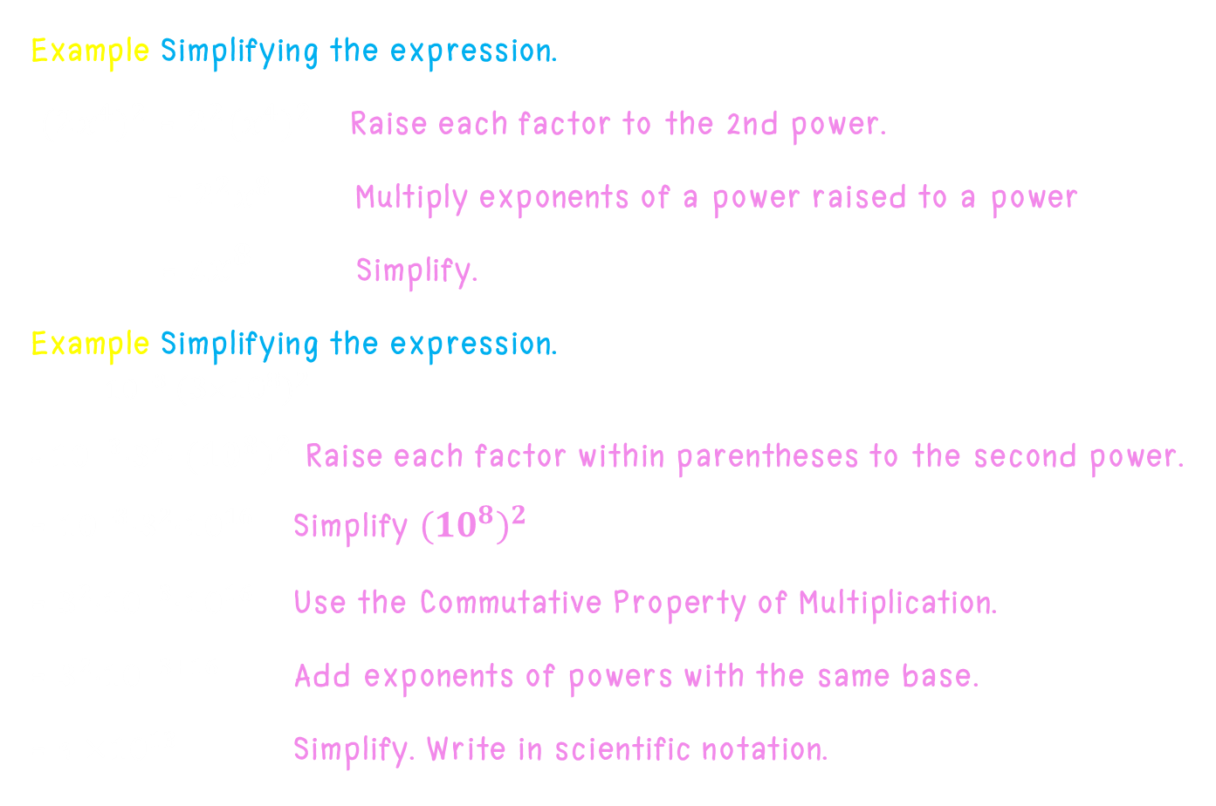
Properties of exponents.
Example Simplifying the expression.
${{(2x}^{4})}^{2}$ = $2^{2}{{(x}^{4})}^{2}$ Raise each factor to the 2nd power.
= $2^{2}x^{8}$ Multiply exponents of a power raised to a power
= 4$x^{8}$ Simplify.
Example Simplifying the expression.
$${10}^{−3} {{(310}^{8})}^{2}$$
= ${10}^{−3}3^{2}$⋅ ${{(10}^{8})}^{2}$ Raise each factor within parentheses to the second power.
= ${10}^{−3}3^{2}$⋅${10}^{16}$ Simplify ${{(10}^{8})}^{2}$
= $3^{2}{10}^{−3}$⋅${10}^{16}$ Use the Commutative Property of Multiplication.
= $3^{2}{10}^{−3+16}$ Add exponents of powers with the same base.
= 9 ×${10}^{13}$ Simplify. Write in scientific notation.

Slide 45

Properties of exponents.
You can use repeated multiplication to simplify the expression ${\left(\frac{x}{y}\right)}^{3}$.
$${\left(\frac{x}{y}\right)}^{3}= \frac{x}{y}∙\frac{x}{y}∙\frac{x}{y}$$
= $\frac{x∙x∙x}{y∙y∙y}$ = $\frac{x^{3}}{y^{3}}$
This illustrates another property of exponents.
Property: Raising a Quotient to a Power
For every nonzero number a and b integer n, ${\left(\frac{a}{b}\right)}^{n}$= $\frac{a^{n}}{b^{n}}$
Example ${\left(\frac{4}{5}\right)}^{3}$= $\frac{4^{3}}{5^{3}}$ = $\frac{64}{125}$

Slide 46

Properties of exponents.
Example Simplify the expression.
${\left(\frac{4}{x^{2}}\right)}^{3}$= $\frac{4^{3}}{{\left(x^{2}\right)}^{3}}$ Raise the numerator and the denominator to the third power
= $\frac{4^{3}}{x^{6}}$ Multiply the exponents in the denominator.
= $\frac{64}{x^{6}}$ Simplify.

Slide 47

Properties of exponents.
You can use what you know about exponents to rewrite an expression in the form ${\left(\frac{a}{b}\right)}^{−n}$using positive exponents.
${\left(\frac{a}{b}\right)}^{−n}$= $\frac{1}{{\left(\frac{a}{b}\right)}^{n}}$ Use the definition of negative exponent.
= $\frac{1}{\frac{a^{n}}{a^{n}}}$ Raise the quotient to a power.
= $\frac{1}{\frac{a^{n}}{b^{n}}}∙\frac{b^{n}}{b^{n}}$ Use the Identify Property of Multiplication to multiply by $\frac{b^{n}}{b^{n}}$
= $\frac{b^{n}}{a^{n}}$ Simplify.
= ${\left(\frac{b}{a}\right)}^{n}$ Write the quotient using one exponent.
So, ${\left(\frac{a}{b}\right)}^{−n}$=${\left(\frac{b}{a}\right)}^{n}$.

Slide 48

Properties of exponents.
Example Simplifying an Exponential Expression
Simplify each expression.
a. ${\left(\frac{3}{5}\right)}^{−2}$=${\left(\frac{5}{3}\right)}^{2}$ Rewrite using the reciprocal of $\frac{3}{5}$.
= $\frac{5^{2}}{3^{2}}$ Raise the numerator and denominator to the second power.
= $\frac{25}{9}$ Simplify.
=2$\frac{7}{9}$ Simplify.

Slide 49

Properties of exponents.
b. ${\left(−\frac{2x}{y}\right)}^{−4}$=${\left(−\frac{y}{2x}\right)}^{4}$ Rewrite using the reciprocal of $−\frac{2x}{y}$.
= ${\left(\frac{−y}{2x}\right)}^{4}$ Write the fraction with a negative numerator.
= $\frac{{(−y)}^{2}}{{(2x)}^{2}}$ Raise the numerator and denominator to the fourth power.
= $\frac{y^{4}}{{16x}^{4}}$ Simplify.

Slide 50
Order of Operations With Exponents
Look at the expression below. It is simplifed in two ways.
3 + 5 – 6 ÷ 2 3 + 5 – 6 ÷ 2
8 – 6 ÷ 2 3 + 5 – 3
2 ÷ 2 8 – 3
1 × 5 
Different results
To avoid having two different results when simplifying the same expression, mathematicians have agreed on an order for doing operations.

Slide 51
Order of Operations With Exponents
You can extend the order of operations to include exponents.
Order of Operations
1. Work inside grouping symbols.
2. Simplify any terms with exponents.
3. Multiply and divide in order from left to right.
4. Add and subtract in order from left to right.

Slide 52
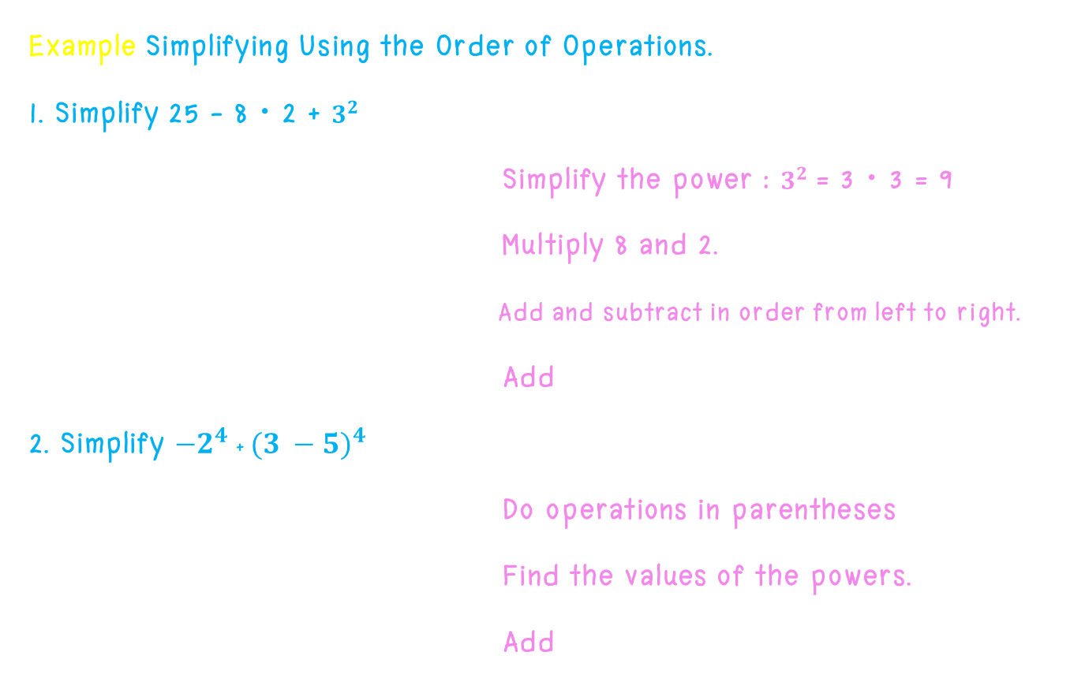
Order of Operations With Exponents
Example Simplifying Using the Order of Operations.
1. Simplify 25 – 8 ⋅ 2 + $3^{2}$
25 – 8 ⋅ 2 + $3^{2}$ = 25 – 8 ⋅ 2 + 9 Simplify the power : $3^{2}$ = 3 ⋅ 3 = 9
= 25 – 16 + 9 Multiply 8 and 2.
= 9 + 9 Add and subtract in order from left to right.
= 18 Add
2. Simplify ${−2}^{4}$ + $({3 −5)}^{4}$
${−2}^{4}$ + ${(3 −5)}^{4}$ = ${−2}^{4}$ + ${(−2)}^{4}$ Do operations in parentheses
= -16 + 16 Find the values of the powers.
= 0 Add

Slide 53
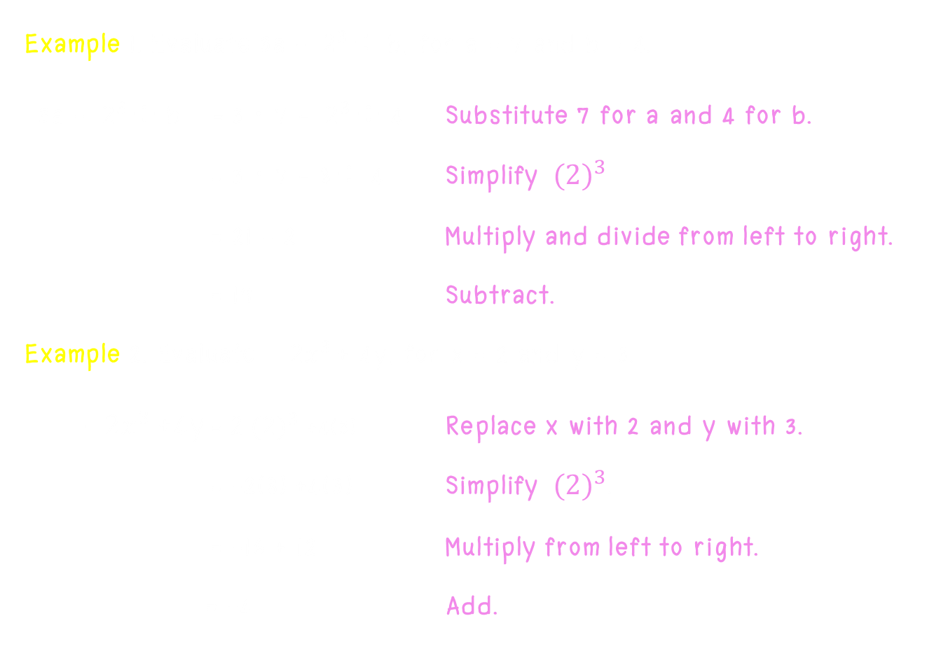
Order of Operations With Exponents
Example 1. Evaluate 3a - ${ 2}^{3}$÷ b, for a = 7 and b = 4.
3a - ${ 2}^{3}$÷ b = 3 ⋅ 7 - ${ 2}^{3}$÷ 4 Substitute 7 for a and 4 for b.
= 3 ⋅ 7 - 8 ÷ 4 Simplify ${ (2)}^{3}$
= 21 - 2 Multiply and divide from left to right.
= 19 Subtract.
Example 2. Evaluate ${ −2x}^{3}$+ 4y, for x = 2 and y = 3.
${ −2x}^{3}$+4y = 2${ (2)}^{3}$ +4(3) Replace x with 2 and y with 3.
= -2(8) +4(3) Simplify ${ (2)}^{3}$.
= -16 + 12 Multiply from left to right.
= -4 Add.

Slide 54
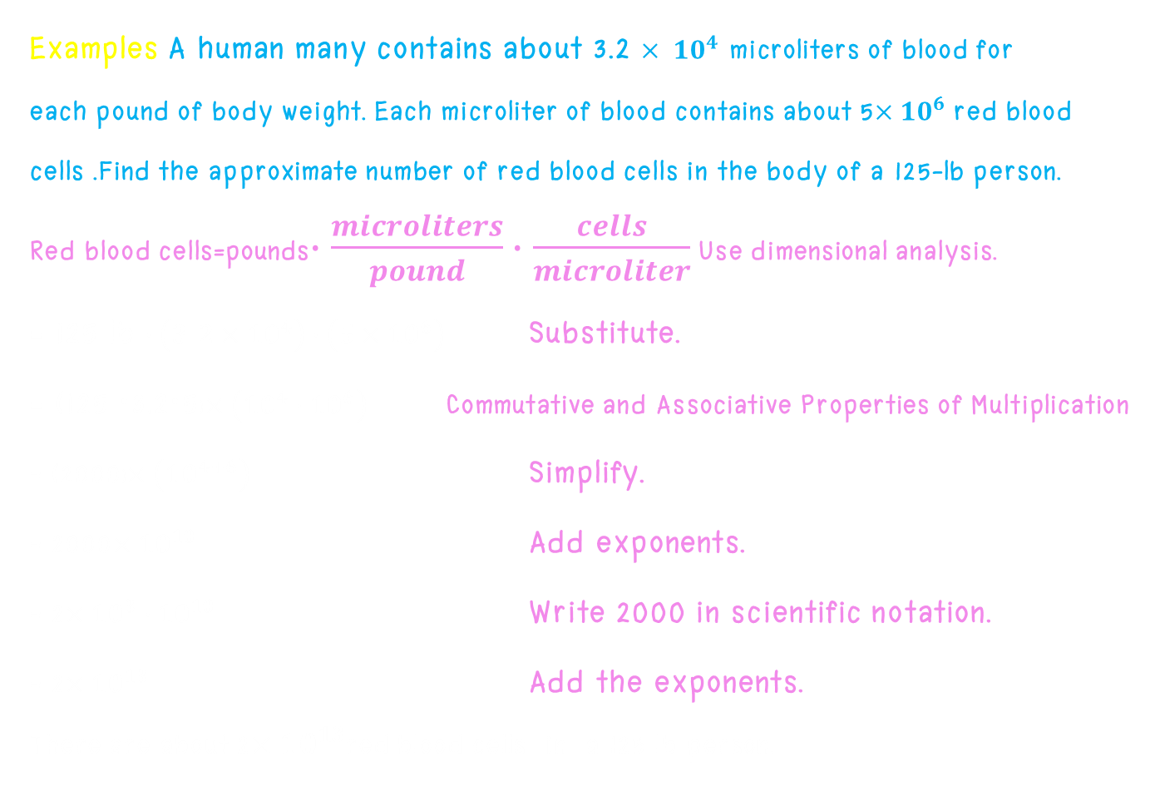
Word problem
Examples A human many contains about 3.2 $× {10}^{4}$ microliters of blood for
each pound of body weight. Each microliter of blood contains about 5$×{10}^{6}$ red blood
cells .Find the approximate number of red blood cells in the body of a 125-lb person.
Red blood cells=pounds$∙\frac{microliters}{pound}∙\frac{cells}{microliter}$ Use dimensional analysis.
= 125 lb $∙\left(3.2×{10}^{4}\right)∙\left(5×{10}^{6}\right)$ Substitute.
= (125 ⋅3.2⋅5)$×\left({10}^{4}∙{10}^{6}\right)$ Commutative and Associative Properties of Multiplication
= (2000)$×\left({10}^{4+6}\right)$ Simplify.
= 2000$×{10}^{10}$ Add exponents.
= 2$×{10}^{3}∙{10}^{10}$ Write 2000 in scientific notation.
= 2$×{10}^{13}$ Add the exponents.
There are about 2$×{10}^{13}$red blood cells in a 125 lb person.

Slide 55
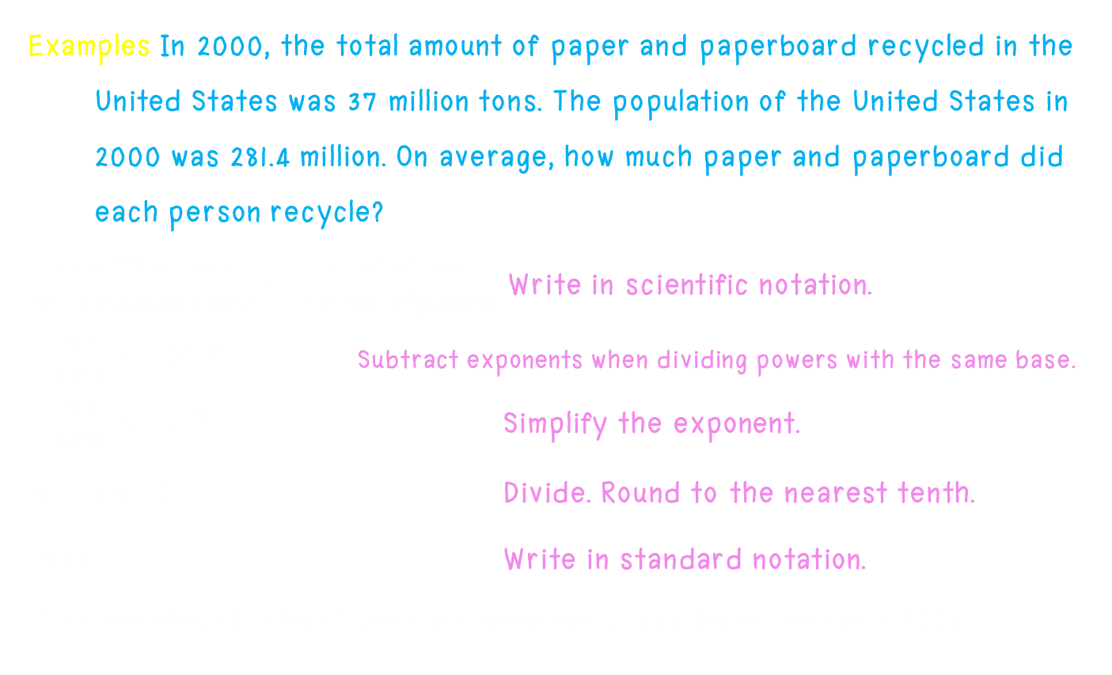
Word problem
Examples In 2000, the total amount of paper and paperboard recycled in the United States was 37 million tons. The population of the United States in 2000 was 281.4 million. On average, how much paper and paperboard did each person recycle?
$\frac{37 million tons}{281.4 million peple}=\frac{{3.7×10}^{7}tons}{{2.814×10}^{8}people}$ Write in scientific notation.
= $\frac{3.7}{2.814}×{10}^{7−8}$ Subtract exponents when dividing powers with the same base.
= $\frac{3.7}{2.814}×{10}^{−1}$ Simplify the exponent.
$≈1.3×{10}^{−1}$ Divide. Round to the nearest tenth.
=0.13 Write in standard notation.
There was about 0.13 ton of paper and paperboard recycled per person in 2000.

Slide 56
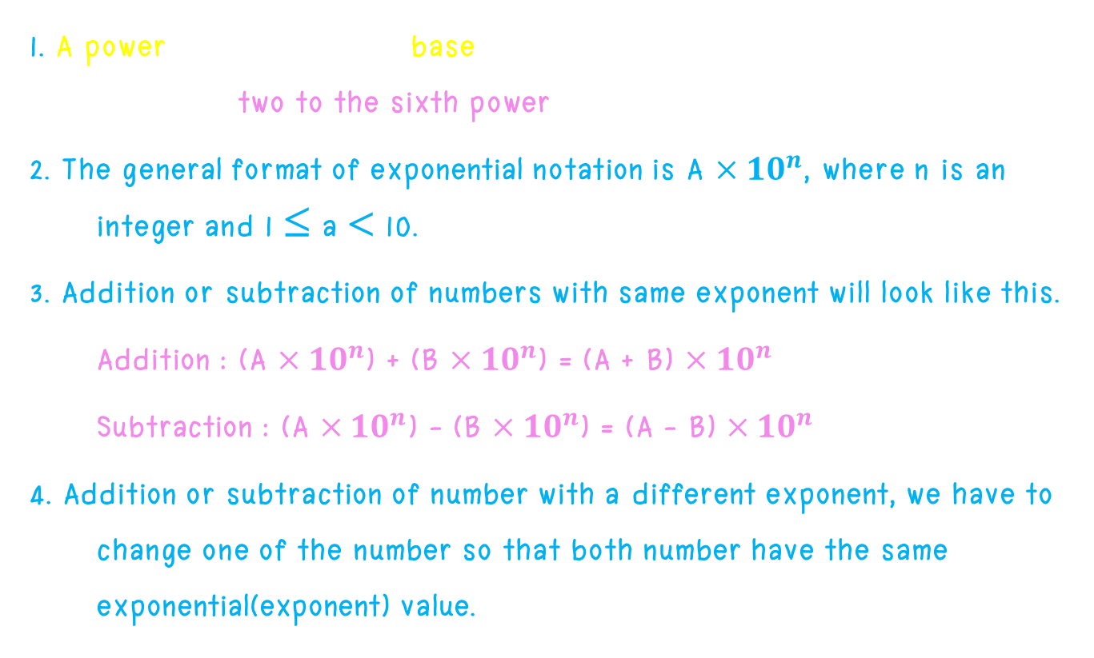
Summary
1. A power has two parts, a base and an exponent. The expression $2^{6}$ is read as “ two to the sixth power.
2. The general format of exponential notation is A $×{10}^{n}$, where n is an integer and 1 ≤ a < 10.
3. Addition or subtraction of numbers with same exponent will look like this.
Addition : (A $×{10}^{n}$) + (B $×{10}^{n}$) = (A + B) $×{10}^{n}$
Subtraction : (A $×{10}^{n}$) - (B $×{10}^{n}$) = (A - B) $×{10}^{n}$
4. Addition or subtraction of number with a different exponent, we have to change one of the number so that both number have the same exponential(exponent) value.

Slide 57

Summary
5. To multiply number in exponential notation, we first would have to multiply the coefficient first and then add the exponents.
Rule to apply when we add the exponents.
${10}^{a}$ $×{10}^{b}$= ${10}^{a+b}$
${\left({10}^{a}\right)}^{b}$ = ${10}^{ab}$
(A $×{10}^{a}$) $×$ (B $×{10}^{b}$) = (A + B) $×{10}^{a+b}$
6. To divide number in exponential notation, we first would have to divide the coefficient first and then subtract the exponents.
Rule to apply when we subtract the exponents.
${10}^{a}$ ${10}^{b}$= ${10}^{a−b}$
(A $×{10}^{a}$)$$(B $×{10}^{b}$) = (A $$ B) $×{10}^{a−b}$

Slide 58

จบการนำเสนอค่ะ

