Slide 1
Cluster of Excellence Asia and Europe in a Global Context
Heidelberg, 2013

Slide 2
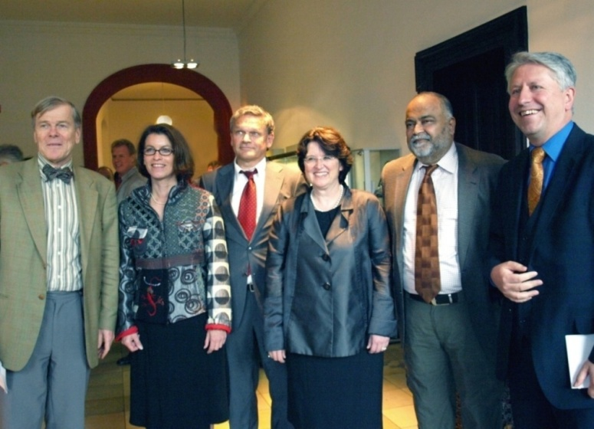
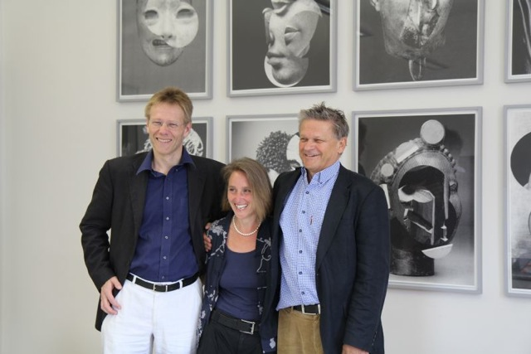
Overview
Interdisciplinary network of researchers at Heidelberg University, Germany
Established in October 2007 as part of the Excellence Initiative
About 250 scholars examine the dynamics of cultural exchanges between Asia and Europe
Offical opening in October 2008
Directorate in April 2013

Slide 3
Infrastructure
Karl Jaspers Centre for Advanced Transcultural Studies, Heidelberg

Slide 4
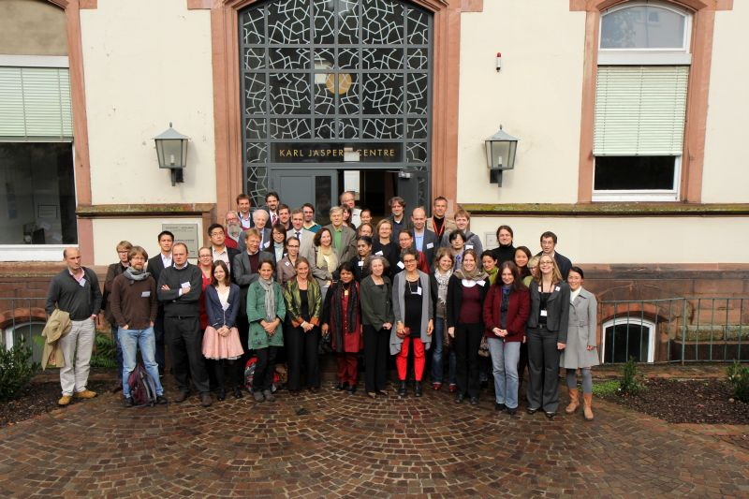
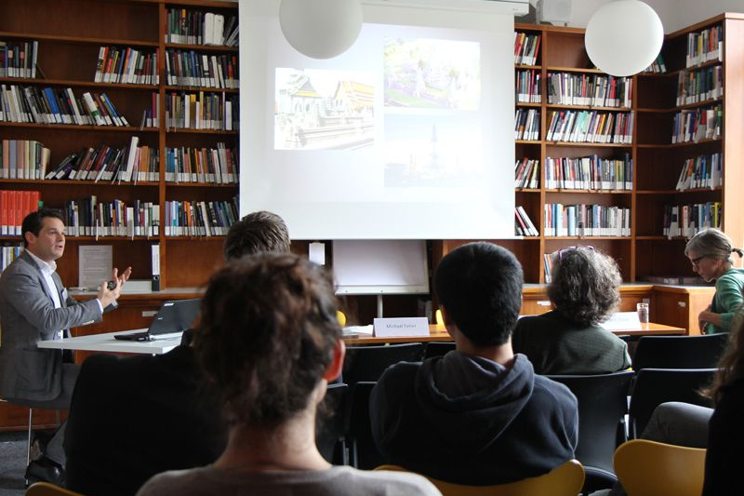
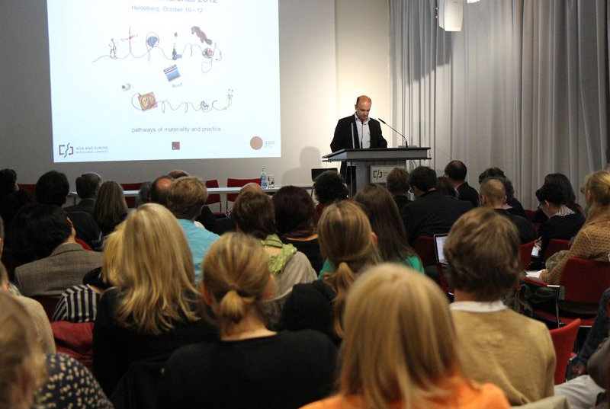
Infrastructure
Conferences and workshops at the Karl Jaspers Centre for Advanced Transcultural Studies

Slide 5
Organisation
Research Area A
Research Area B
Research Area C
Research Area D
Cluster Professorships
Buddhist Studies
Cultural Economic History
Global Art History
Intellectual History
Visual and Media Anthropology
Heidelberg
Research
Architecture
Digital Resources
Digital Humanities
Teaching
Graduate Programme
M.A. Transcultural Studies
Governance &
Administration
Public Spheres
Knowledge
Systems
Historicities &
Heritage

Slide 6
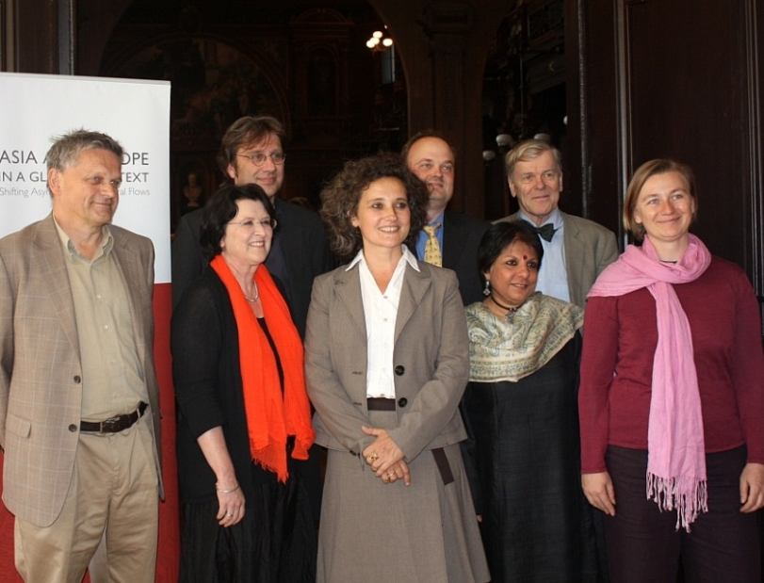
Research
Five transregional oriented Professorships
Buddhist Studies
Cultural Economic History
Global Art History
Intellectual History
Visual and Media Anthropology
Cluster Professors and Directors

Slide 7
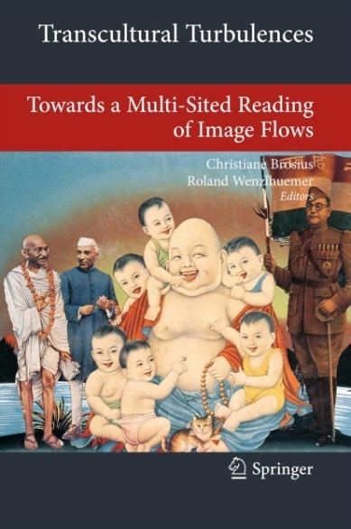
Publications
Book Series
“Transcultural Research:
Heidelberg Studies on Asia and
Europe in a Global Context”
Peer Reviewed E-Journal
Transcultural Studies

Slide 8
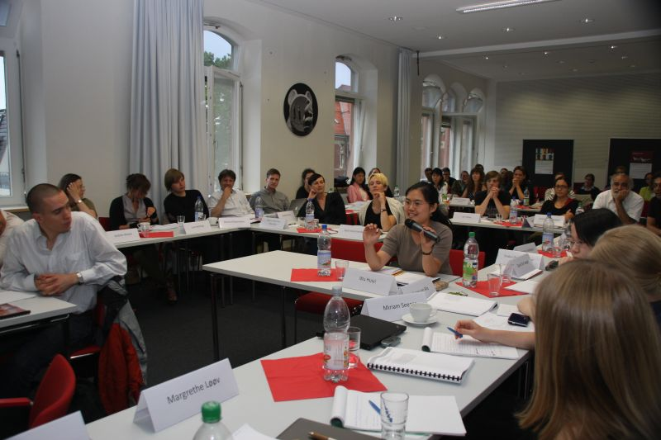
Teaching
Support for Young Scholars
Junior Research Groups (1 postdoc, 2-3 graduates)
Graduate Programme for Transcultural Studies
M.A. Transcultural Studies

Slide 9
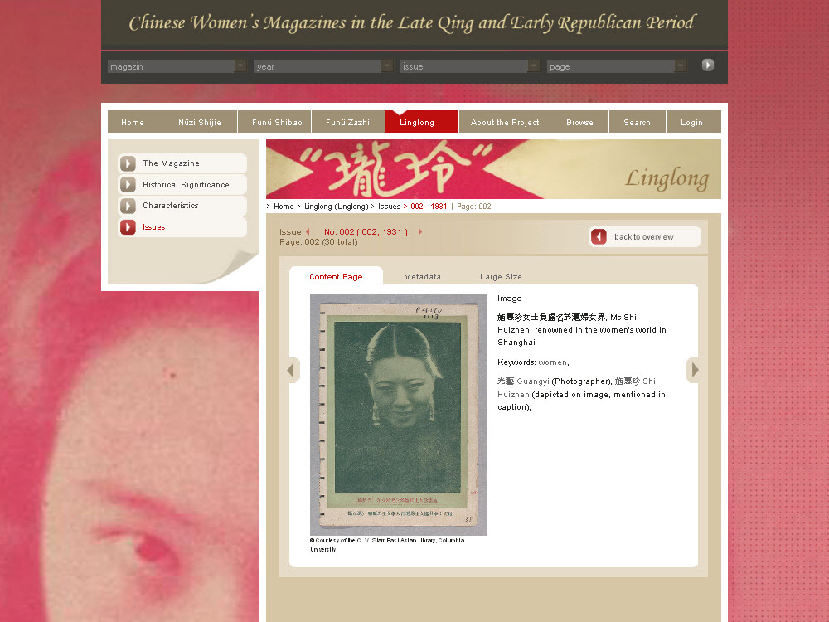
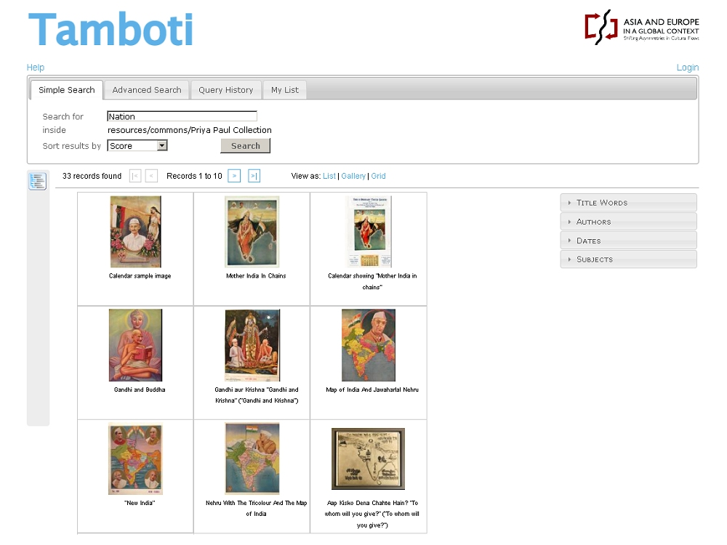
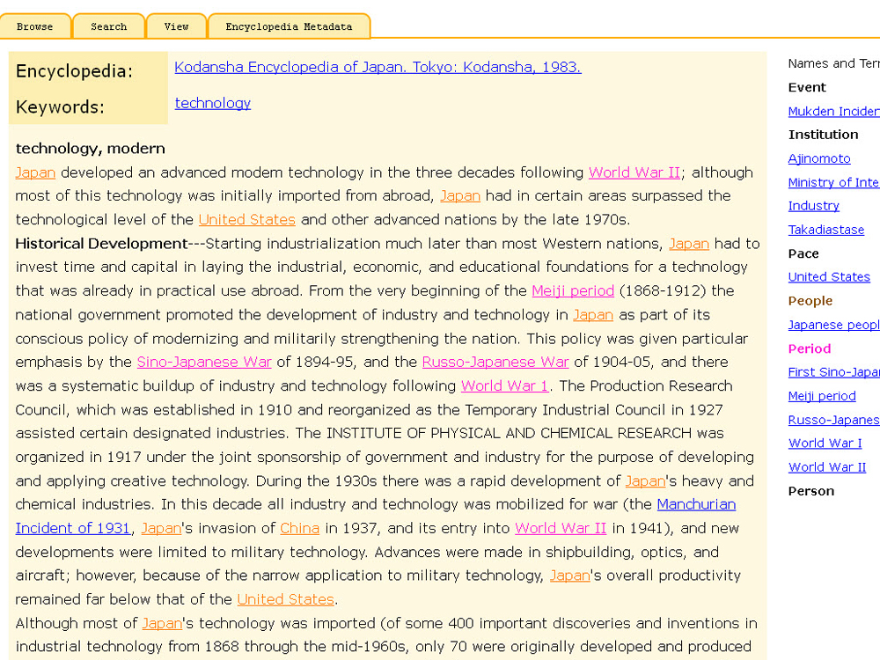
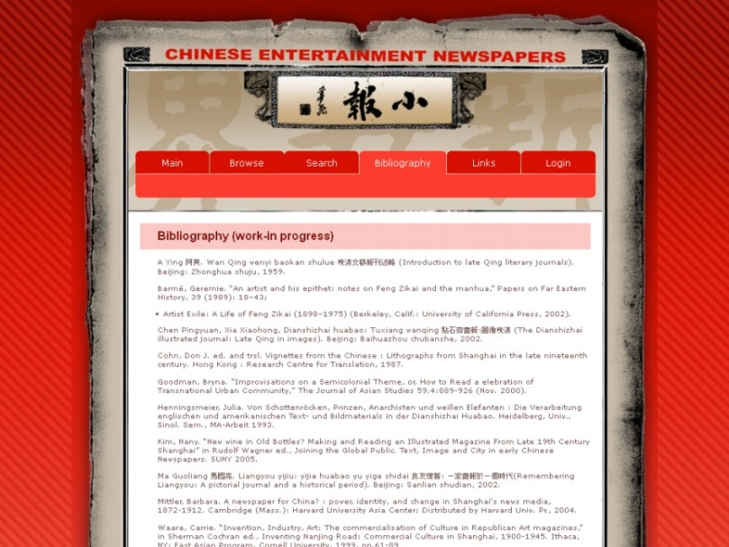
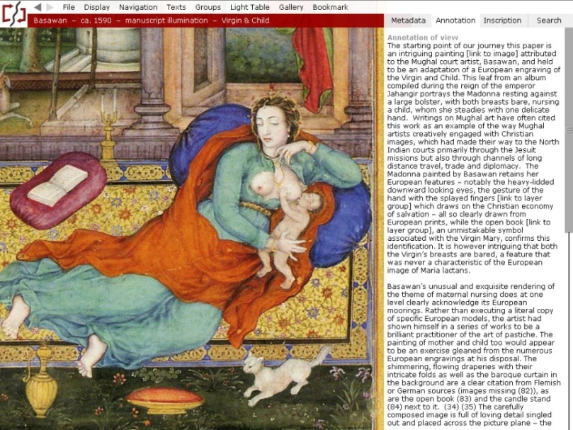
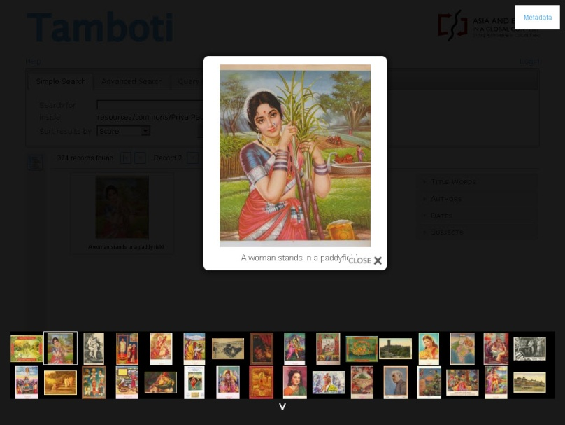
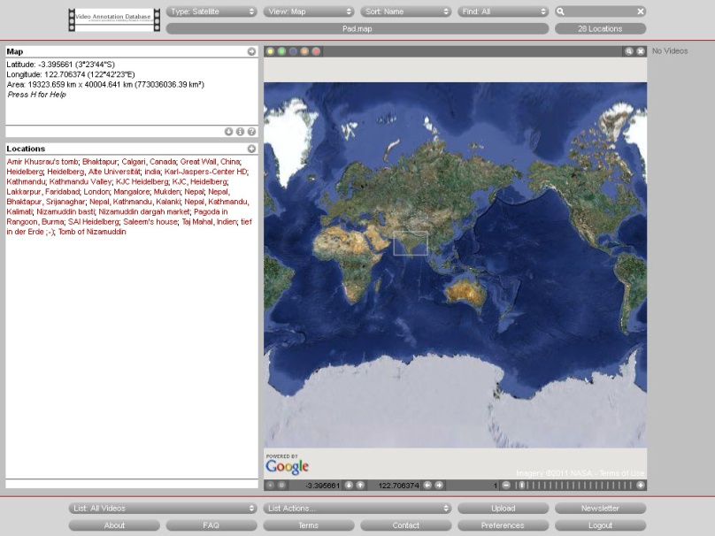
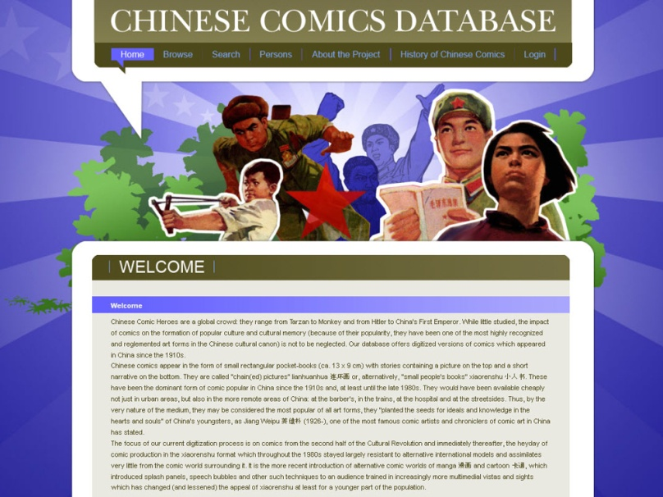
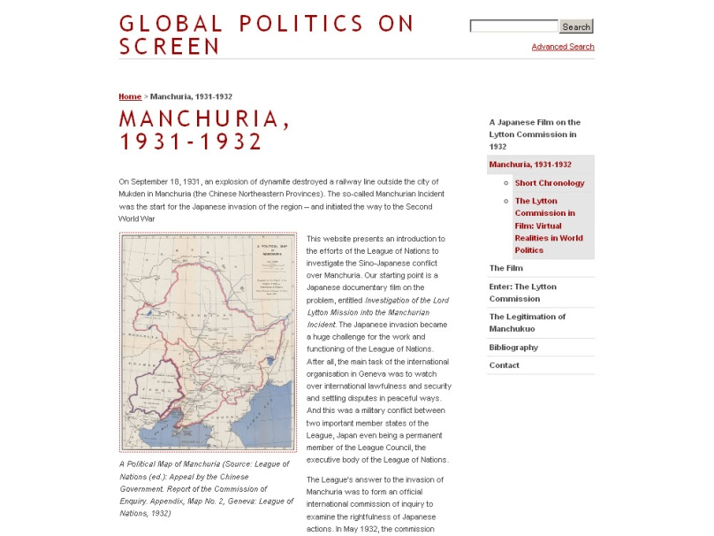
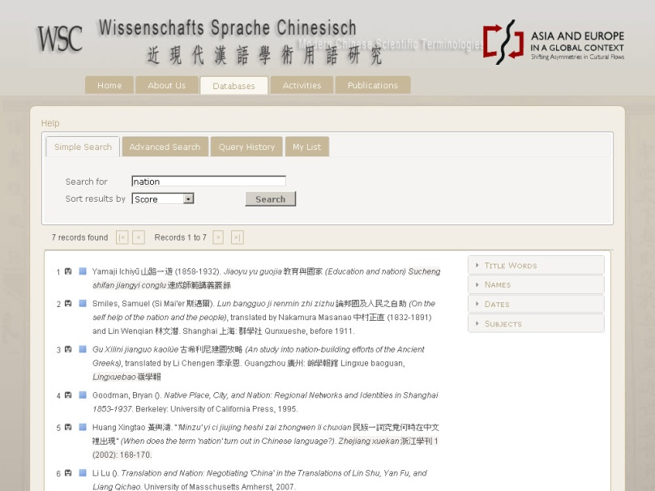
Heidelberg Research Architecture
Tamboti
Metadata Framework
Encyclopedia Database
Chinese Women’s Magazines
South Asian Popular Art

Slide 10
International Partner Network
Branch office at the “Heidelberg Centre South Asia” in New Delhi, India
Cooperations with institutions around the world, e.g. Chicago University, Oslo University, Zurich University, Jawaharlal Nehru University and Kyoto University

Slide 11
Thank you

