Slide 1
INTEGERS SYSTEM
Panatda noennil
Photakphittayakhom School

Slide 2
Topic
1. Integers
2. Opposites and absolute Value.
3. Comparing and ordering Integers.
4. Adding two positive integers and adding two negative integers.
5. Adding positive integers and negative integers.
6. Subtracting integers.
7. Subtracting two positive integer.
8. Subtracting two negative integer.
9. Subtracting positive integers and negative integers.

Slide 3
Topic
10. Multiplying two positive integers.
11. Multiplying two negative integer
12. Multiplying positive integers and negative integers.
13. Dividing two positive integers.
14. Dividing two negative integers.
15. Dividing positive integer and negative integer.
16. Order of Operations.
17. Properties of integers.
18. Properties of one and zero.
19. word problems.

Slide 4
Learning Objective
1. What is an integers.
2. To determine the position of an integer on a number line.
3. To understand the symbols >, ≥, <, ≤.
4. To add, subtract, multiply and division of positive and
negative integers.
5. To understand the properties of the four operation.
6. Solve word problems involving integers.

Slide 5
Key words
Integers จำนวนเต็ม Inequality sign เครื่องหมายไม่เท่ากัน
Multiplication การคูณ Smallest น้อยที่สุด
Less than น้อยกว่า Negative integers จำนวนเต็มลบ
Positive integerจำนวนเต็มบวก Zero ศูนย์
Positive number จำนวนบวก Positive direction ทิศทางบวก
Number line เส้นจำนวน Subtract(minus) การลบ
Division การหาร Product ผลลัพธ์
Positive sign เครื่องหมายบวก Addition การบวก
Negative number จำนวนลบ Operation การดำเนินการ

Slide 6
Integers
Integers are the set of positive numbers negative number and zero.
We can use a Number line to show integers as shown below.
-5 -4 -3 -2 -1 0 1 2 3 4 5
. . . negative integers positive integers . . .
zero
Positive integers are whole numbers that are greater than zero.
Example : 1, 2, 3, 4, . . .
Negative integers are whole numbers that are smaller than zero.
Example : -1, -2, -3, -4, . . .
Zero is an integer that is not positive or negative.

Slide 7
Integers
Negative numbers are numbers with the ‘negative sign’ ( - )
Positive numbers is a numbers with a ‘positive sign’ ( + ) or without any sign.
Example Name the integer represented by each point on the number line.
M N P Q
-6 -5 -4 -3 -2 -1 0 1 2 3 4 5 6
1. M -6 2. Q 5 3. P 1 4. N -4

Slide 8
Opposites
Opposite are two numbers that are the same distance from 0 on a number line but in opposite directions.
Example write the opposite of 3.
3 units 3 units
-4 -3 -2 -1 0 1 2 3 4
The opposite of 3 is -3.
-3 and 3 are each three units from 0

Slide 9
Opposites
Example
write the opposite of -5.
5 units 5 units
-5 -4 -3 -2 -1 0 1 2 3 4 5
The opposite of 5 is -5.
-5 and 5 are each five units from 0

Slide 10

Absolute value
The absolute value of a number is its distance from 0 on a number line.
The symbol for the absolute value of a number n is $\left|n\right|$. Opposite
numbers have the same absolute value.
Example
Find $\left|−4\right|$ and $\left|2\right|$
4 units 2 units
-5 -4 -3 -2 -1 0 1 2 3 4 5
Since -4 is four units from 0, $\left|−4\right|$ = 4. Since 2 is two units from 0, $\left|2\right|$ = 2.

Slide 11

Absolute value
Example Find $\left|−1\right|$
1 units
-5 -4 -3 -2 -1 0 1 2 3 4 5
Since -1 is one units from 0, $\left|−1\right|$ = 1.
Example Find $\left|7\right|$
7 units
-2 -1 0 1 2 3 4 5 6 7 8
Since 7 is seven units from 0, $\left|7\right|$ = 7.

Slide 12
Comparing Integers
You can use a number line to compare integers.
Any number on the right of the zero is greater than any number on the
left of the zero
-5 -4 -3 -2 -1 0 1 2 3 4 5
Example : 5 is greater than -2 and we show it by writing 5 > -2
We can also write -2 is smaller than 5 by writing -2 < 5
>, < ,≤, ≥ are called INEQUALITY SIGNS.
> Mean ‘ is greater than’ , < mean ‘is smaller than’
≥ Mean ‘ is greater than or equal to’ , ≤ mean ‘is smaller than or equal to’

Slide 13
Comparing Integers
Example Comparing Integers
1) Compare -6 and -4
-8 -6 -4 0 2 4
Since -6 is to the left of -4 on the number line, -6 < -4, or -4 > -6.
2) Compare -5 and 3
-8 -7 -6 -5 -4 -3 -1 0 1 2 3
Since -5 is to the left of 3 on the number line, -5 < 3, or 3 > -5.

Slide 14
Ordering Integers
Example
Order -2, 3, and -6 from least to greatest.
Put the integers
-7 -6 -5 -4 -3 -2 -1 0 1 2 3 on the same
The numbers from left to right are -6, -2, and 3. number line.
Example
Order -5, 0, and 4 from least to greatest.
Put the integers
-6 -5 -4 -3 -2 -1 0 1 2 3 4 on the same
The numbers from left to right are -5, 0, and 4. number line.

Slide 15
Adding two positive integers and adding two negative integers
Example Add the following : 2 + 3 = 5
We can show the above addition with the help of a number line.
Move 3 steps to the right ‘(3)’
Start from here ‘2’ answer
-4 -3 -2 -1 0 1 2 3 4 5 6
Example Add the following : 2 + 5 = 7
We can show the above addition with the help of a number line.
Move 5 steps to the right ‘5’
Start from here ‘2’ answer
-2 -1 -0 1 2 3 4 5 6 7 8

Slide 16
Adding two positive integers and adding two negative integers
Example Add the following : (-2) + (-3) = (-5)
We can show the above addition with the help of a number line.
Move 3 steps to the left ‘(-3)’
answer Start from here ‘-2’
-9 -8 -7 -6 -5 -4 -3 -2 -1 0 1
Example Add the following : (-2) + (-5) = (-7)
We can show the above addition with the help of a number line.
Move 5 steps to the left ‘-5’
answer Start from here ‘-2’
-11 -10 -9 -8 -7 -6 -5 -4 -3 -2 -1

Slide 17
Adding positive integers and negative integers
Example Add the following : 2 + (-4) = -2
We can show the above addition with the help of a number line.
Move 4 steps to the left ‘(-4)’ -4
answer Start from here ‘2’
-7 -6 -5 -4 -3 -2 -1 0 1 2 3
Example Add the following : 1 + (-4) = -3
We can show the above addition with the help of a number line.
Move 4 steps to the left ‘(-4)’
answer Start from here ‘1’
-6 -5 -4 -3 -2 -1 0 1 2 3 4

Slide 18
Adding positive integers and negative integers
Example Add the following : 6 + (-4) = 2
We can show the above addition with the help of a number line.
answer Start from here ‘6’
-4 -3 -2 -1 0 1 2 3 4 5 6
Example Add the following : 1 + (-4) + (-2) = -5
We can show the above addition with the help of a number line.
answer Start from here ‘1’
-6 -5 -4 -3 -2 -1 0 1 2 3 4

Slide 19
Concepts Adding integers
Same Signs The sum of two positive integers is positive. The sum of two negative integers is negative
Example 2 + 6 = 8 -2 + (-6) = -8
Different Signs Find the absolute value of each integer. Then subtract the lesser absolute value from the greater. The sum has the sign of the integer with the greater absolute value.
Example 3 + (-7) = -4 -3 + 7 = 4

Slide 20
Subtracting integers
To subtract an integer, add its opposite.
Arithmetic Algebra
5 – 7 = 5 + (-7) a – b = a + (-b)
5 – (-7) = 5 + 7 a – (-b) = a + b
-5 -7 = (-5) + (-7) -a – b = (-a) + (-b)
Example
Simplify the expression 12 – (-15)
12 – (-15) = 12 + 15 Add the opposite of -15, which 15.
= 27 Simplify.

Slide 21
Subtracting integers
Example Simplify each expression.
1. (-7) – (-12)
-7 – (-12) = (-7) + 12 Add the opposite of -12, which 12.
= 5 Simplify.
2. (-8) -10
-8 – 10 = (-8) + (-10) Add the opposite of 10, which -10.
= -18 Simplify.
3. 9 - 15
9 - 15 = 9 + (-15) Add the opposite of 15, which -15.
= -6 Simplify.

Slide 22
Subtracting two positive integers
Example Subtract the following : 4 - 7 = -3
We can show the above Subtraction with the help of a number line.
Move 7 steps to the left ‘(-7)’
answer Start from here ‘4’
-5 -4 -3 -2 -1 0 1 2 3 4 5
Example Subtract the following : 2 - 5 = -3
We can show the above Subtraction with the help of a number line.
Move 5 steps to the left ‘5’
answer Start from here ‘2’
-7 -6 -5 -4 -3 -2 -1 0 1 2 3

Slide 23
Subtracting two negative integers
Example Subtract the following : (-4) - (-3) = (-4) + 3 = -1
We can show the above addition with the help of a number line.
Move 3 steps to the right ‘(3)’
Start from here ‘-4’ answer
-9 -8 -7 -6 -5 -4 -3 -2 -1 0 1
Example Subtract the following : (-2) - (-5) = (-2) + 5 = 3
We can show the above addition with the help of a number line.
Move 5 steps to the right ‘5’
Start from here ‘-2’ answer
-6 -5 -4 -3 -2 -1 0 1 2 3 4

Slide 24
Subtracting positive integers and negative integers
Example Add the following : 2 - (-4) = 2 + 4 = 6
We can show the above addition with the help of a number line.
Move 4 steps to the right‘4’
Start from here ‘2’ answer
-3 -2 -1 0 1 2 3 4 5 6 7
Example Add the following : 5 - (-4) = 5 + 4 = 9
We can show the above addition with the help of a number line.
Move 4 steps to the right ‘4’
Start from here ‘5’ answer
1 2 3 4 5 6 7 8 9 10 11 12

Slide 25
Subtracting positive integers and negative integers
Example Add the following : -6 – 4 = (-6) + (-4) = -10
We can show the above addition with the help of a number line.
Move 4 steps to the left ‘(-4)’
answer Start from here ‘-6’
-11 -10 -9 -8 -7 -6 -5 -4 -3 -2 -1
Example Add the following : -1 - 4 = (-1) + (-4) = -5
We can show the above addition with the help of a number line.
Move 4 steps to the left ‘(-4)’
answer Start from here ‘-1’
-8 -7 -6 -5 -4 -3 -2 -1 0 1 2

Slide 26
Multiplying two positive integers
The multiplication of integer can be represented as repeated addition.
For example, evaluate
1. 2 × 5 = 5 + 5 = 10 mean 2 group of 5
2. 3 × 4 = 4 + 4 + 4 = 12 mean 3 group of 4
3. 9 × 5 = 9 + 9 + 9 + 9 + 9 = 45 mean 5 group of 9
4. 12 × 4 = 12 + 12 + 12 + 12 = 48 mean 4 group of 12
5. 6 × 5 = 6 + 6 + 6 + 6 + 6 = 30 mean 5 group of 6
Rules for multiplication of two positive integers.
(+) × (+) = (+) The product of two positive integers is a positive integer.

Slide 27
Multiplying two negative integers
You can use a number line to multiply integers . Always start at 0.
3 × 2 means three groups of 2 each : 3 × 2 = 6.
Start from here ‘0’ answer
+2 +2 +2
-6 -5 -4 -3 -2 -1 0 1 2 3 4 5 6

Slide 28
Multiplying two negative integers
You can think of -3 × (-2) as the opposite of three groups of -2 each .
Since 3 × (-2) = -6, -3 × (-2) = 6
Example1. (-2) × (-3) = -[ 2 × (-3)]
= -(-6)
= 6
2. (-5) × (-4) = -[ 5 × (-4)]
= -(-20)
= 20
Rules for multiplication of two negative integers.
(-) × (-) = (+) The product of two negative integers is a positive integer.

Slide 29
Multiplying two negative integers
You can use a number line to multiply integers . Always start at 0.
You can think of -3 × (-2) as the opposite of three groups of -2 each .
Since 3 × (-2) = -6, -3 × (-2) = 6
answer
-2 -2 -2
-6 -5 -4 -3 -2 -1 0 1 2 3 4 5 6

Slide 30
Multiplying positive integer and negative integers
The multiplication of integer can be represented as repeated addition.
For example, evaluate
1. (-2) × 3 = (-2) + (-2) + (-2) = -6 mean 3 group of (-2)
2. 3 × (-4) = (-4) + (-4) + (-4) = -12 mean 3 group of (-4)
3. (-8) × 4 = (-8) + (-8) + (-8) + (-8) = -32 mean 4 group of (-8)
4. 2 × (-7) = (-7) + (-7) = -14 mean 2 group of (-7)
5. (-6) × 4 = (-6) + (-6) + (-6) + (-6) = -24 mean 4 group of (-6)
Rules for multiplication of a positive and negative integers.
(+) × (-) = (-) and (-) × (+) = (-)
The product of a positive and negative integers is a negative integer

Slide 31
Multiplying two negative integers
You can use a number line to multiply integers . Always start at 0.
3 × (-2) means three groups of -2 each : 3 × (-2) = -6
answer
-2 -2 -2
-6 -5 -4 -3 -2 -1 0 1 2 3 4 5 6

Slide 32
Concepts Multiplying integers
The product of two integers with the same signs is positive.
The product of two integers with different signs is negative.
Examples: 4 × 5 = 20
-4 × (-5) = 20
4 × (-5) = -20
-4 × 5 = -20

Slide 33
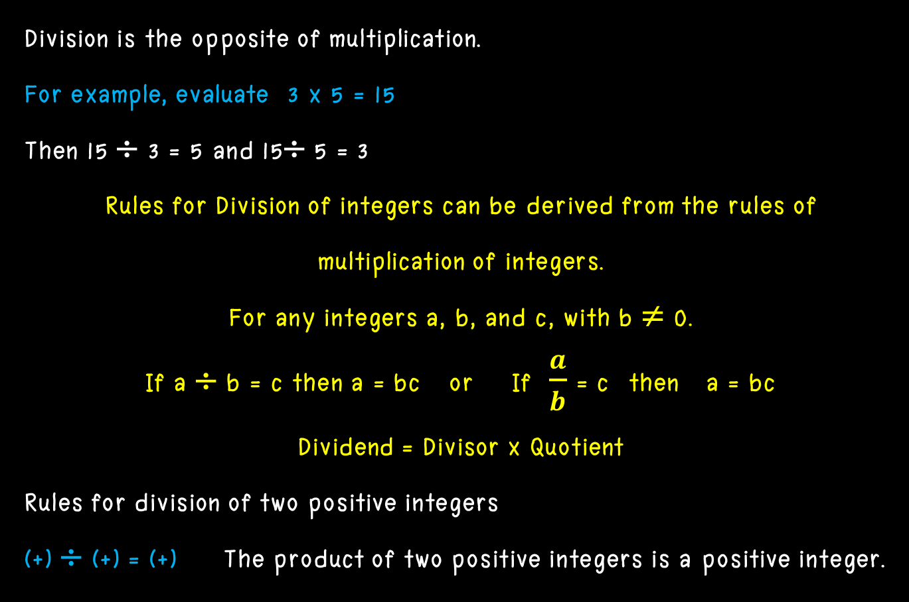
Dividing two positive integers
Division is the opposite of multiplication.
For example, evaluate 3 x 5 = 15
Then 15 ÷ 3 = 5 and 15÷ 5 = 3
Rules for Division of integers can be derived from the rules of
multiplication of integers.
For any integers a, b, and c, with b ≠ 0.
If a ÷ b = c then a = bc or If $\frac{a}{b}$ = c then a = bc
Dividend = Divisor x Quotient
Rules for division of two positive integers
(+) ÷ (+) = (+) The product of two positive integers is a positive integer.

Slide 34
Dividing two negative integers
For example, evaluate
1. (-12) ÷ (-3) = 4
2. (-25) ÷ (-5) = 5
3. (-72) ÷ (-9) = 8
4. (-45) ÷ (-9) = 5
5. (-144) ÷ (-3) = 48
Rules for division of two negative integers.
(-) ÷ (-) = (+) The product of two negative integers is a positive integer.

Slide 35
Dividing positive integer and negative integers
For example, evaluate
1. (-12) ÷ 3 = -4
2. 70 ÷ (-7) = -10
3. (-18) ÷ 2 = -9
4. 25 ÷ (-5) = -4
5. (-65) ÷ 5 = -13
Rules for division of a positive and negative integers.
(+) ÷ (-) = (-) and (-) ÷ (+) = (-)
The product of a positive and negative integers is a negative integer.

Slide 36
Concepts Multiplying integers
The quotient of two integers with the same signs is positive.
The quotient of two integers with different signs is negative.
Examples: 20 ÷ 4 = 5
-20 ÷ (-4) = 5
20 ÷ (-4) = -5
-20 ÷ 4 = -5

Slide 37
Order of Operations
The order in which we perform operation in an expression is shown below.
1. If an expression contains brackets ( ), simplify the expression within the brackets first.
Example 15 – (18 – 5) = 15 – 13
= 2
2. If there are more than one pair of brackets, simplify the innermost pair of brackets first.
Example 7 + [11 –( 2 + 6)] = 7 + (11 – 8)
= 7 + 3
= 10

Slide 38
Order of Operations
3. If an expression contains only addition and subtraction, work from left to right.
Example 6 + 8 - 5 = 14 – 5
= 9
4. If an expression contains only multiplication and division, work from left to right.
Example 35 ÷ 7 × 4 = 5 × 4
= 20

Slide 39
Order of Operationsgers
5. If an expression contains all the four operation, perform multiplication or division before addition or subtraction.
Example 10 + 2 × 3 – 8 ÷ 4 = 10 + 6 - 2
= 16 – 2
= 14
The rules for order of operations on integers are the same for whole number
- When there is more than one pairs of brackets, always work within the innermost brackets first and work outward.
- Always start working from the left to the right. If multiplication come first (do it first) then follow by division before working on addition or subtraction.

Slide 40
Properties of integers
1. Commutative Law
What is Commutative Law?
Commutative law must always obeys when performing addition addition and multiplication of integers
Commutative Law of Addition of integers:
a + b = b + a Example 1 : 3 + 5 = 8 and 5 + 3 = 8
Therefore, 3 + 5 = 5 + 3
Example 2 : 3 + (-10) = -7 and (-10) + 3 = -7
Therefore, 3 + (-10) = (-10) + 3

Slide 41
Properties of integers
Commutative Law of Multiplication of integers:
a × b = b × a Example 1 : 3 × 5 = 15 and 5 × 3 = 15
Therefore, 3 × 5 = 5 × 3
Example 2 : 3 × (-10) = -30 and (-10) × 3 = -30
Therefore, 3 × (-10) = (-10) × 3

Slide 42
Properties of integers
2. Associative Law
What is Associative Law?
Associative law must always obeys when performing addition addition and multiplication of integers.
Associative Law of Addition of integers:
(a + b) + c = a + (b + c)
Example 1 : (3 + 5) + 2 = 10 and 3 + (5 + 2) = 10
Therefore, (3 + 5) + 2 = 3 + (5 + 2)
Example 2 : [3 + (-10)] + 2 = -5 and 3 + [(-10) + 2] = -5 Therefore, [3 + (-10)] + 2 = 3 + [(-10) + 2]

Slide 43
Properties of integers
Associative Law of Multiplication of integers:
(a × b) × c = a × (b × c)
Example 1 : (3 × 5) × 2 = 30 and 3 × (5 × 2) = 30
Therefore, (3 × 5) × 2 = 3 × (5 × 2)
Example 2 : [3 × (-10)] × 2 = -60 and 3 × [(-10) × 2] = -60 Therefore, [3 × (-10)] × 2 = 3 × [(-10) × 2]

Slide 44
Properties of integers
3. Distributive Law
What is Distributive Law?
Distributive law must always obeys when performing multiplication of integers over addition and subtraction.
Distributive Law of Multiplication over Addition of integers:
a × (b +c) = (a × b) + (a × c)
Example 1 : 3 × (5 + 2) = 21 and (3 × 5) + (3 × 2) = 21
Therefore, 3 × (5 + 2) = (3 × 5) + (3 × 2)
Example 2 : 3 × [(-10) + 2] = -24 and [3 × (-10)] + [(3 × 2)] = -24 Therefore, 3 × [(-10) + 2] = [3 × (-10)] + [(3 × 2)]

Slide 45
Properties of integers
Distributive Law of Multiplication over Subtraction of integers:
a × (b - c) = (a × b) - (a × c)
Example 1 : 3 × (5 - 2) = 9 and (3 × 5) - (3 × 2) = 9
Therefore, 3 × (5 - 2) = (3 × 5) - (3 × 2)
Example 2 : 3 × [(-10) - 2] = -36 and [3 × (-10)] - [(3 × 2)] = -36 Therefore, 3 × [(-10) - 2] = [3 × (-10)] - [(3 × 2)]

Slide 46
Properties of one
1. Multiplying any number With one or any number multiplied by one. The product will be equal to that amount.
Example
a. 7 × 1 = 1 × 7 = 7
b. (-5) × 1 = 1 × (-5) = -5
c. 11 × 1 = 1 × 11 = 11
d. (-6) × 1 = 1 × (-6) = -6
For any number a.
a × 1 = 1 × a = a

Slide 47

Properties of one
2. Dividing any number With one or any number divided by one. Quotient will be equal to that amount.
Example
a. $\frac{27}{1}$ = 27
b. $\frac{−31}{1}$ = -31
For any number a.
$\frac{a}{1}$ = a

Slide 48
Properties of zero
1. Adding any number With zero or any number added by zero. The product will be equal to that amount.
Example
a. 7 + 0 = 0 + 7 = 7
b. (-5) + 0 = 0 + (-5) = -5
c. 0 + 0 = 0
For any number a.
a + 0 = 0 + a = a

Slide 49
Properties of zero
2. Multiplying any number With zero or any number multiplied by zero. The product will be equal to zero.
Example
a. 7 × 0 = 0 × 7 = 0
b. 11 × 0 = 0 × 11 = 0
c. (-24) × 0 = 0 × (-24) = 0
d. 0 × 0 = 0
For any number a.
a × 0 = 0 × a = a

Slide 50

Properties of zero
3. Dividing any number by zero. Non-zero. Quotient will be equal to zero.
Example
a. $\frac{0}{25}$ = 0
b. $\frac{0}{−9}$ = 0
For any number a of Non-zero
$\frac{0}{a}$ = 0
Note: In mathematics, we don’t use 0 as the divisor, that is.
For any number a.
$\frac{a}{0}$ No mathematical definition.

Slide 51
Properties of zero
4. If the product of two numbers is equal to zero. Any number of at least one number must be zero.
Example
a. 0 = 0 × 5
b. 0 = 11 × 0
c. 0 = (-24) × 0
d. 0 =0 × 0
For any integers a, b
If a × b =0 then a = 0 or b = 0

Slide 52

Word Problems
Example
1. The temperature in Caribou, Maine, was 8 $℃$ at noon. By 10.00 P.M. the temperature had dropped to -4 $℃$. Find the change in the temperatures.
Solution
8 – (-4) Subtract to find the difference.
8 + 4 Add the opposite of -4, which is 4.
12
The change in the temperatures in 12 $℃$

Slide 53

Word Problems
Example
2. The temperature of a chicken is -12 $℃$ when it is just removed from the freezer. The temperature then rises by 16 $℃$ after half an hour. After that the temperature of the chicken decreases by 8 $℃$ when it is placed in the freezer again. Find the final temperature of the chicken.
Solution
Let the increase in temperature be denoted by positive integer and a decrease in temperature be denoted by a negative integer.
Final temperature = [(-12) + 16 + (-8)] $℃$
= [-12 + 16 – 8] $℃$
= -4 $℃$

Slide 54
Word Problems
Example
3. A skydiver falls 56 meters each second. The skydiver waits 8 seconds before opening her parachute. Use an integer to express the change in the skydiver’s elevation?
Solution
(-56) × 8 = -448 Use a negative number to represent falling.
The integer -448 expresses the change in the skydiver’s elevation.

Slide 55

Word Problems
Example
4. A hider descends 360 feet in 40 minutes. What is the hider’s change in elevation per minute?
Solution
Let -360 represent a descent of 360 feet. Then divide the descent by the number of minutes to find the change in elevation per minute.
$\frac{feet}{minutes}$ $\frac{−360}{40}$ = -9 different signs, negative quotient
The change in elevation is -9 ft/min so the answer in A.

Slide 56
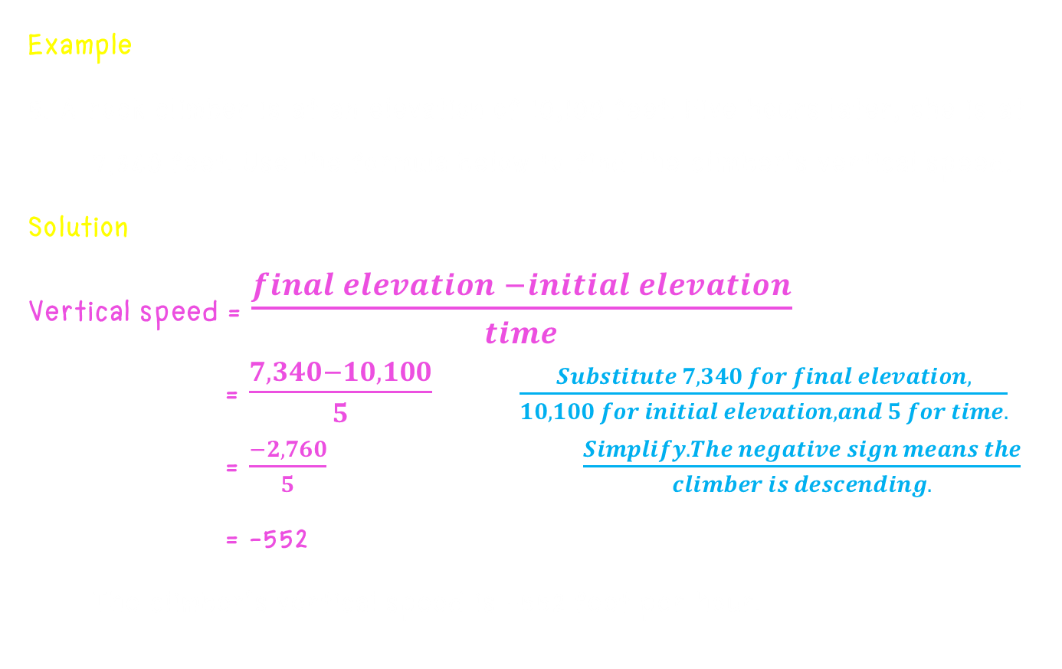
Word Problems
Example
5. A rock climber is at an elevation of 10,100 feet. Five hours later, she is at 7,340 feet. Use the formula below to find the climber’s vertical speed.
Solution
Vertical speed = $\frac{final elevation −initial elevation}{time}$
= $\frac{7,340−10,100}{5}$ $\frac{Substitute 7,340 for final elevation,}{10,100 for initial elevation, and 5 for time.}$
= $\frac{−2,760}{5} \frac{Simplify. The negative sign means the}{climber is descending.}$
= -552
The climber’s vertical speed is -552 feet per hour.

Slide 57
Summary
1. Integer can be shown on a number line, Where it can be a positive or
negative integers and including zero.(Example, .. -4, -3, -2, -1, 0, 1, 2, 3, 4, .. )
2. A > B means that A is greater than B.
3. A < B means that A is less than B.
4 A ≥ B means that A is greater than or equal B.
5. A ≤ B means that A is less than or equal B.
6. A < x < B means that x is greater than A but less than B.
7. A ≤ x < B means that x is greater than or equal to A but less than B.
8. A ≤ x < B means that x is greater than A but less than or equal to B.
9. A ≤ x ≤ B means that x is greater than or equal to A but less than or equal to B.

Slide 58
Summary
10. Addition of Integers :
i) For any two negative integers –x and –y
-x + (-y) = - (x + y)
ii) For a positive integer x and a negative integer (–y)
x + (-y) = x – y if x > y and x + (-y) = -(y × x) if y > x
11. Subtraction of Integer :
i) For any two integers A and B, A – B = A + (-B)

Slide 59
Summary
12. Multiplication of Integers : For any two positive integers x and y
i) x × (-y) = -(x × y) and (-x) × y = -(x × y)
ii) x × y = +(x × y) and (-x) × (-y) = +(x × y)
13. Division of Integers : For any two positive integers x and y
i) 0 ÷ x = 0 and 0 ÷ (-x) = 0
i) x ÷ (-y) = -(x ÷ y) and (-x) ÷ y = -(x ÷ y)
ii) x ÷ y = +(x ÷ y) and (-x) ÷ (-y) = +(x ÷ y)

Slide 60

จบการนำเสนอค่ะ

