Slide 1

Looking for learning in
21st century classrooms
A leaders guide to improving student learning and classroom instruction
Notes:
Looking for Learning in 21st Century Classrooms
A leadership guide to supporting and coaching best practice technology use across the curriculum. Administrators are given the charge to foster professional development of teachers through classroom observation, walk-through’s and overall supervision. In recent years, technology has changed significantly and the world has altered alongside that change. Education has begun the process of including technology, but finds variety in teacher expertise and practice.
What questions can supervisors ask of their teachers to best promote technology-use to improve learning? Here are some helpful guiding questions.
What to look for in classroom observations and visits:
Physical layout of the room
o Does the room layout hinder or support collaboration?
o Can students hide behind their laptops?
o Can the teacher easily walk around?
o Are power cords being managed effectively?
o Does the room layout promote student accountability?
What is the technology being used for?
o New way to do old things?
o Doing something that otherwise wouldn’t have been possible?
o Making tasks efficient to foster deeper understanding?
How is the classroom managed?
o What are the tasks that are engaging (or not engaging) students?
o How are students made accountable for their own learning?
o How are students kept on task?
o If students are using the internet for research, how are they being guided?
o Are they being pointed to the TYS online library? Why? Why Not?
If the projector is on does that mean the SMART board is being used?
o Is the teacher interacting with the SMART board? Why? / Why not?
o Are the students interacting with the SMART board? Why? Why not?
o How is the SMART board enhancing learning?
o If the SMART Board were removed could the same lesson have be taught?
Post-observations questions to ask teachers:
On use of technology:
In what ways did the technology enhance the learning?
What technology skills did you expect students to have in order to be successful?
o Did they have them? Did you teach them?
What technology skills did you expect students to acquire if successful?
o Did they get them? How did you know?
When student were searching the internet in your class, how were you able to assess their success?
o Did you frontload some searching techniques prior to their search?
o Did you provide them with the sites in advance?

Slide 2
Our classrooms are shifting from….

Slide 3
Traditional

Slide 4


Slide 5
21st century

Slide 6
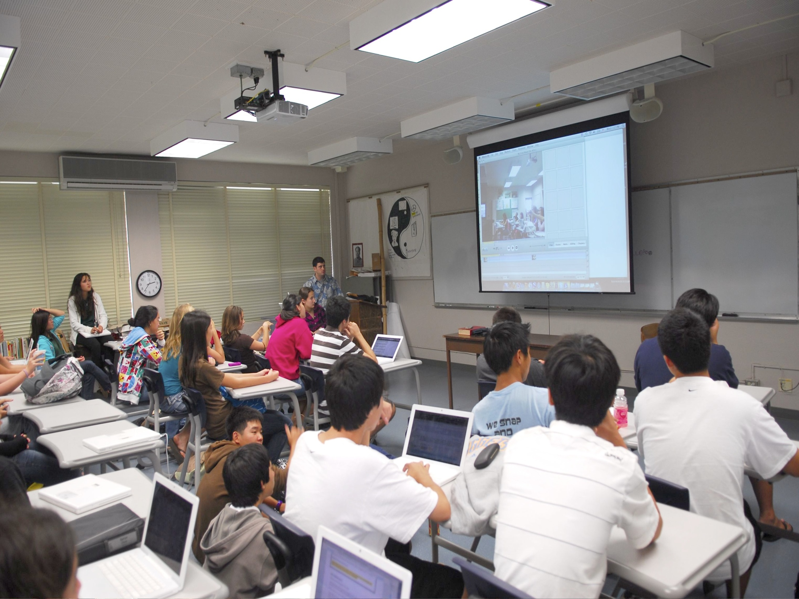

Slide 7

New tools are everywhere……..

Slide 8






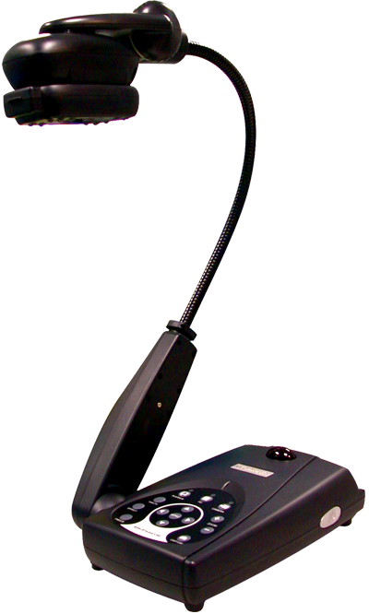










Slide 9
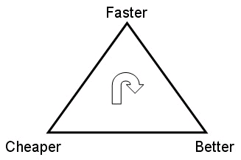
Technology……….

Slide 10

No signs of slowing

Slide 11

What does this mean for those responsible for……..

Slide 12
Teacher
Professional
Development
Instructional Standards
Teacher
Evaluation
Notes:
A leadership guide to supporting and coaching best practice technology use across the curriculum. Administrators are given the charge to foster professional development of teachers through classroom observation, walk-through’s and overall supervision. In recent years, technology has changed significantly and the world has altered alongside that change. Education has begun the process of including technology, but finds variety in teacher expertise and practice.
What questions can supervisors ask of their teachers to best promote technology-use to improve learning? Here are some helpful guiding questions.
What to look for in classroom observations and visits:

Slide 13

Technology is another lens.

Slide 14

You don’t have to be a tech expert
to ask the right questions

Slide 15
So

Slide 16

What should you be looking for when you go into classroom?

Slide 17

What questions can you be asking teachers and students?

Slide 18

What does best practice look like?

Slide 19


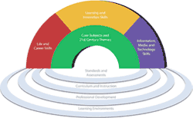


Slide 20
21st Century
Student
Collaboration
Communication
Creativity
Critical Thinking

Slide 21

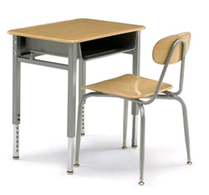
The Classroom
Pedagogy
Student Tools
Instructional Tools

Slide 22
The Classroom
Instruction
Student Tools
Instructional Tools

Slide 23
The Classroom
Management
Layout
Online/LMS

Slide 24
The Classroom
Management
Layout
Online/LMS

Slide 25
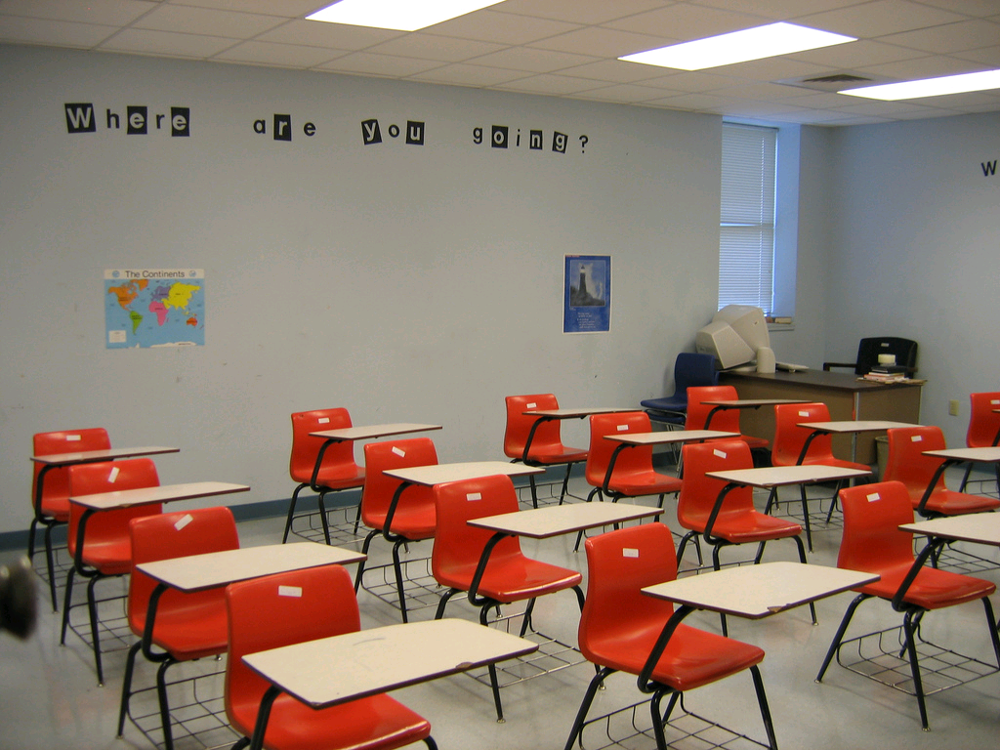
Does room layout hinder or support collaboration?

Slide 26

Can students hide behind their computers?

Slide 27

Can the teacher easily walk around?
Can teachers walk around easily?

Slide 28
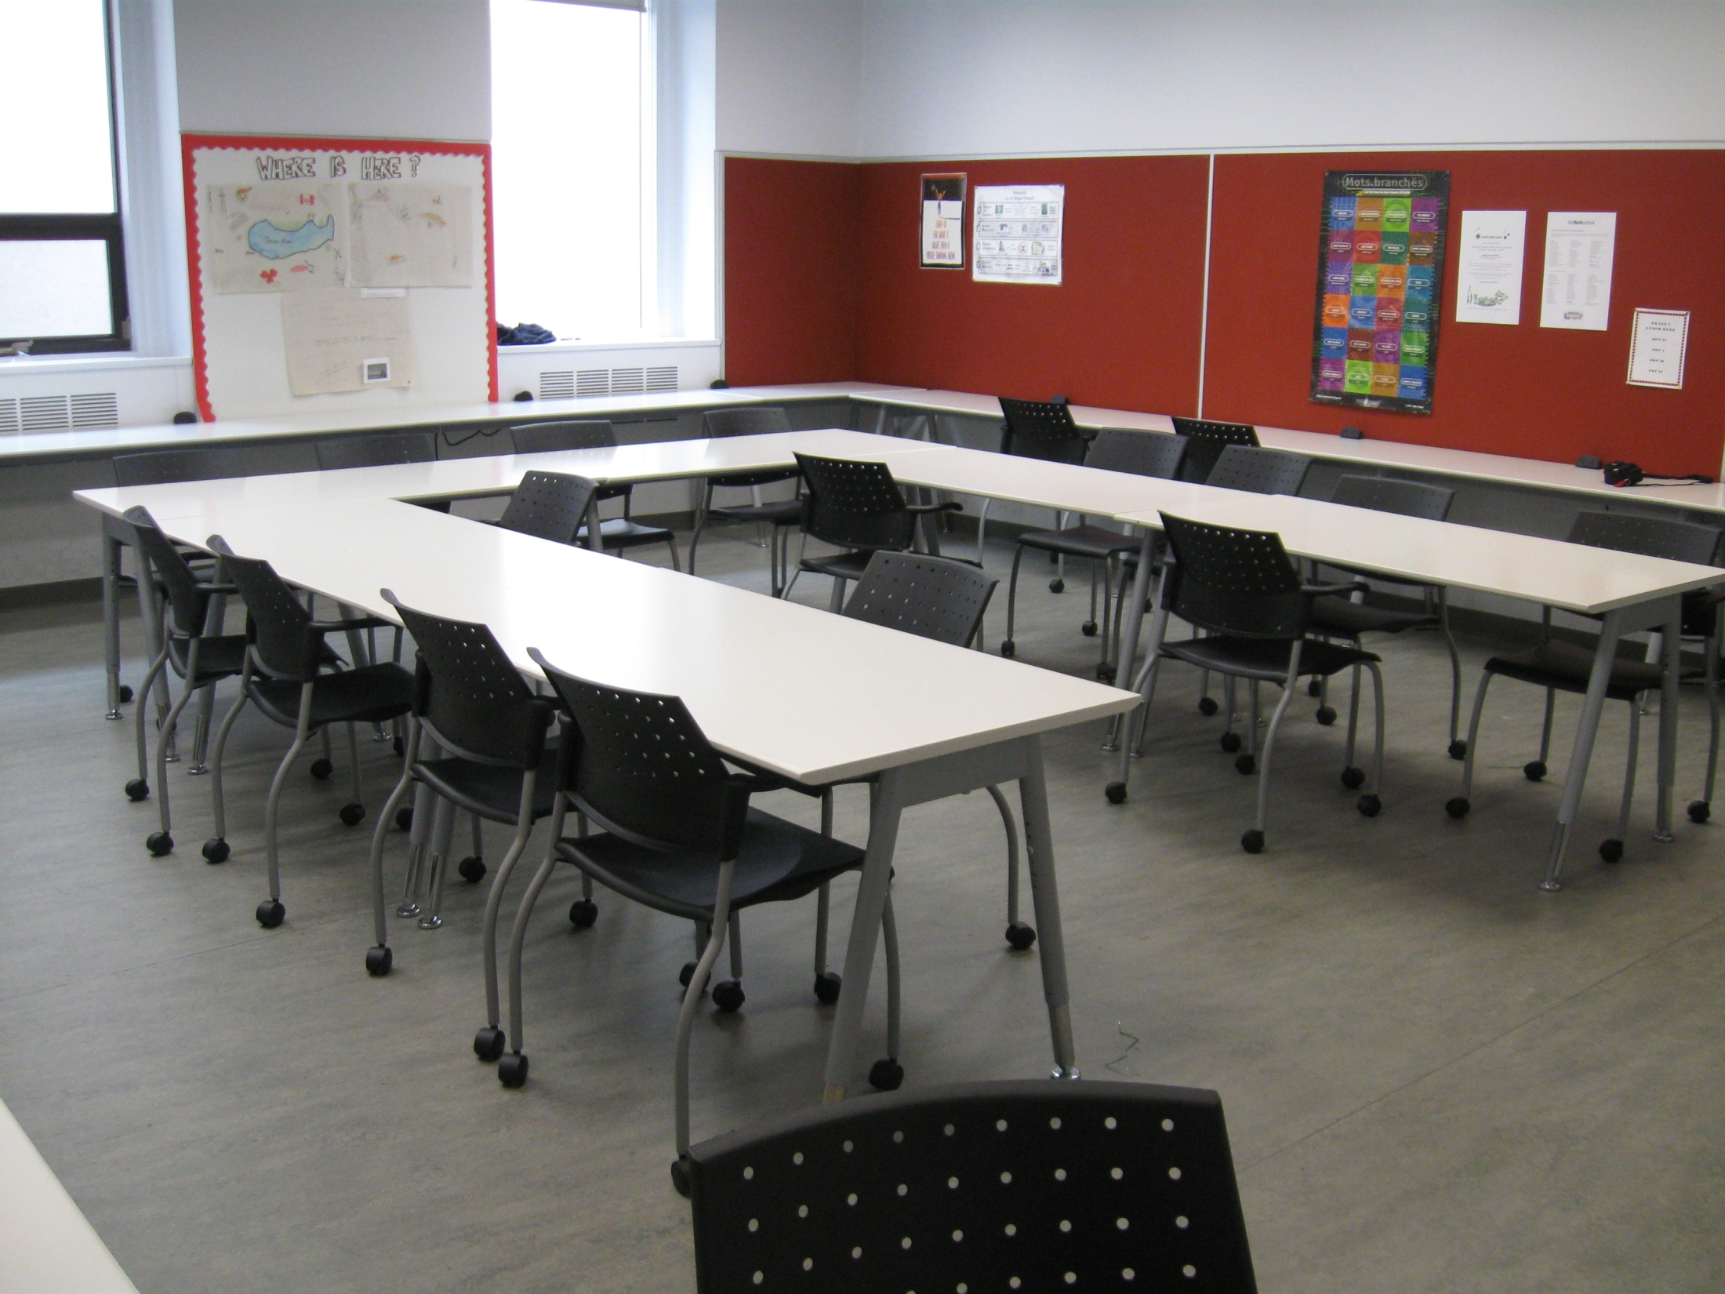
Does the room layout promote student accountability?

Slide 29
The Classroom
Management
Layout
Online/LMS

Slide 30

How are students made accountable for their own learning?

Slide 31

How are students kept on task?
How are students kept on task?

Slide 32

What are the tasks that are engaging (or not engaging) students?

Slide 33

What are the powerful practices you would like to see in all classes?

Slide 34
The Classroom
Management
Layout
Online/LMS

Slide 35
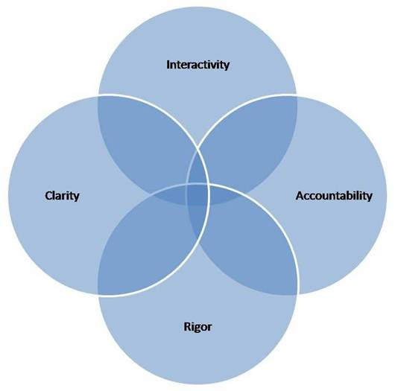
What are the elements of great blended learning?
Interactivity
Clarity
Accountability
Rigor
http://www.personal.psu.edu/scs15/idweb/blendedlearning.htm

Slide 36
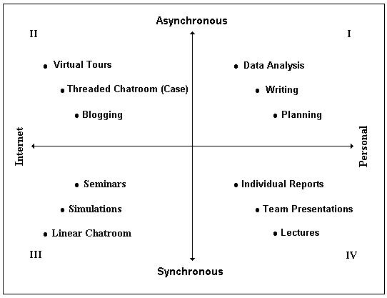

Slide 37
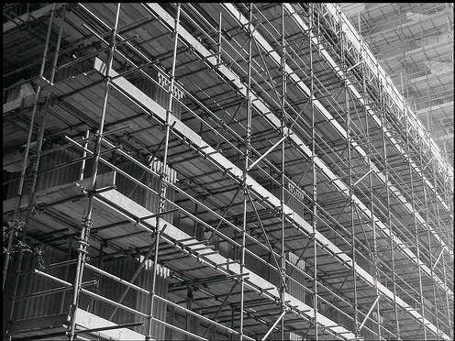
Good Scaffolding is vital!

Slide 38
The Classroom
Pedagogy
Student Tools
Instructional Tools

Slide 39

Are you getting the most out of your investment?

Slide 40
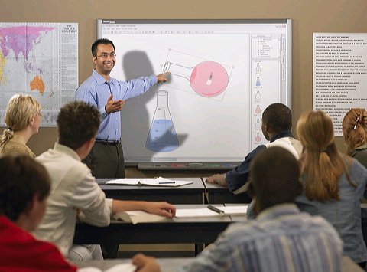
The projector is on but is the board being used?

Slide 41
Where is use focused?
Student Centered Use
Teacher Centered Use

Slide 42

Are its strengths as a tool for learning
being fully leveraged?

Slide 43

What are the barriers (if any) for use?

Slide 44
The Classroom
Pedagogy
Student Tools
Instructional Tools

Slide 45
21st Century
Student
Collaboration
Communication
Creativity
Critical Thinking

Slide 46
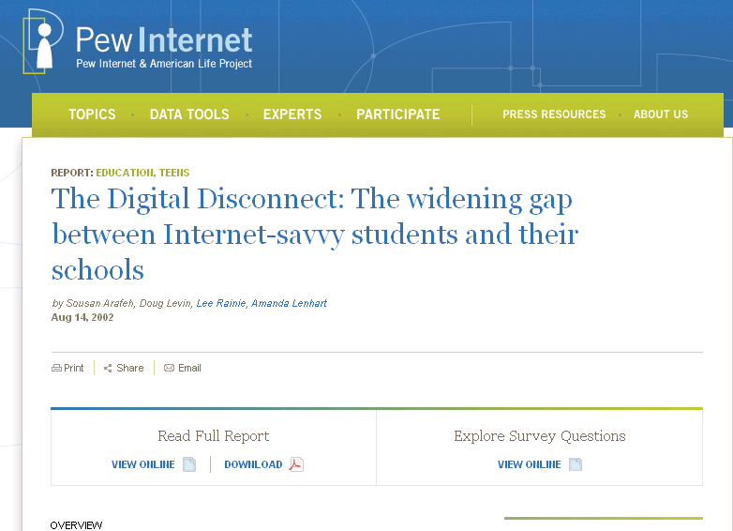

Slide 47
“This generation of student is expert in using new media to entertain themselves but knows very little about how to use it as a tool for learning.”
Michael Wesch

Slide 48

Who is teaching search?

Slide 49

If students are using the internet for research, how are they being guided?
o Are they being pointed to the TYS online library? Why? Why Not?
If students are using the internet for research, how are they being guided?
If students are using the internet for research how are they being guided?

Slide 50
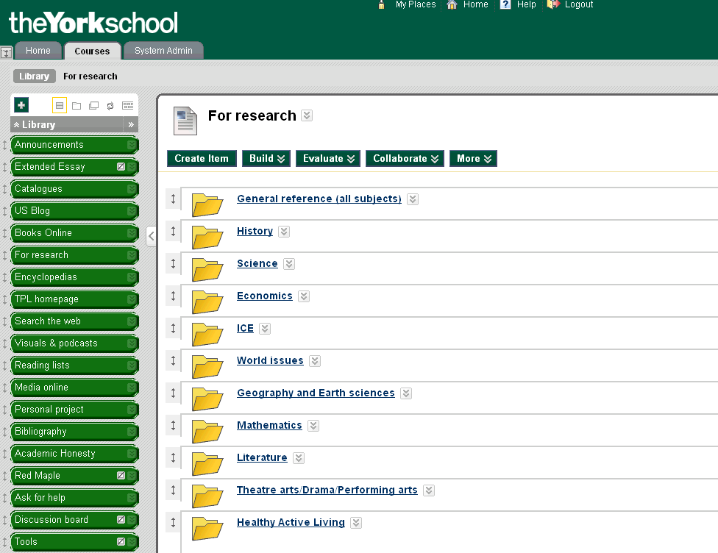
Are your paid databases being used by students ?

Slide 51

How are student being made accountable for the research process?

Slide 52
The Classroom
Pedagogy
Student Tools
Instructional Tools

Slide 53
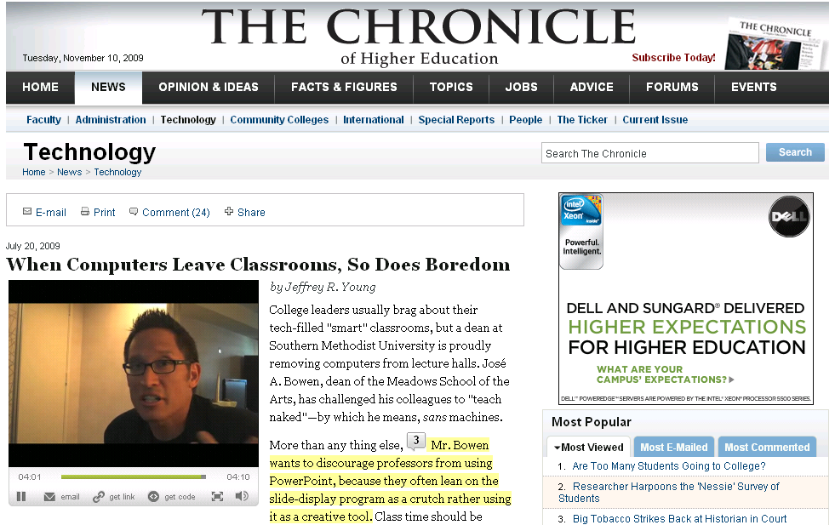
http://chronicle.com/article/Teach-Naked-Effort-Strips/47398/

Slide 54


Slide 55

Today’s best schools are measured by their ability to provide students with:

Slide 56
1) Differentiated Instruction
2) Dynamic Learning Environments
3) Unique opportunities to create, collaborate and communicate

Slide 57

How is technology being used in your school?
o New way to do old things?
o Doing something that otherwise wouldn’t have been possible?
o Making tasks easier in order to achieve deeper understanding?

Slide 58
Slides posted and feedback appreciated @
http://blogs.yorkschool.com/tystechsessions/
and
http://medagogy.edublogs.org/

Slide 59

Justin Medved
Technology and Learning Specialist
The York School
Bookmarks: http://www.diigo.com/user/jmedved
Twitter: http://twitter.com/jmedved

