Slide 1
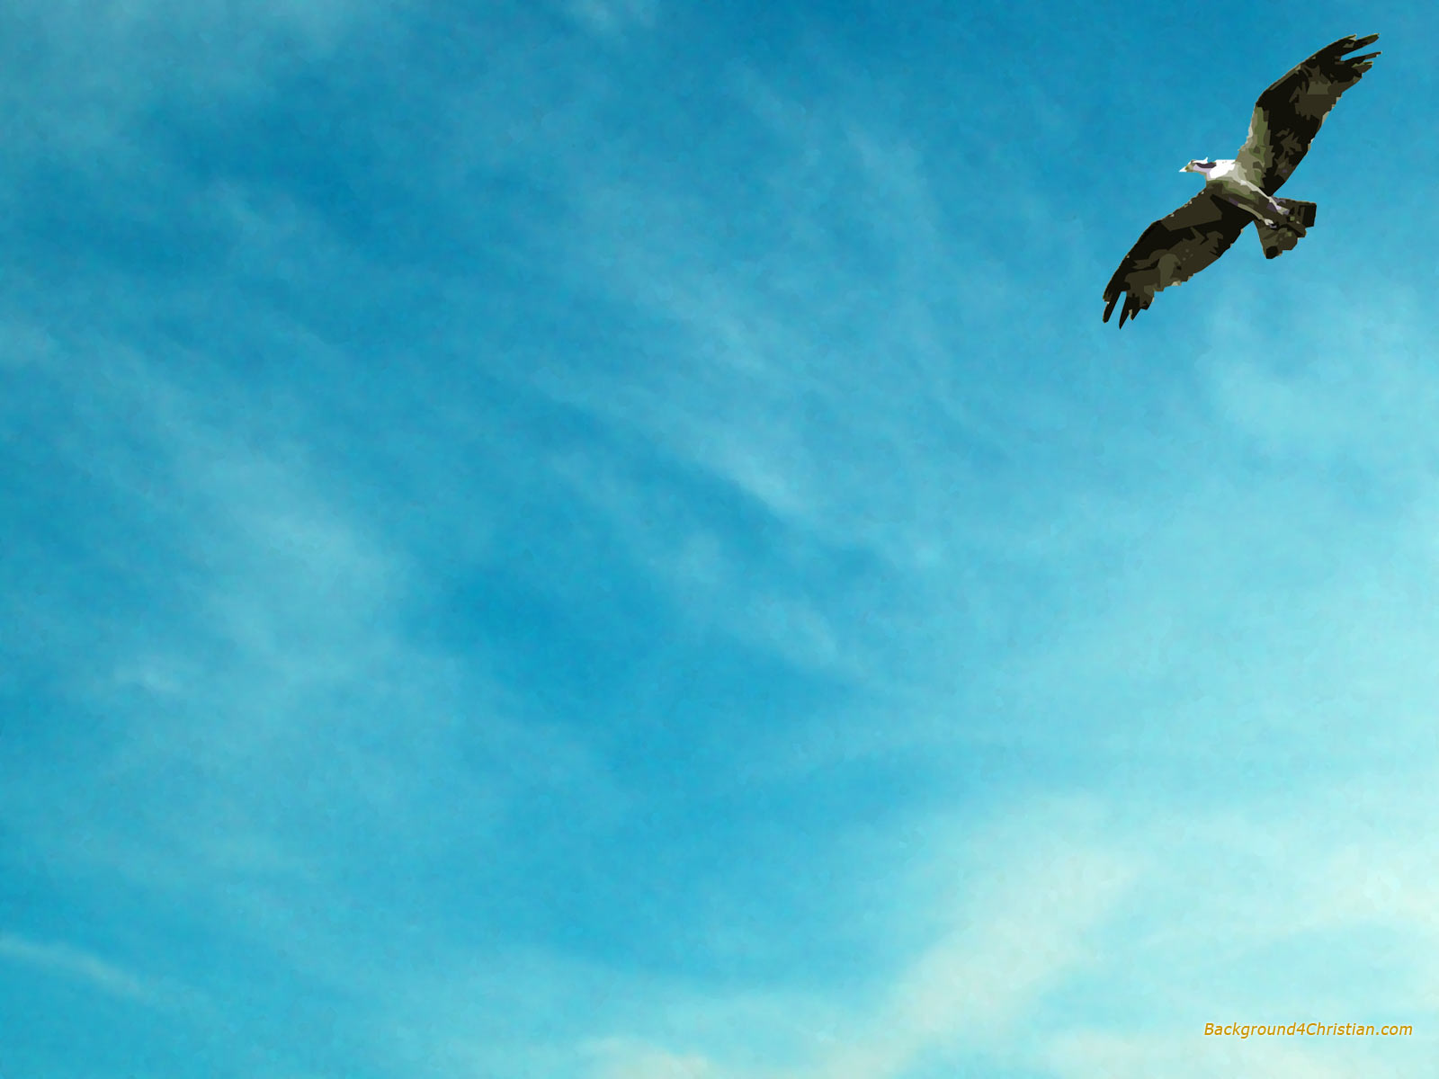
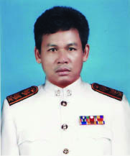
ประวัติผู้จัดทำนวัตกรรมแบบฝึก
การใช้ Tenses โดยใช้สื่อ CAI
นายประกอบ ห้องแซง
ครูชำนาญการพิเศษภาษาอังกฤษ
กศ.ม.การศึกษามหาบัณฑิต(การบริหารการศึกษา)
มหาวิทยาลัยมหาสารคาม

Slide 2
1. Present Simple Tense

Slide 3
แบบทดสอบตนเองก่อนเรียนที่ 1 Direction : Choose the correct answers.

Slide 4
1. I …… in Yasothon.
Direction : Choose the correct answers
a. lives
b. live
c. lived
d. living

Slide 5
2. Mario …… a supper star now.
Direction : Choose the correct answers
a. is
b. am
c. are
d. were

Slide 6
3. We don’t …..to school on Sunday.
Direction : Choose the correct answers
a. went
b. gone
c. goes
d. go

Slide 7
Direction : Choose the correct answers
4. Everybody …… ready for the lesson.
a. am
is
c. are
d. were

Slide 8
Direction : Choose the correct answers
5. Do you…….the guitar?
a. playing
b. played
c. plays
d. play

Slide 9
Direction : Choose the correct answers
6. Film …… hair cut twice a month.
a. had
b. have
c. has
d. having

Slide 10
Direction : Choose the correct answers
7. Does she…...every day?
a. running
b. runs
c. run
d. ran

Slide 11
Direction : Choose the correct answers
8. Where do we……English?
a. study
b. studies
c. studied
d. studying

Slide 12
Direction : Choose the correct answers
9. When does your sister…….?
a. got up
b. gets up
c. get up
d. getting up

Slide 13
Direction : Choose the correct answers
10. Why do you …..milk?
a. drunk
b. drank
c. drinks
d. drink

Slide 14
เฉลยแบบทดสอบตนเองก่อนเรียนที่ 1 Direction : Choose the correct answers.

Slide 15
1. I …… in Yasothon.
Direction : Choose the correct answers
a. lives
b. live
c. lived
d. living
b. live

Slide 16
2. Mario …… a supper star now.
Direction : Choose the correct answers
a. is
b. am
c. are
d. were
a. is

Slide 17
3. We don’t ……to school on Sunday.
Direction : Choose the correct answers
a. went
b. gone
c. goes
d. go
d. go

Slide 18
Direction : Choose the correct answers
4. Everybody …… ready for the lesson.
a. were
b. are
c. am
d. is
d. is

Slide 19
Direction : Choose the correct answers
5. Do you …… the guitar?
a. playing
play
c. played
d. plays
play

Slide 20
Direction : Choose the correct answers
6. Film …… hair cut twice a month.
a. had
b. have
c. has
d. having
c. has

Slide 21
Direction : Choose the correct answers
7. Does she …… everyday?
a. running
b. runs
c. run
d. ran
c. run

Slide 22
Direction : Choose the correct answers
8. Where do we …… English?
a. study
b. studies
c. studied
d. studying
a. study

Slide 23
Direction : Choose the correct answers
When does your sister……?
a. got up
b. get up
c. gets up
d. getting up
b. get up

Slide 24
Direction : Choose the correct answers
10. Why do you …… milk?
a. drink
b. drank
c. drunk
d. drinking
a. drink

Slide 25
THE END

